Slide 1
The Nature of Life
Chapter 1: The Science of Biology

Slide 2
What do we know about science and the nature of life?
All life is based on a universal genetic code written in DNA
Scientific tools provide more information about the living world than we ever thought possible
Science enables us to understand the natural world and allows us to predict and influence natural events

Slide 3
What discoveries lie in the future?
Can new tools and techniques for studying DNA allow us to cure or prevent diseases?
How will we respond to new information about humanity’s complicated effects on the natural world?
How will studying the smallest systems (molecules) affect our understanding of the largest biological systems (ecosystems)?

Slide 4
1-1 What is Science?
Goals:
To investigate and understand nature
To explain events in nature
Use explanations to make predictions

Slide 5
1-1 What is Science?
Deals only with the natural world
Scientists collect and organize information in a careful, organized way, looking for patterns and connections
Scientists make predictions that can be tested by examining evidence
Refers to a body of knowledge that scientists have built up after years of using this process

Slide 6
1-1 What is Science?
Evidence is based on observation and is called data
Evidence can be qualitative or quantitative
Observations are followed by inferences, a logical interpretation of evidence based on prior knowledge

Slide 7
1-1 What is Science?
A hypothesis is a possible explanation for an observation or an answer to a scientific question. It must be testable!
They may come from prior knowledge, logical inferences or imaginative guesses
Even incorrect hypotheses advance scientific knowledge

Slide 8
1-1 What is Science?
All scientists have a problem solving attitude at work
Scientists consider the universe as a system in which basic rules apply and assume those rules can be discovered through scientific inquiry
Scientists must be open minded, curious , honest and skeptical

Slide 9
1-1 What is Science?
Science involves human values (ethics)
Make a list of all the things you need to understand in order to protect your life and the lives of those close to you
Understanding all these things involve scientific information, but also involve moral principles, laws, and the economy
Science makes recommendations, but people decide what to do with that information so it is important that everyone understand what science is, what it can do and what it cannot do

Slide 10
1.2 How Science Works
Designing an experiment
6 steps
Stating a problem
Forming the hypothesis
Designing controlled experiments
Recording and analyzing results
Drawing a conclusion
Publishing and repeating investigations

Slide 11
1.2 How Science Works
Read and quick write in pairs
Discuss the work of Francesco Redi, Lazzaro Spallazani and Louis Pasteur
What were the problems each experiment was designed to solve, their experimental steps and the conclusions of each experiment
How did Pasteur improve upon Redi’s experiments?
What is the impact of their work on society?

Slide 12
1.2 How Science Works
Sometimes model systems or alternative experiments are used when experiments on humans or animals have ethical implications

Slide 13
1.2 How Science Works
A theory is developed after evidence from numerous investigations build up
A theory is a well supported and tested hypothesis or explanation that unifies many observations

Slide 14
1.3 Studying Life
Characteristics of living things
Made up of cells
Reproduce
Based on a universal genetic code
Grow and develop
Obtain materials and energy
Respond to their environment
Maintain a stable internal environment
As a group change over time

Slide 15
1.3 Studying Life
Branches of Biology
Zoology-animals
Botany-plants
Microbiology-microorganisms
Neurobiology-neurons
Biotechnology-recombinant DNA
Ecology-ecosystems
Ethologists-behaviors
Paleontology-life as it was in the past
And more!

Slide 16
1.3 Studying Life
Levels of organization in life
Molecules
Cells
Tissues
Organs
Organisms
Populations
Communities
Ecosystems
Biosphere

Slide 17
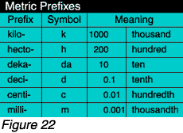
1.4 Tools and Procedures
Common measuring system-metric

Slide 18
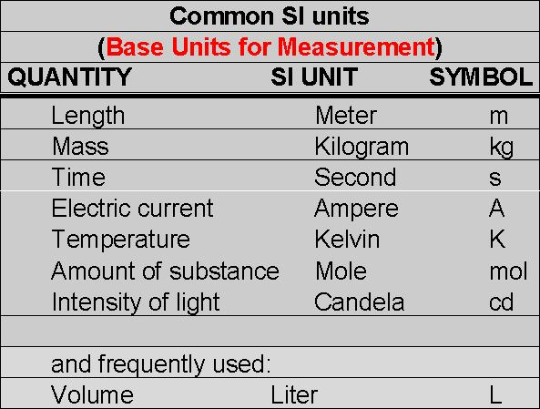
1.4 Tools and Procedures
Common measuring system-metric

Slide 19
1.4 Tools and Procedures
Scientists used data tables and graphs to organize data and looks for patterns to help in understanding
Technology helps with this

Slide 20
1.4 Tools and Procedures
Microscopes
Produce magnified images of things too small to see
Light microscopes focus visible light to produce images. Compound microscopes allow light to pass through a sample and use two lenses to form an image
Electron microscopes focus beams of electrons. Includes transmission electron microscopes (TEM), scanning, scanning tunneling
Atomic force used a movable tip that is dragged over the surface of the sample and maps the topography

Slide 21
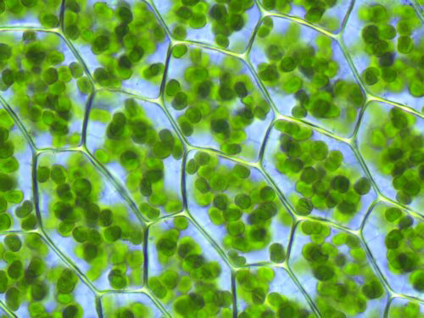
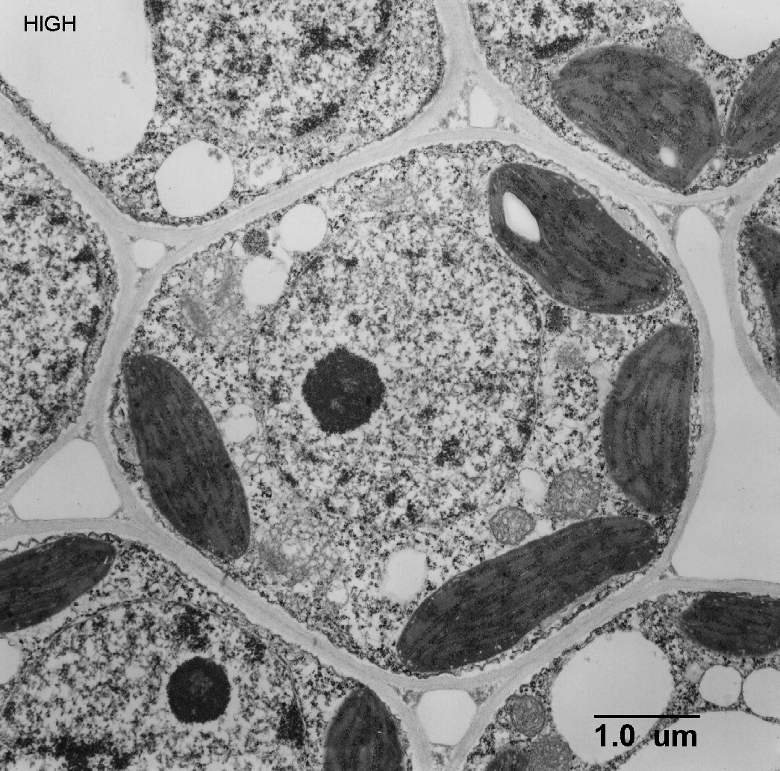
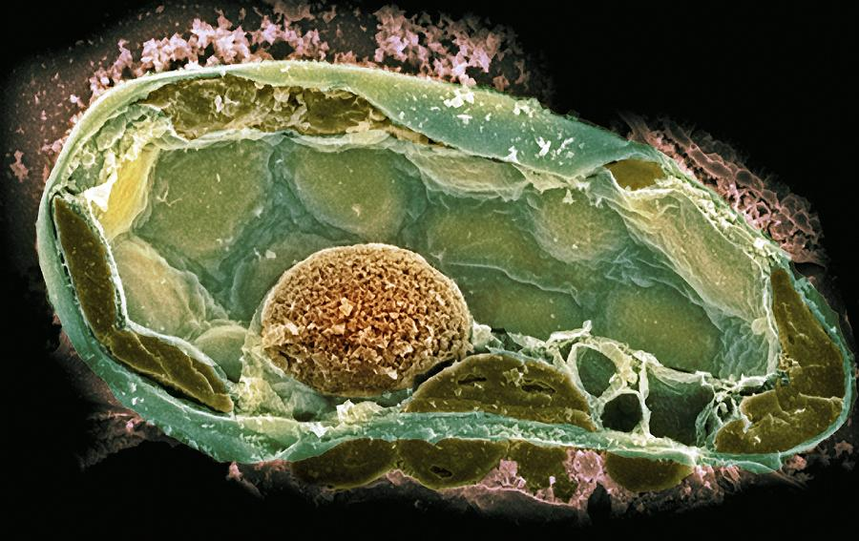
1.4 Tools and Procedures

Slide 22
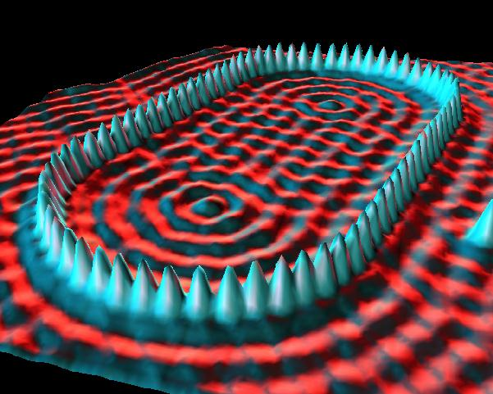
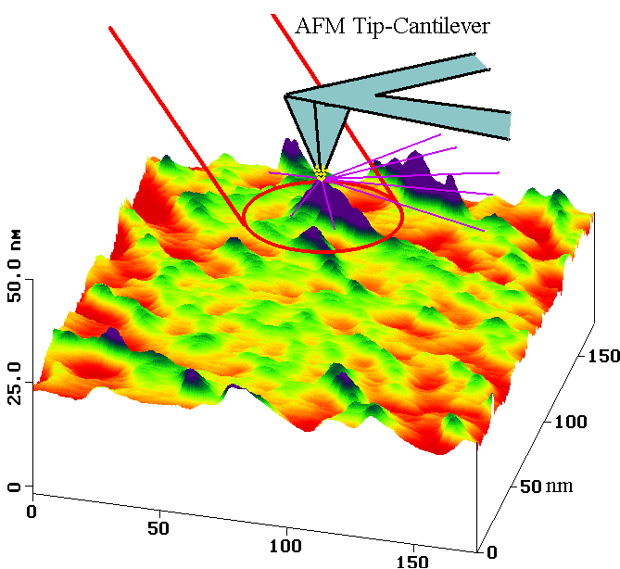
1.4 Tools and Procedures

Slide 23
1.4 Tools and Procedures
Lab techniques for studying cells
Cell culture
Cell fractionation
Lab techniques for studying organisms
Animal experiments
Lab safety and disposal of hazardous materials

Slide 24
The Nature of Life
Chapter 2: The Chemistry of Life

Slide 25
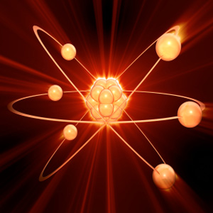
2.1 The Nature of Matter
Atoms and subatomic particles
Protons and neutrons in the nucleus
Electrons outside the nucleus

Slide 26
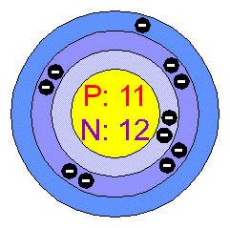
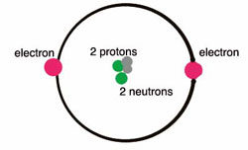
2.1 The Nature of Matter
Atoms
Helium atom
Element #2 in periodic table
Sodium atom
Element #11 in periodic table

Slide 27
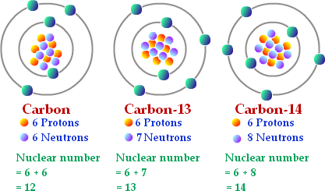
2.1 The Nature of Matter
Isotopes
Atoms of an element that have a different number of neutrons
Same chemical properties, same number of protons and electrons

Slide 28
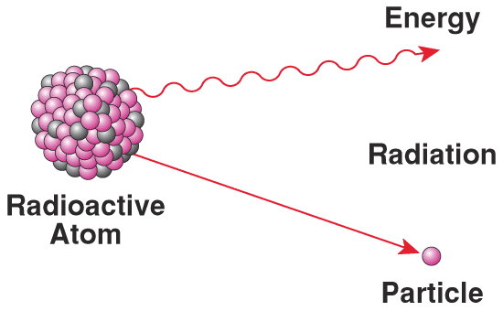
2.1 The Nature of Matter
Radioactive isotopes
Some isotopes have unstable nuclei; the nucleus breaks down and subatomic particles and/or electromagnetic radiation
Used as tracers in the body or in an ecosystem, radiation therapy, radiocarbon dating

Slide 29
2.1 The Nature of Matter
Chemical Compound
Elements combine with other elements to form compounds
Named by chemical formulas
Ex H₂O, CO₂, NaCl
Atoms in a compound are held together by chemical bonds (ionic or covalent)-Intramolecular

Slide 30
2.1 The Nature of Matter
Chemical Bonds
Ionic-bond forms when one of more electrons are transferred from one atom to another, resulting in 2 charged atoms called ions. Opposite charges attract each other. Occurs between a metal and a nonmetal Ex NaCl
Covalent-bond formed when electrons are shared between 2 atoms. Occurs between 2 non-metals Ex CH₄

Slide 31
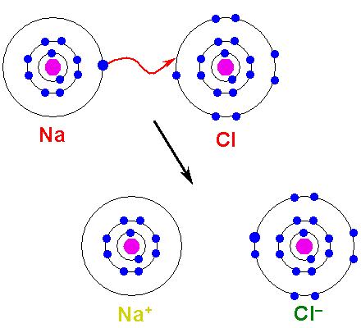
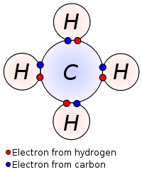
2.1 The Nature of Matter

Slide 32
2.1 The Nature of Matter
Van der Waals Forces
An attraction between oppositely charged regions of nearby molecules
Weak
Hold molecules together-Intermolecular
Gecko feet

Slide 33
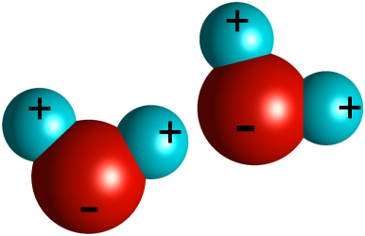
2-2 Properties of Water
Polarity
Water is polar; the electrons that are shared are not equally distributed between the hydrogens and the oxygen
Oxygen is more electronegative and attracts electrons more strongly

Slide 34
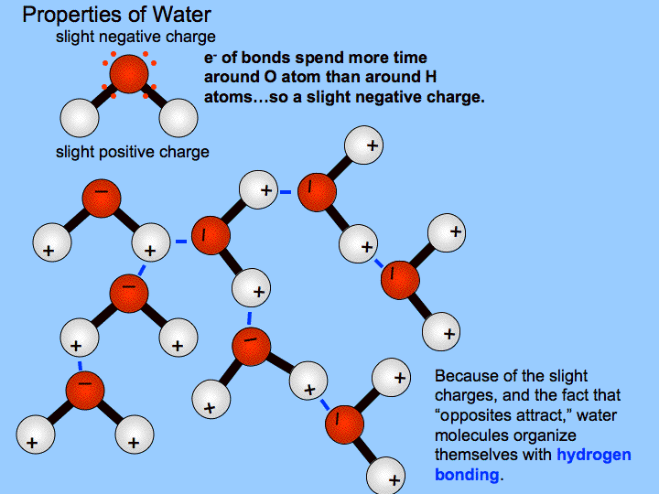
2-2 Properties of Water
Hydrogen bonds-polar molecules attract each other and form bonds between hydrogen and any small electronegative atom, like oxygen
Results in cohesion (between molecules of the same substance) and adhesion (between molecules of different substances)

Slide 35
2-2 Properties of Water
Solutions and Suspensions
Mixtures made with water
Solution-a substance is dissolved in water
Solute-substance dissolved
Solvent-the substance the solute is dissolved in to
Suspension-substance is not dissolved in water

Slide 36
2-2 Properties of Water
Acids, bases and pH
Ionization of water
2H₂O ↔ H₃O⁺ + OH⁻
H₃O⁺ makes solutions acidic, OH⁻ makes solutions basic. When H₃O⁺ = OH⁻ the solution is neutral
pH scale 0-14; lower number is more acidic
Buffers are substances that help solutions resist pH change

Slide 37
2-3 Carbon Compounds
Organic chemistry deals with carbon containing compounds
Carbon forms 4 bonds; can form single, double or triple covalent bonds

Slide 38
2-3 Carbon Compounds
Macromolecules
Giant molecules
Formed by polymerization-form polymers
Four categories
Carbohydrates
Lipids
Nucleic acids
proteins

Slide 39
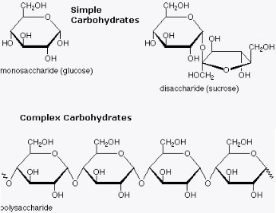
2-3 Carbon Compounds
Carbohydrates
C:H:O 1:2:1
Energy and structural purposes
Glucose is basic unit
Starch and cellulose are polymers

Slide 40
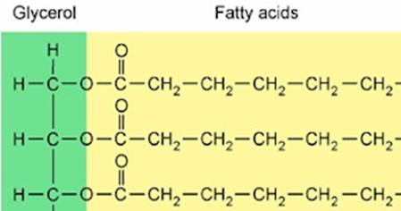
2-3 Carbon Compounds
Lipids
Carbon and Hydrogen
Stores energy and makes up cell and organelle membranes, messengers
Glycerol + fatty acid

Slide 41
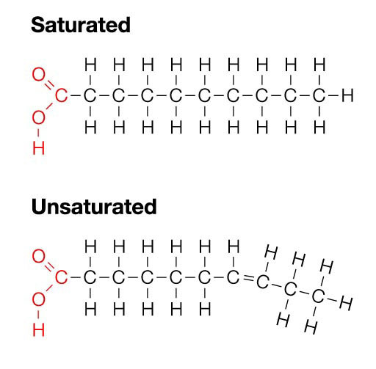
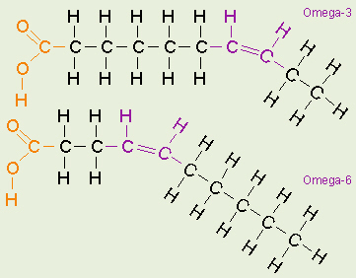
2-3 Carbon Compounds
Lipids
Saturated (all single bonds between C’s) and unsaturated (some double bonds)

Slide 42
2-3 Carbon Compounds
Nucleic Acids
C, H, O,N,P
Nucleotides-monomer
Nucleic acid-polymer
Stores and transmits information
DNA (deoxy-)and RNA(ribonucleic acid)

Slide 43
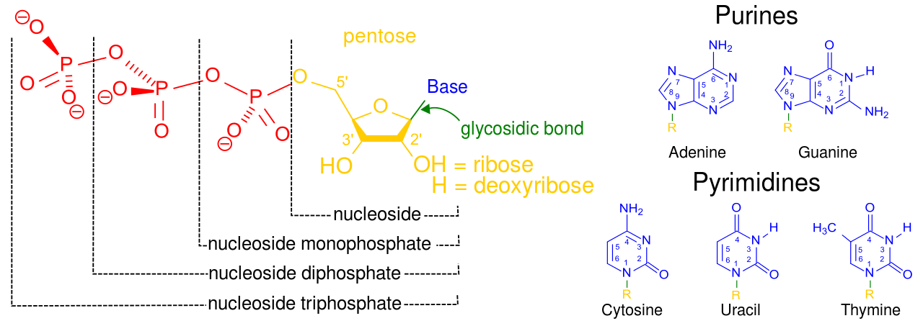
2-3 Carbon Compounds
Nucleotide

Slide 44
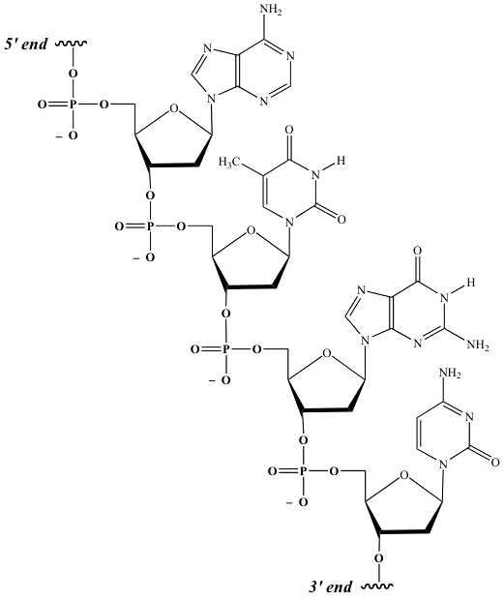
2-3 Carbon Compounds
Nucleic acid

Slide 45
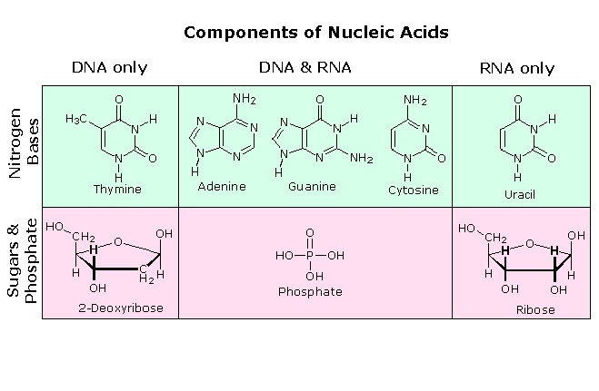
2-3 Carbon Compounds
DNA vs RNA

Slide 46
2-3 Carbon Compounds
Proteins
Polymers of amino acids
Control the rate of reactions and regulate cell processes, form bones and muscle (structural), transport substances and fight disease
Amino acids have an amino group end (-NH₂) and carboxylic acids end (-COOH)
Amino acids joined by peptide bond

Slide 47
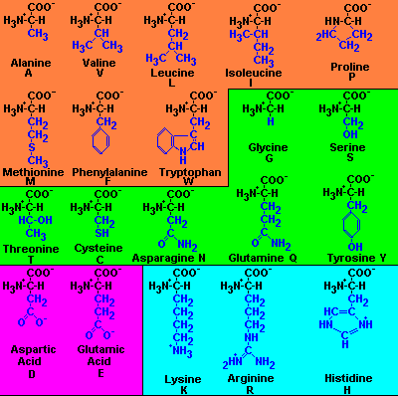
2-3 Carbon Compounds
Amino acids

Slide 48
2-3 Carbon Compounds
Peptide bond

Slide 49
2-3 Carbon Compounds
Protein Structure
4 levels
Primary-sequence of amino acids
Secondary-chains of AA’s can be twisted or folded into alpha helices or beta sheets
Tertiary-The twisted and folded chain can be twisted and folded again; 3-D structure of the protein
Quartenary-if the protein has more than one polypeptide chain, the individual chains bonded together

Slide 50
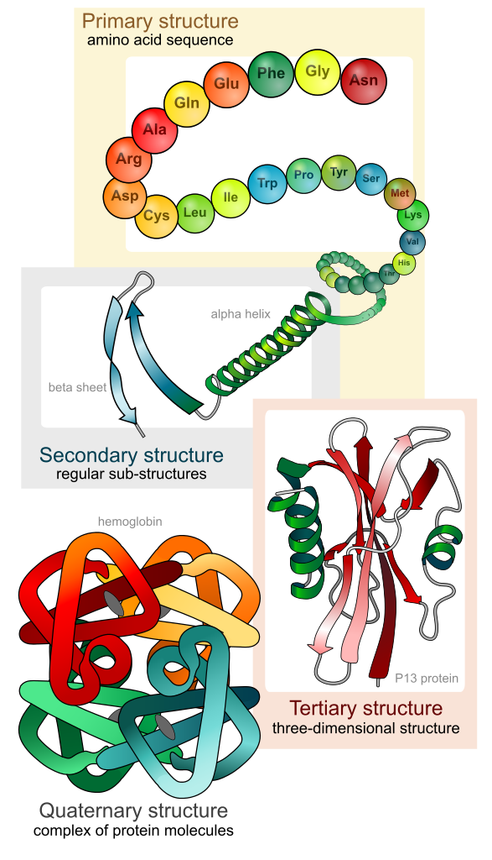
2-3 Carbon Compounds
Protein structure

Slide 51
2-4 Chemical Reactions and Enzymes
Every thing that happens in a cell, and therefore an organism, is the result of chemical reactions
Chemical reactions change one set of chemical into another set of chemicals
Reactants →Products

Slide 52
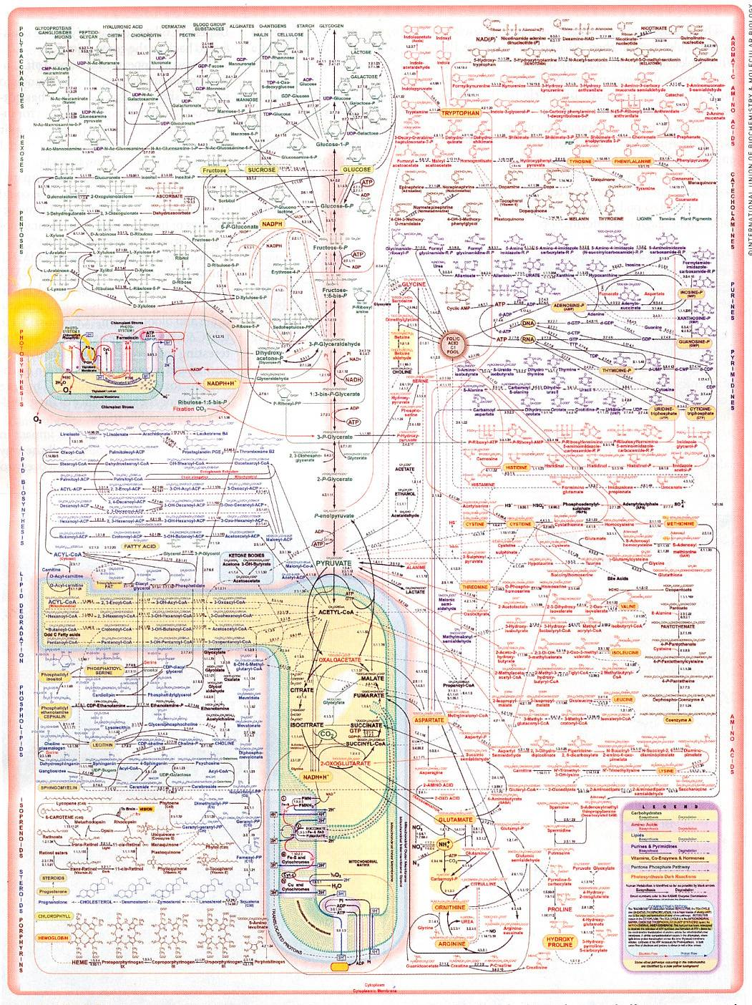

Slide 53
2-4 Chemical Reactions and Enzymes
Energy in reactions
Chemical reactions either absorb or release energy
Reactions that release energy are spontaneous
Those that are not spontaneous require energy
2H₂ + O₂→2H₂O releases energy (exothermic)
2H₂0 →2H₂ + O₂ absorbs energy(endothermic)
Organisms need energy for many endothermic reactions
Activation energy is the energy required to get a reaction started. Amount of activation energy required determines if a reaction will occur

Slide 54
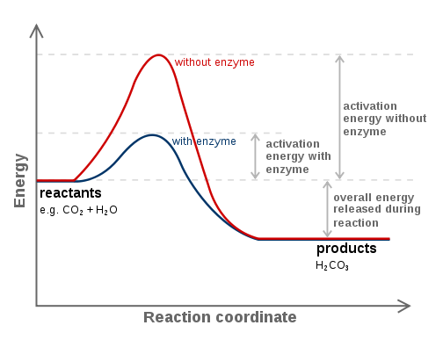
2-4 Chemical Reactions and Enzymes
Activation energy

Slide 55
2-4 Chemical Reactions and Enzymes
Enzymes
Proteins that catalyze reactions
Very specific for the substances they act on, substrates
Enzyme activity is regulated by many factors including cofactors and other things that switch them on and off

Slide 56
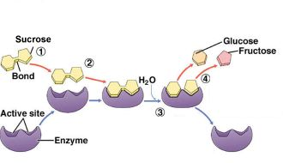
2-4 Chemical Reactions and Enzymes
Enzyme substrate complex

Slide 57
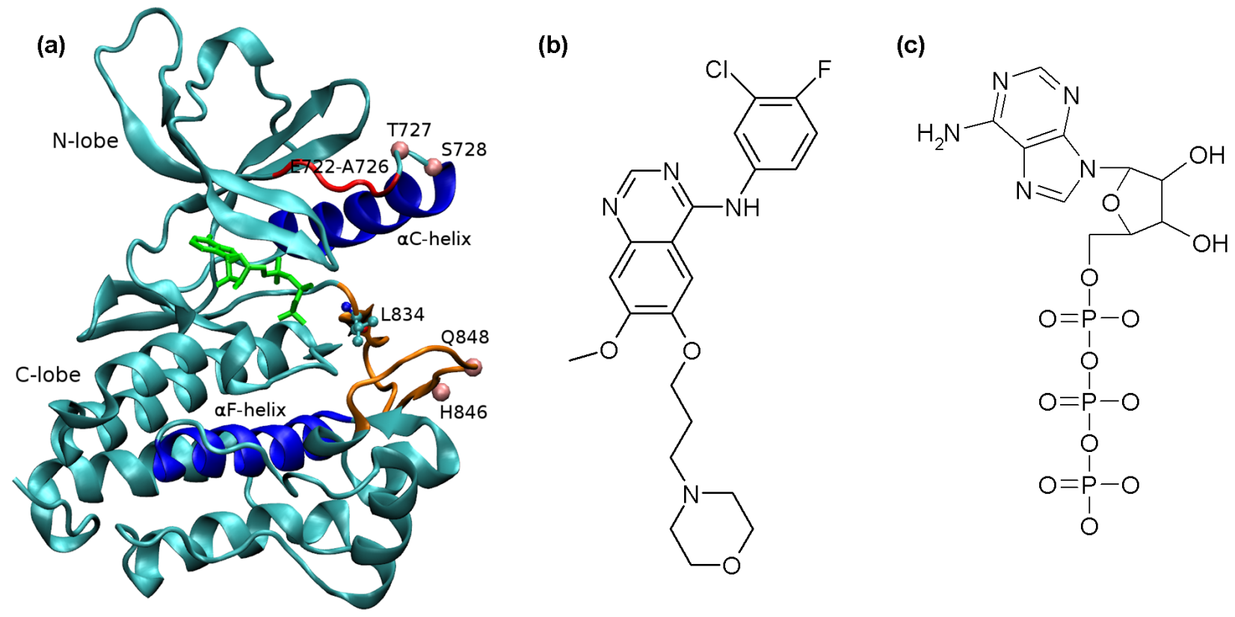
2-4 Chemical Reactions and Enzymes
Tyrosine Kinase-adds phosphate to a tyrosine in a protein substrate

