Slide 1
Cell Growth and Division
Ch 10

Slide 2
10-1 Cell Growth
Adult animal cells are the same size as those of a young animal
Cell size is limited by 2 things:
The demand on the DNA
Library analogy
Ability of cells to move all necessary substances across the membrane
Ratio of surface area to volume
Larger cells produce more waste and need more nutrients; ability to move these things across the membrane is limited by the surface area
Volume (lxwxh)increases more than surface area(lxw)
Two lane street in town analogy

Slide 3
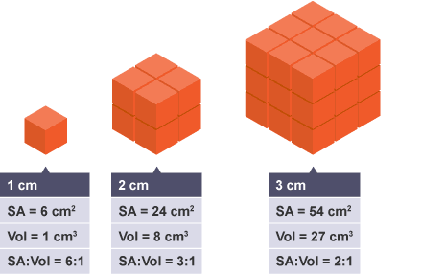
10-1 Cell Growth
Why is surface area so important anyway?!

Slide 4
10-2 Cell Division
What would happen if cells divided without any preparation?
What needs to happen first? Why?

Slide 5
10-2 Cell Division
Chromosomes-DNA and proteins
Only visible during cell division because all other times the chromosomes are spread throughout the nucleus
Chromosomes condense into compact structures than can be seen with a light microscope

Slide 6
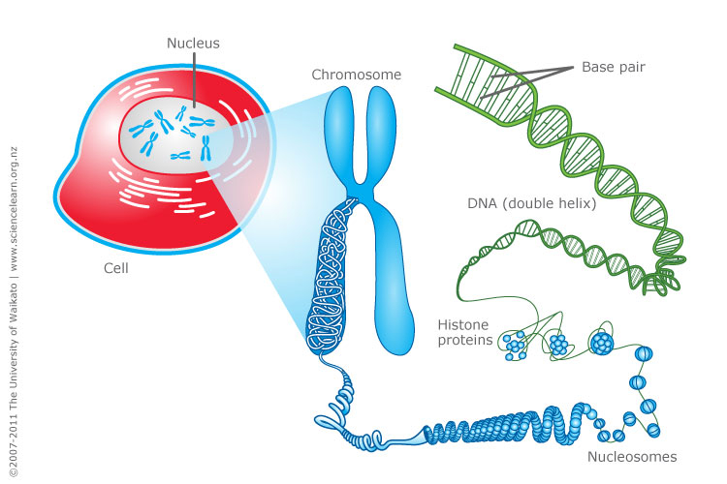
10-2 Cell Division

Slide 7
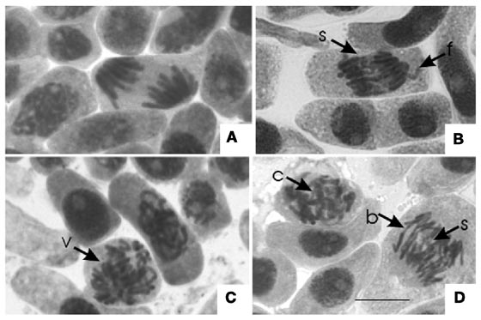
10-2 Cell Division

Slide 8
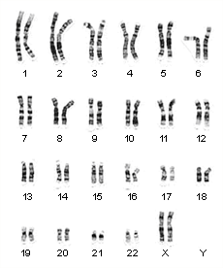
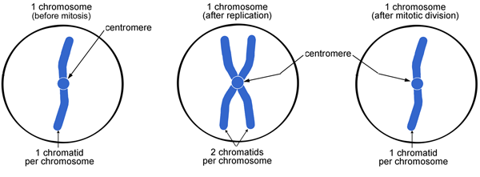
10-2 Cell Division
Structure of chromosomes
Human cells have 46

Slide 9
10-2 Cell Division
Cell cycle-Cell grows, prepares for division, and divides to form 2 daughter cells
4 phases-M phase, S phase, G1 and G2 phases
M=mitosis
S=synthesis
G1&G2=gap phases

Slide 10
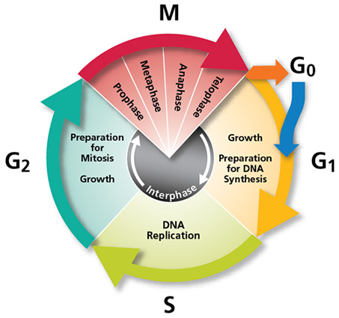
10-2 Cell Division-Cell cycle
G1-most of the cell growing happens in this phase
S-chromosomes are replicated, DNA is synthesized
G2-shortest; organelles and molecules necessary for cell division are made
M-Mitosis

Slide 11
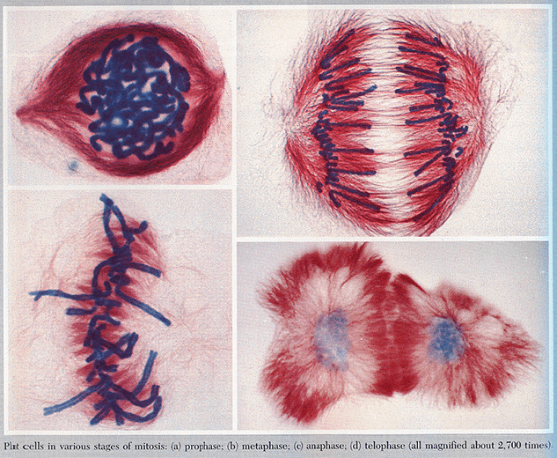
10-2 Cell Division-Cell cycle
Mitosis

Slide 12
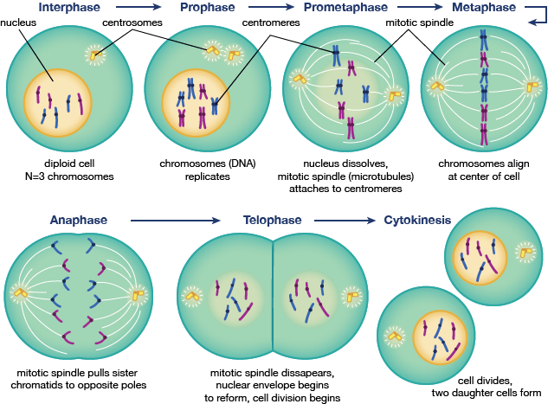
10-2 Cell Division-Cell cycle

Slide 13
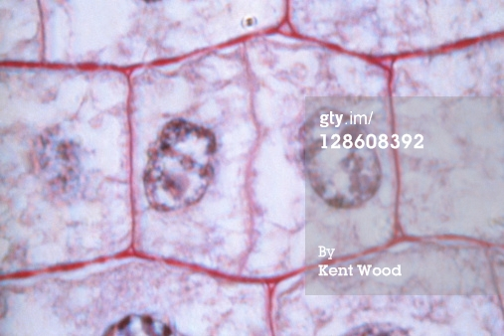
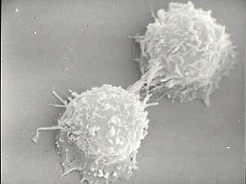
10-2 Cell Division-Cytokinesis
Division of cytoplasm
Membrane pinches and divides cell in two equal part (animal cells)
Cell plate forms midway between the 2 nuclei (plant cells)

Slide 14
10.2 Cell Cycle-Overview
https://www.youtube.com/watch?v=JcZQkmooyPk

Slide 15
10-3 Regulating the cell cycle
Proteins, Nutrients and space regulate cell division
Contact inhibition-when cells stop dividing when they touch each other-Lost in caner/tumor cells
Cyclins are proteins that regulate timing of the cell cycle in eukaryotes
Other proteins (regulators)-Can respond to events inside cells(internal regulators) or outside cells (external regulators)

Slide 16
10-3 Regulating the cell cycle-Cancer
Uncontrolled cell growth=cancer
Cancer cells do not respond to signals that regulate cell growth of most cells
Form cell masses (tumors) that can damage surrounding tissue
Tobacco, radiation, viruses, mutations
All cause control of cell cycle to break down

Slide 17
10-3 Regulating the cell cycle-Cancer and p53
P53 is a tumor suppressor gene that regulated repair of DNA, keeps cells from regulating until DNA damage is repaired
More than 50% of all cancers have a mutation in the p53 gene, and therefore an incorrect amino acid(s) in the p53 protein

Slide 18
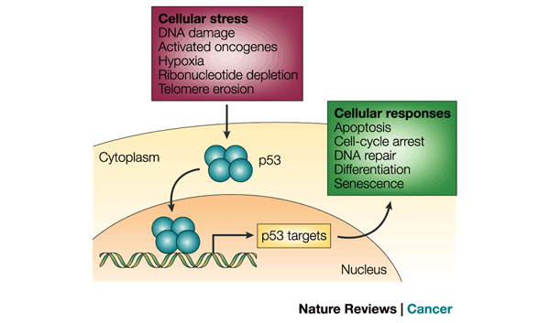
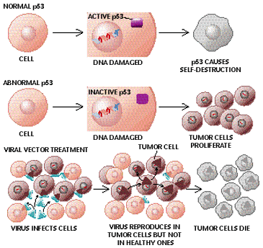
10-3 Regulating the cell cycle

Slide 19
10-3 Regulating the cell cycle-Cancer
https://www.youtube.com/watch?v=LEpTTolebqo

