Slide 1
Introduction to Genetics
Chapter 11

Slide 2
11.1 Gregor Mendel
Genetics-scientific study of heredity
Mendel-1822
Studied true breeding pea plants-if they self pollinated offspring would be identical to parent plant
Wanted to cross pollinate so cut off male flowers and hand-applied pollen from other plants

Slide 3
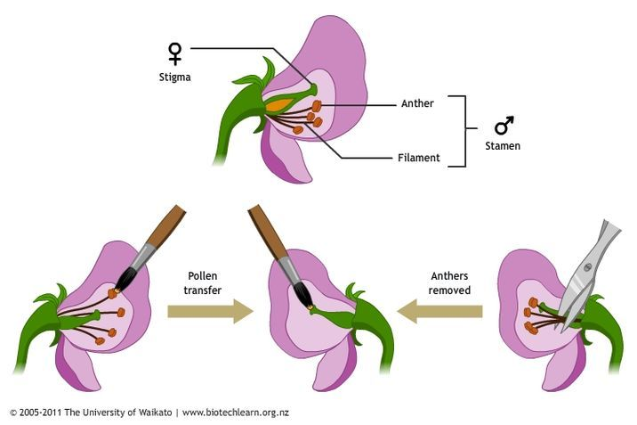
11.1 Gregor Mendel

Slide 4
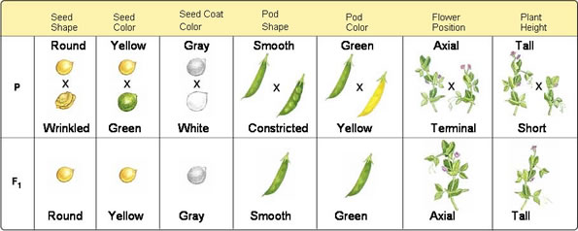
11.1 Gregor Mendel
Studied 7 traits
P1-original plants
F1 first generation offspring
Made hybrids by crossing plants with different characteristics due to different forms of each gene (alleles)

Slide 5
11.1 Gregor Mendel
Two conclusions-
Biological characteristics are determined by factors that are inherited (genes)
Some alleles are dominant and some recessive

Slide 6
11.1 Gregor Mendel
Mendel wanted to know if the recessive alleles had disappeared or were still present in the F1 generation
Crossed F1 plants to make F2 plants using self pollination
Traits controlled by the recessive alleles reappeared
Somehow the alleles had been separated-segregation-occurred in gametes (sex cells)
Each F1 plant has 2 alleles for each trait and produces two types of gametes
Results in new combinations of alleles

Slide 7
11-2 Probability and Punnett Squares
Mendel realized form his crosses that when he crossed the plants he always got the same ratios of characteristics in the offspring
Laws of probability explain his results

Slide 8
11-2 Probability and Punnett Squares
Coin toss example
50% heads or tails
Probability =1/2
Each coin toss is independent of the one before
Probability of getting heads or tails a second and third time=1/2x1/2x1/2=1/8
Can use probabilities to predict outcomes of crosses

Slide 9
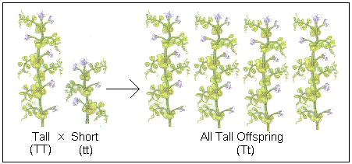
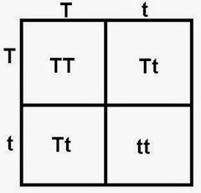
11-2 Probability and Punnett Squares
Punnett squares
TT, tt=homozygous
Tt=heterozygous
25% chance of getting each genotype
Ratio of phenotypes is 75% tall, 25% short

Slide 10
11-2 Probability and Punnett Squares
Probabilities explained Mendel’s results
Probabilities describes average of a large number of events(for many crosses for example) but cannot predict the outcome of a single event
Think about the coin toss example

Slide 11
11-3 Mendelian Genetics
Mendel wondered if the alleles for the different traits segregated independently from the segregation of alleles for other traits
Did 2-factor crosses

Slide 12
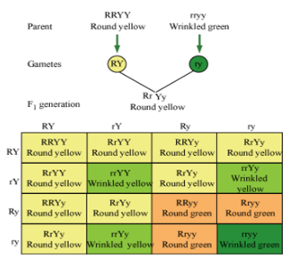
11-3 Mendelian Genetics
Two factor crosses-F1

Slide 13
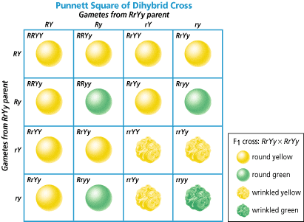
11-3 Mendelian Genetics
Two factor crosses-F2
9:3:3:1 ratio

Slide 14
11-3 Mendelian Genetics
New plants had new combinations of alleles not seen in parent plants in a 9:3:3:1 ratio
Law of independent assortment

Slide 15
11-3 Mendelian Genetics
Some alleles are neither dominant nor recessive
Some traits are controlled by multiple alleles or genes
Incomplete dominance-when one allele is not completely dominant over another one
The heterozygous phenotype is in between the two homozygous phenotypes Ex: pink flowers from a red-white flower cross

Slide 16
11-3 Mendelian Genetics
Co-dominance-both alleles contribute to the phenotype
Ex: Roan cattle have both red and white hair and appear pinkish-brown or speckled chickens with black and white feathers

Slide 17
11-3 Mendelian Genetics
Multiple alleles-more than two alleles for a single gene
Ex: 4 coat colors for rabbits
Polygenic traits-traits controlled by more than one gene
Ex: skin color in humans is controlled by 4 different genes

Slide 18
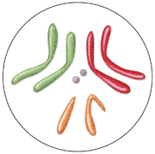
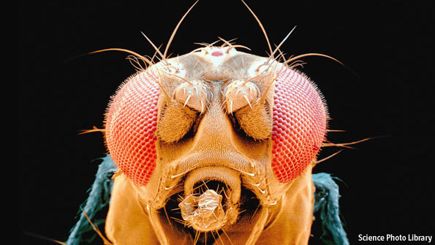
11-3 Mendelian Genetics
Thomas Morgan (early 1900’s)studied inheritance in flies (Drosophila melanogaster) and found Mendel’s principles were the same in flies as in plants

Slide 19
11-4 Meiosis
Mendel reasoned that if all cells had alleles from both parents, and alleles were independently assorted or segregated, when the gametes formed there must be a process that separates the two sets of genes so that each gamete has only one set.
Meiosis

Slide 20
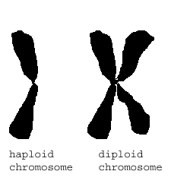
11-4 Meiosis
Haploid(1N)Diploid(2N)
Diploid (2N) fly chromosome
8 chromosomes each with two halves or chromatids
2N=8

Slide 21
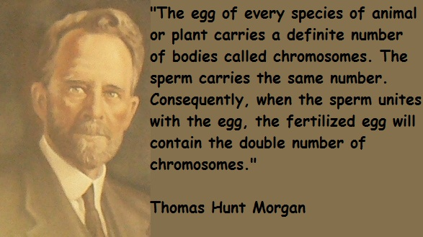
11-4 Meosis

Slide 22
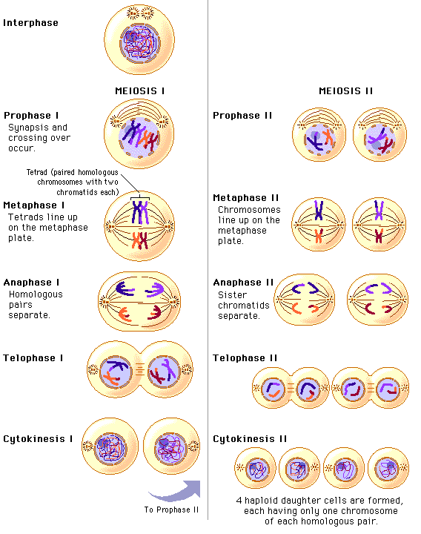
11-4 Meosis
Phases
of
Meiosis and
crossing over

Slide 23
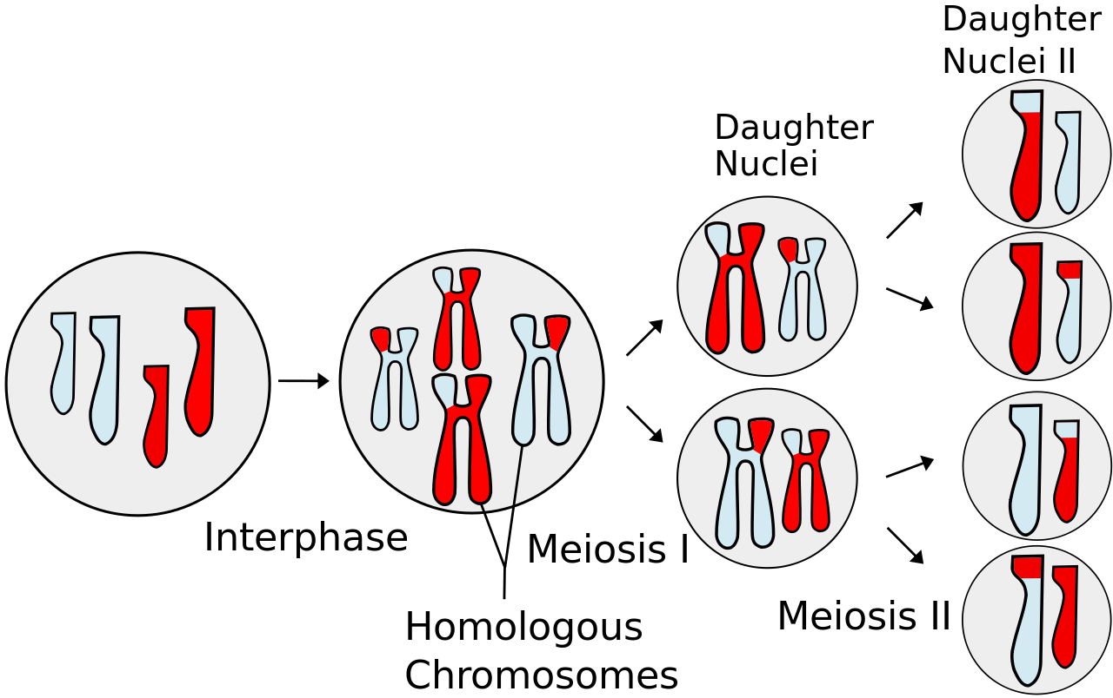
11-4 Meosis
Phases
of
Meiosis and
crossing over

Slide 24
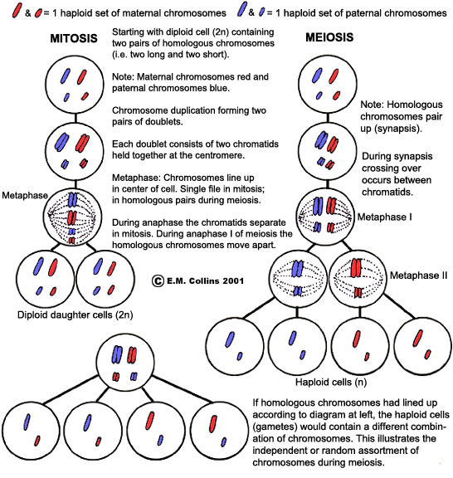
11-4 Meosis
Comparing
Mitosis and
Meiosis

Slide 25
11-4 Meosis
https://www.youtube.com/watch?v=qCLmR9-YY7o

Slide 26
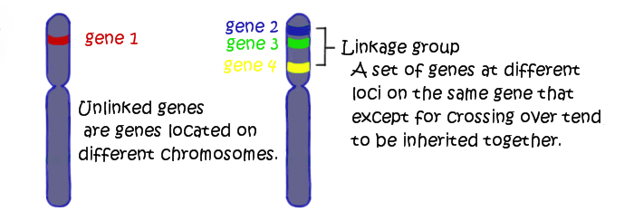
11-5 Linkage and Gene Maps
Genes that are on the same chromosome are linked and are inherited together
Chromosomes are groups of linked genes
Chromosomes assort independently, not genes

Slide 27
11-5 Linkage and Gene Maps
Mendel was just lucky 6 of the 7 traits he studied were on separate chromosomes.

Slide 28
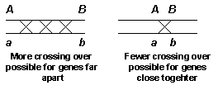
11-5 Linkage and Gene Maps
Genes can become unlinked by crossing over
Crossing over of linked genes on homologous chromosomes produces new genetic variation and diversity
The further apart two genes on a chromosome are the more likely crossing over will occur

Slide 29
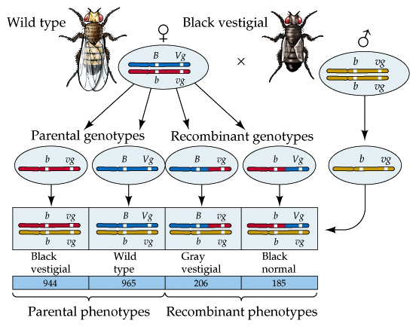
11-5 Linkage and Gene Maps
Can use crossing over or recombination rates to build maps of where the relative positions of all the genes are on a chromosome

Slide 30
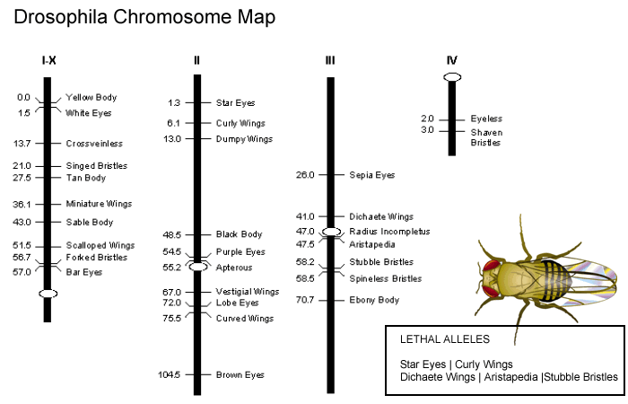
11-5 Linkage and Gene Maps

