Slide 1
Genetic Engineering
Ch 13

Slide 2
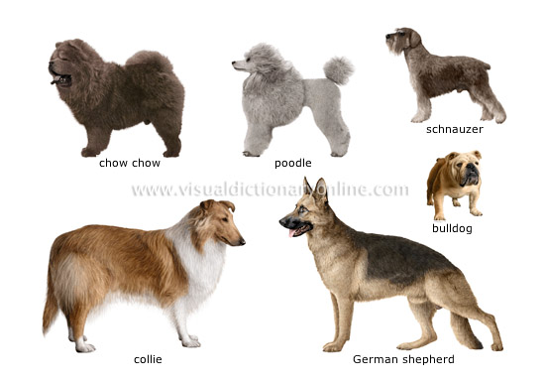
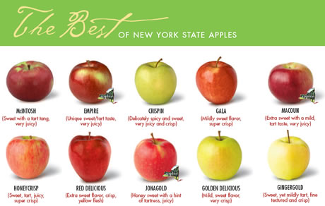
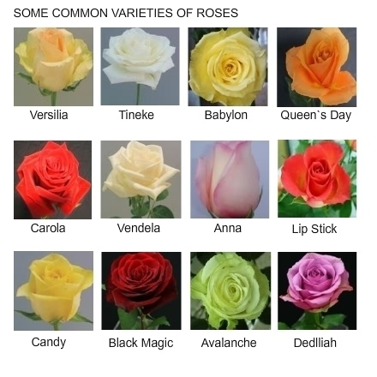
13-1 Selective Breeding
Used by humans to pass on desired traits

Slide 3
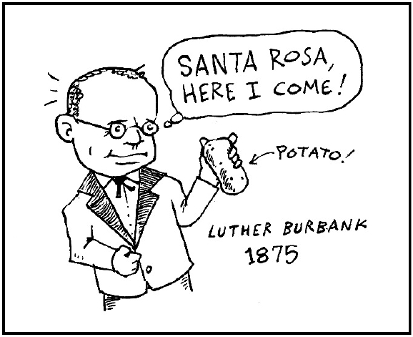
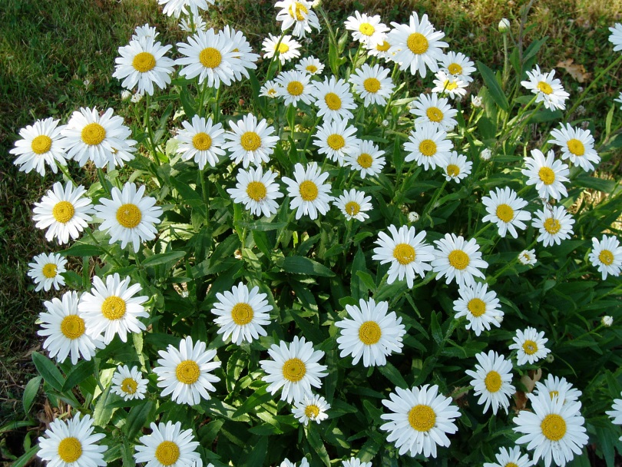
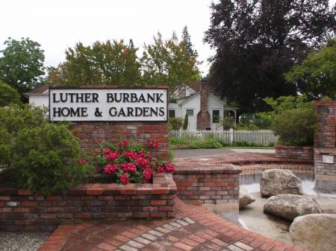
13-1 Selective Breeding
Luther Burbank (1849-1926)
Disease resistant potatoes, Gravenstein apples, Shasta daisy

Slide 4
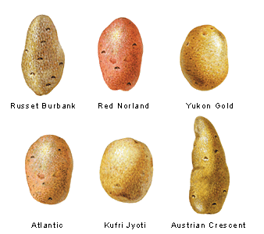
13-1 Hybridization
Crossing dissimilar individuals to bring together the best of both organisms, like disease resistance and food production in Burbank’s potatoes

Slide 5
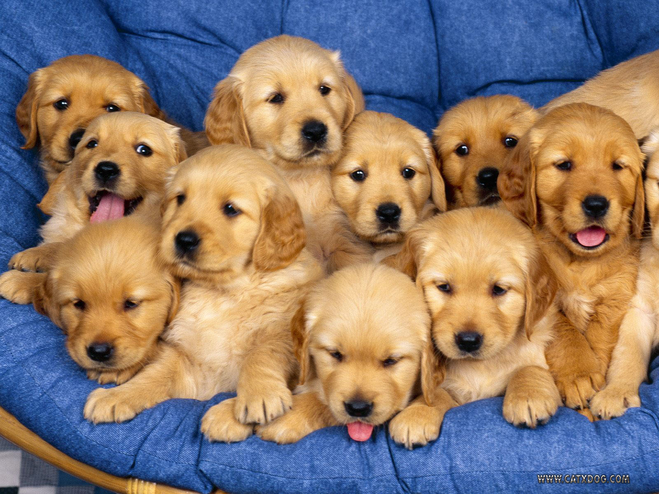
13-1 Inbreeding
Continued breeding of individuals with similar characteristics

Slide 6
13-1 Increasing Variation
Breeders can increase the genetic variation in a population by inducing mutations
Mutations are the ultimate source of genetic variability
Mutations occur spontaneously but frequency can be increased by radiation and chemicals
Many mutations are harmful to the organism but some will produce desired characteristics
Used to develop useful bacteria strains, like those that can break down oil and plastic

Slide 7
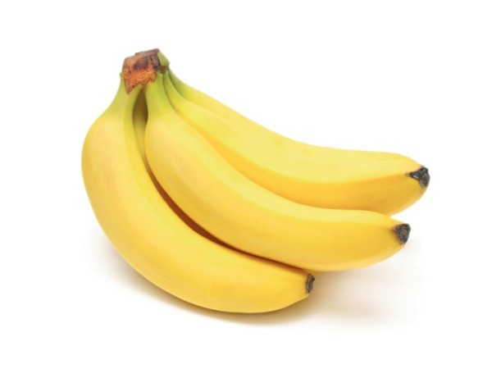
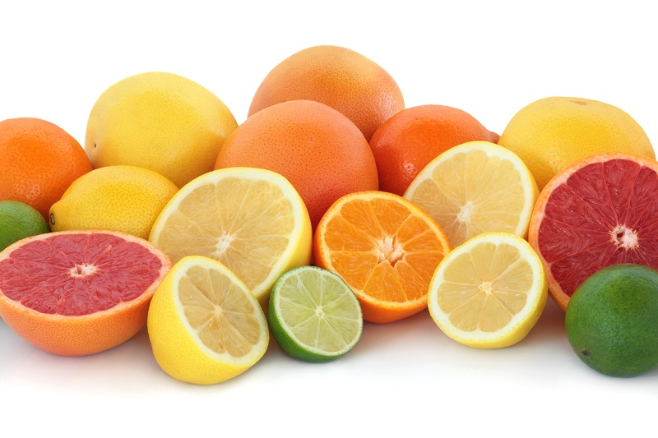
13-1 Polyploidy
Some drugs can prevent chromosomal separation in plants and are used to produce seeds that have double or triple the amount of chromosomes
Polyploidy
Usually fatal in animals but plants are better at tolerating it
Makes plant and fruit bigger and stronger

Slide 8
13-2 Manipulating DNA
DNA can now be extracted from cells, cut into pieces, sequenced, copied, and pasted back together
Genetic engineering

Slide 9
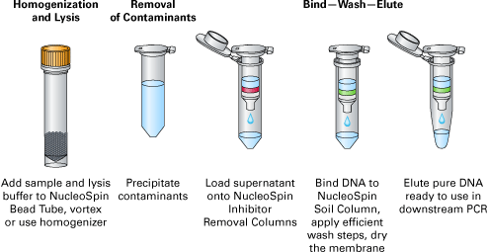
13-2 Manipulating DNA
DNA extraction-cells can be broken open with enzymes and detergents and DNA can be separated from other molecules in cells

Slide 10
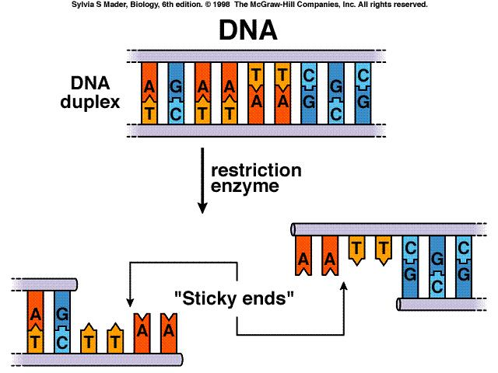
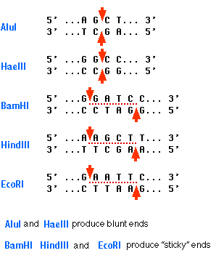
13-2 Manipulating DNA
Cutting DNA-using restriction endonucleases
Cut at specific sequences
Hundreds of restriction sites and enzymes
Enzymes isolated from organisms like bacteria or viruses
Example BamH1 or EcoR1

Slide 11
13-2 Manipulating DNA
Separating DNA and DNA fragments using gel electrophoresis
Use a polymer gel like agarose or acrylamide-molecular sieve
Pass electric current through
DNA is (-) charged and moves in an electric field toward the (+) positive electrode
Smaller ones move through gel faster, large one slower so can be separated based on size
Can be used for analysis/diagnostic purposes or fragments can be recovered from gel and used for further studies or manipulation

Slide 12
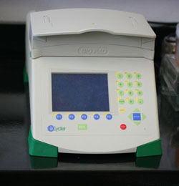
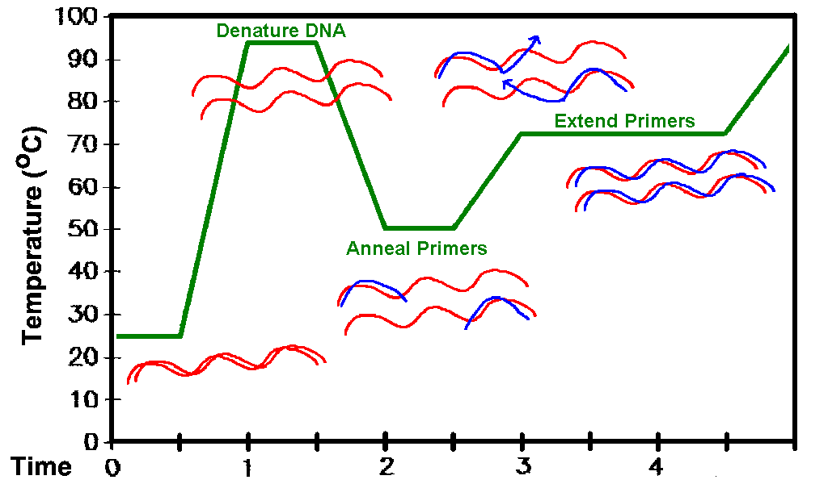
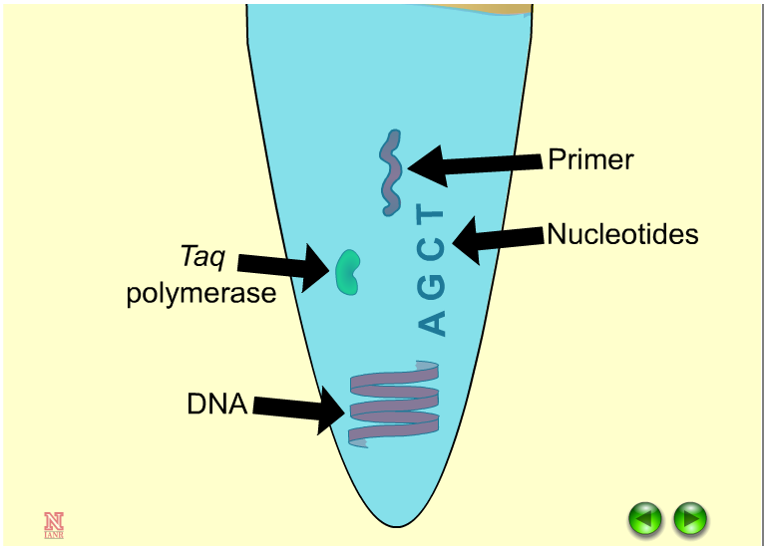
13-2 Manipulating DNA
Making copies of DNA-Polymerase chain reaction-PCR
Makes millions of copies of DNA by cycling through temperatures that allow DNA to unwind, primers to anneal or stick, and nucleotides to be added or extended

Slide 13
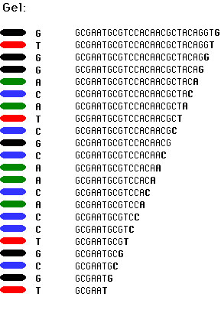
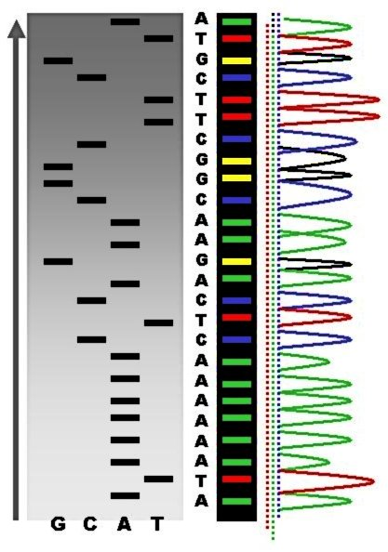
13-2 Manipulating DNA
Can read a DNA sequence by copying the DNA strand, making a complementary copy with fluorescent nucleotides to label the DNA copy then sequencer machine “reads” the sequence

Slide 14
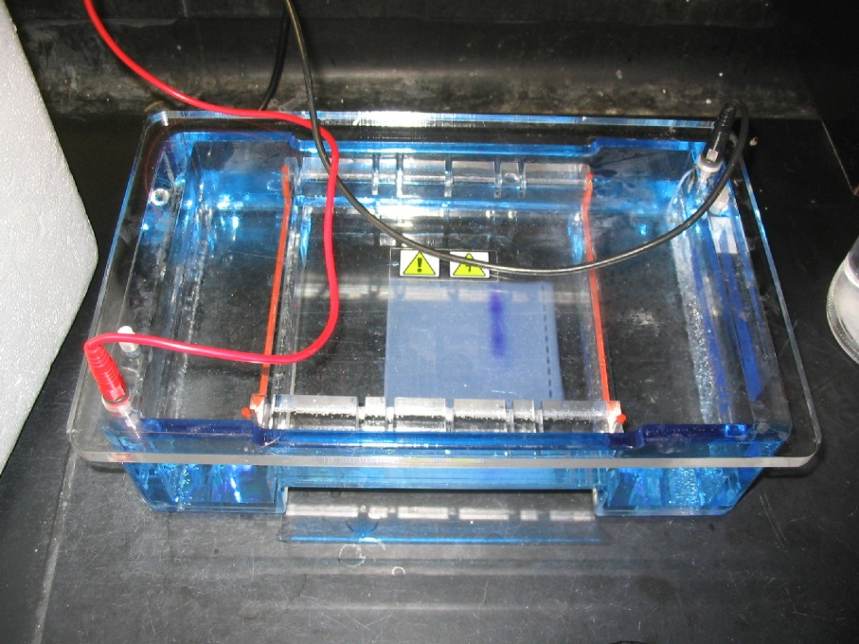
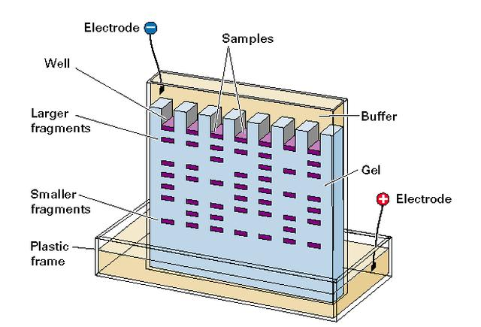
13-2 Manipulating DNA
Gel electrophoresis

Slide 15
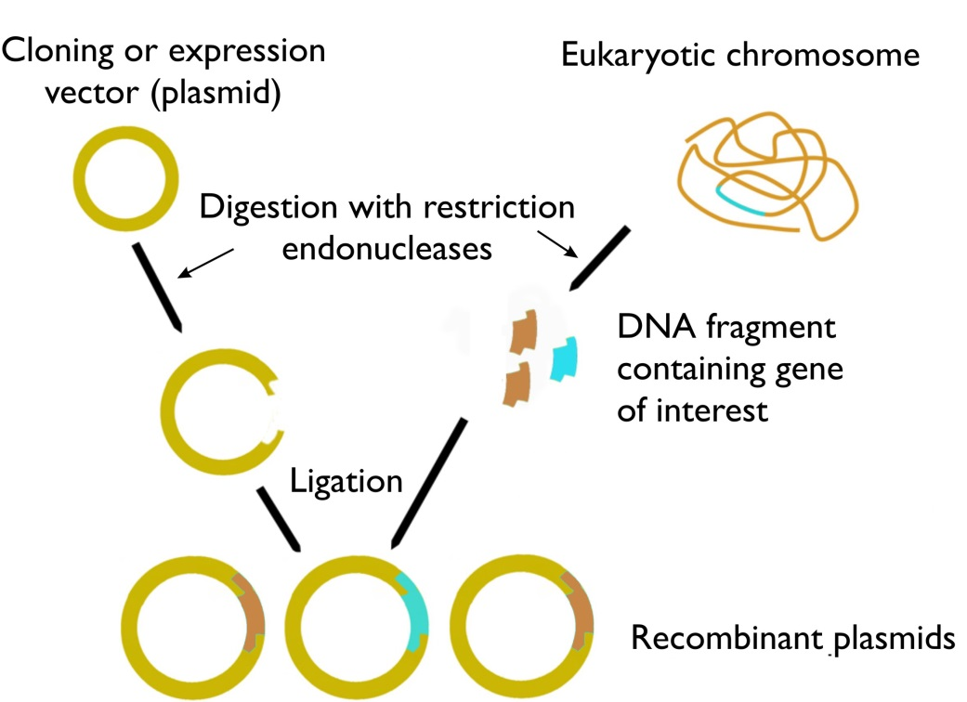
13-2 Manipulating DNA
Cutting with restriction endonucleases and pasting with ligase to make recombinant DNA

Slide 16
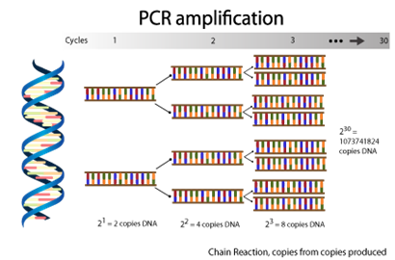
13-2 Manipulating DNA

Slide 17
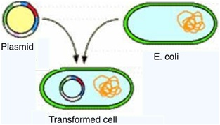
13-3 Cell Transformation
Cell takes in external DNA in the form of a plasmid, a small circular DNA
In bacteria, transformation
In eukaryotic cells, transfection

Slide 18
13-3 Cell Transformation

Slide 19
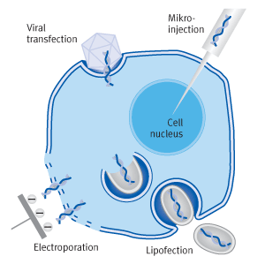
13-3 Transfection

Slide 20
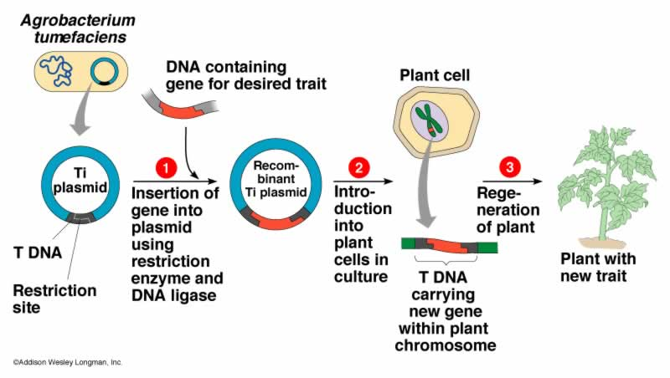
13-3 Plant cell transformation

Slide 21
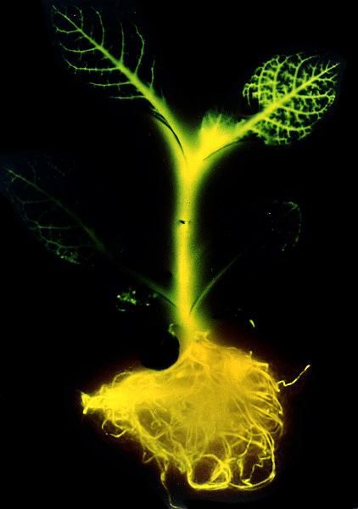
13-4 Applications of Genetic Engineering
Transgenic organisms contain genes from other organisms
Bacteria and yeast are used to make proteins cheaply and in great abundance
Insulin, growth hormones, clotting factors
Works because mechanism of gene expression (DNA-RNA-Protein) works the same in all organisms

Slide 22
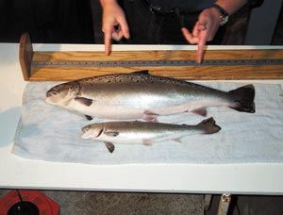
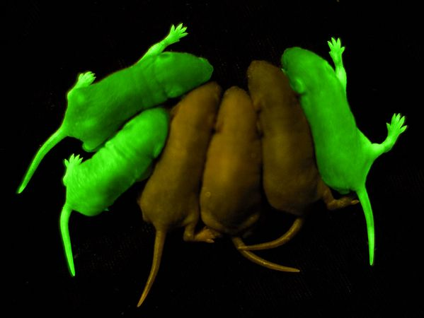
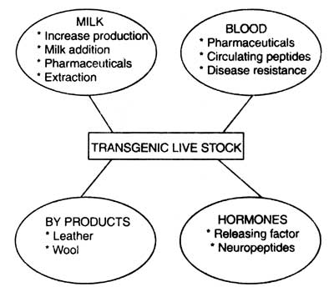
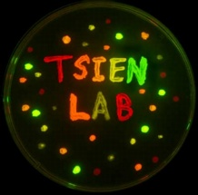
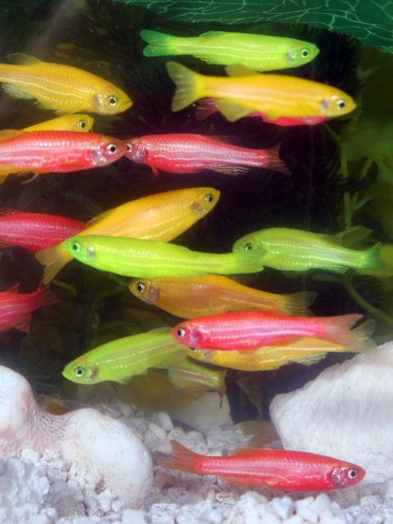
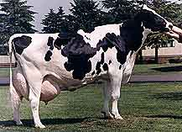
13-4 Transgenic Bacteria and Animals

Slide 23
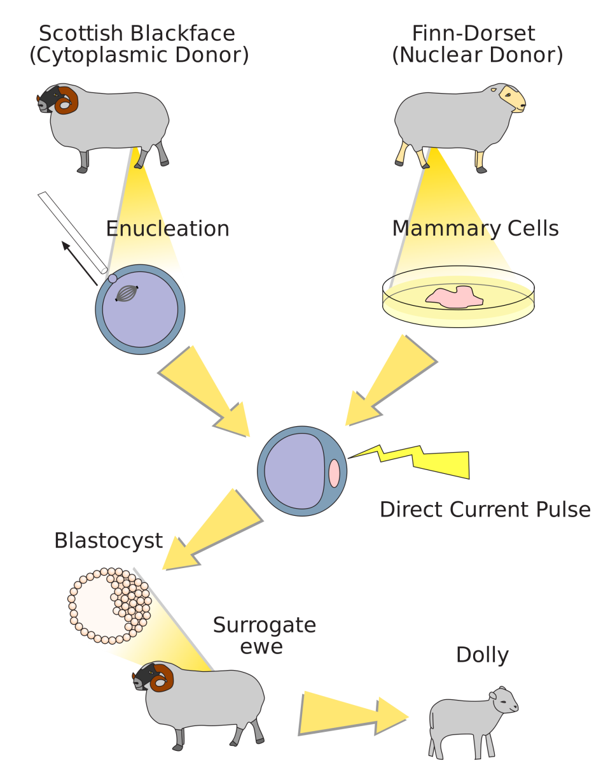
13-4 Transgenic Animals-Cloning

Slide 24
8.1 Overview of genetic engineering
Pharmaceuticals
Protropin HGH, Actimmune interferon, Herceptin anticancer antibody
Industrial enzymes
Indiage cellulase, Purafect protease
Agricultural products
Round up ready soybeans, New leaf potatoes pest resistant

Slide 25
8.1 Overview of genetic engineering
General steps
1. The coding region for a desired characteristic or protein is identified and isolated from a donor cell, confirmed by restriction digest and sequencing and pasted into a vector to form rDNA

Slide 26
8.1 Overview of genetic engineering
2. Recombinant cells are transformed/transfected with the rDNA and cells are assayed to confirm presence of the rDNA and expression of the protein

Slide 27
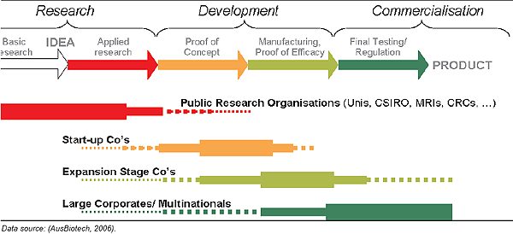
8.1 Overview of genetic engineering
3. The recombinant cells are grown in culture at a small (fermentation) then a large (manufacturing) scale
4. Recombinant protein is isolated and purified from cell cultures, analyzed for purity and activity, then goes to market

Slide 28
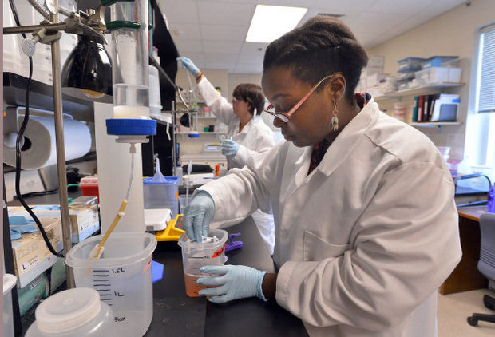
8.1 Overview of genetic engineering
A product must be better produced by genetic engineering than by conventional methods in order to justify the investment in R&D
Scale
Safety
Ease of isolation/production
Chymosin/Renin
Renin isolated from calf gut
Chymosin produced in yeast cells (Chymax by Genencor)

Slide 29
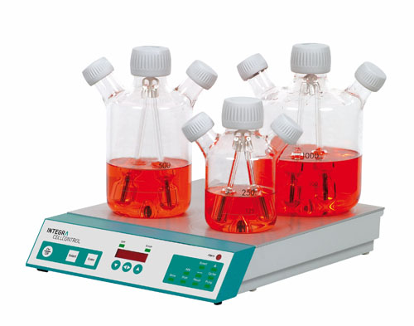
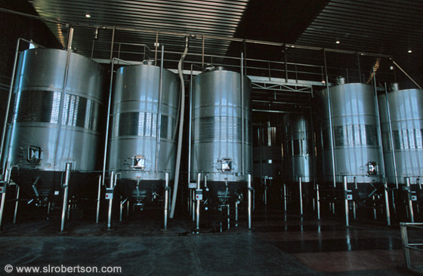
8.3 After Transformation
Scale up-need more than a few colonies to purify enough protein to use as a product
1-2L spinner flasks are appropriate size for R&D
For production, fermentation tanks 10K liters
Require sterile conditions and strict protocols for cleaning and sterilizing equipment

Slide 30
8.3 After Transformation
Using assays during scale up
Test at every step of scale up and production for
Presence
Activity
Concentration
Conducted by Quality Control (QC) Department

Slide 31
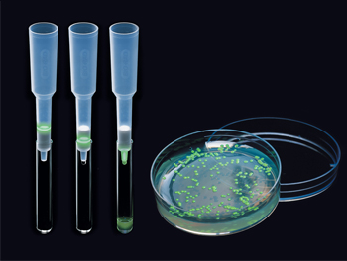
8.4 Fermentation, Manufacturing and GMP
Fermentation in biotechnology is growing cells under optimal conditions for maximum cell division and product production
Highly controlled large scale growth
A seed colony is a colony growing on a petrie dish
Because of exponential growth (every 20 minutes the number of cells in the culture double) large cultures can quickly be reached as long as optimal conditions are maintained
Then product is isolated

Slide 32
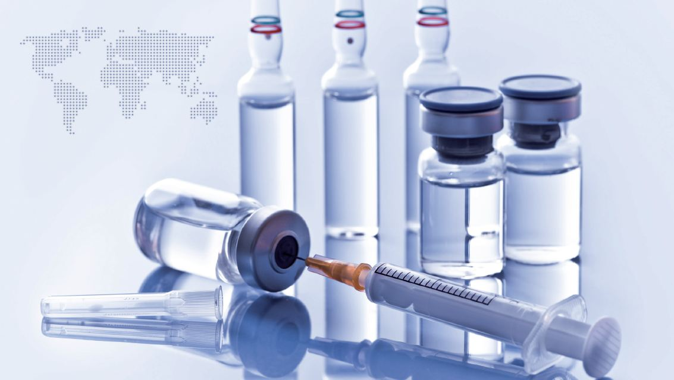
8.4 Fermentation, Manufacturing and GMP
After product isolation it must be formulated
Prepared for delivery and storage
Route of drug administration must be determined-oral, IV, etc
Testing and market analysis involved
Often an entire department is devoted to this

Slide 33
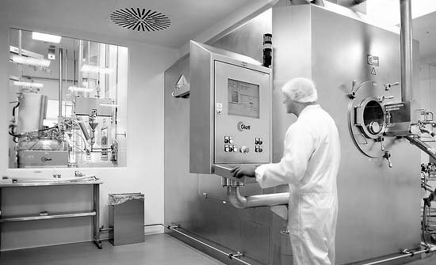
8.4 Fermentation, Manufacturing and GMP
During manufacture, current good manufacturing practices (cGMP) must be followed

Slide 34
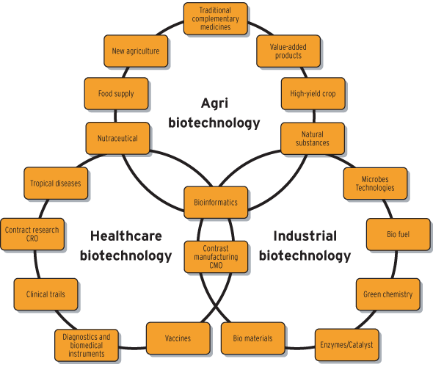
What is Biotechnology

Slide 35
How Companies Select Products to Manufacture
Biotechnology Products
More nutritious foods
Better medicine
Improved living conditions
Cleaner environment
Commonality is that the potential product must make it through the product pipeline and generate sales in a reasonable amount of time and at a reasonable cost

Slide 36
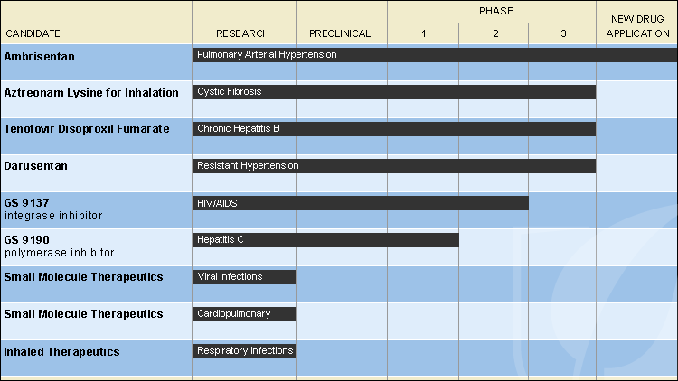
How Companies Select Products to Manufacture
Product pipeline-what is that?

Slide 37
How Companies Select Products to Manufacture
Product development plan
Does the product meet a critical need?
Who will use it? Is the market large enough? How many customers?
Do preliminary data support that the product will work? Will the product do what the company claims?
Can patent protection be secured? Can the company prevent another company from making it?
Can the company make a profit? How much will it cost to produce and how much can it be sold for?

Slide 38
How Companies Select Products to Manufacture
Product development is based on criteria set by the
Food and Drug Administration (FDA)
Environmental Protection Agency (EPA)
United States Department of Agriculture (USDA)

Slide 39
How Companies Select Products to Manufacture
Clinical Trials
Test potential therapeutics in human patients
Three phases
I. Test on terminally ill patients with no other treatment options
Is it safe? Does it work?
How should it be given/ What is the dose?
Small sample size (a dozen patients)
II. Further safety tests
How well does it work?
Tested with a specific type of cancer
III. Test compared to other drugs used for the same condition
Does it work better?
Overseen by the FDA

Slide 40
Careers in the Biotechnology Industry
Funding is necessary for research and development (R&D) and manufacturing
Raw materials, utilities and building maintenance
Majority of budget spent on employee salaries and benefits
Once a product starts making money, the profits repay the cost, and additional profit is reinvested

Slide 41
Careers in the Biotechnology Industry
Scientific and non-scientific jobs
Scientific-R&D, manufacturing and production, clinical research, quality control
Non-Scientific-information systems, marketing and sales, regulatory affairs, administration/legal affairs

Slide 42
Careers in the Biotechnology Industry
HS Diploma-Lab assistant
Certificate (1-2 years community or career college)-Biotechnician
Bachelor’s Degree (4 yrs college)-Research Associate
Masters degree (1-3 yrs graduate school)- Research Associate
Doctorate (4-6 yrs after bachelor’s degree)-Scientist
Postdoctorate (1 or more years after doctorate)-Scientist

