Slide 1
The Human Genome
Ch 14

Slide 2
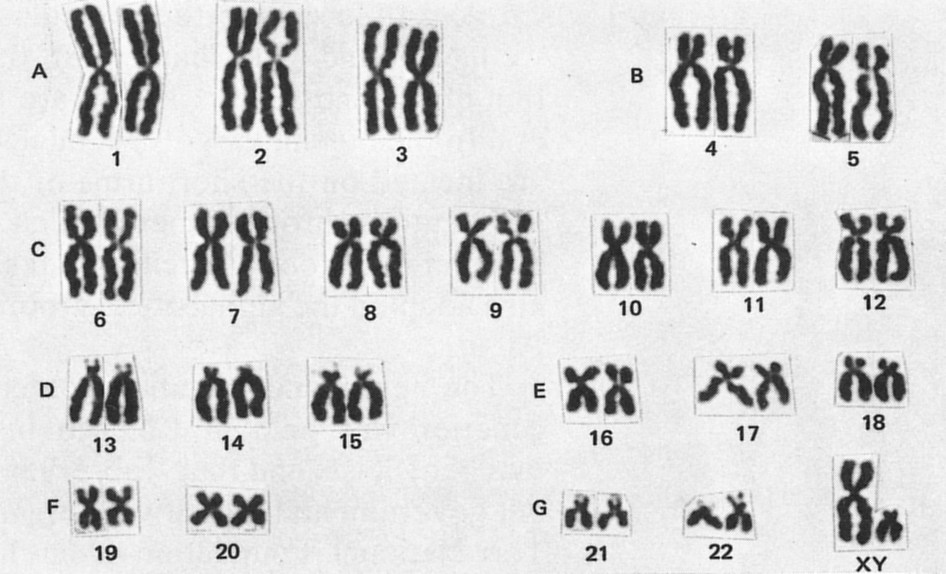
14-1 Human Heredity
Karyotypes are pictures of human chromosomes
1N (Haploid) + 1N egg=diploid zygote
46 chromosomes, 23 different ones
2 are sex chromosomes
Females XX, Males XY

Slide 3
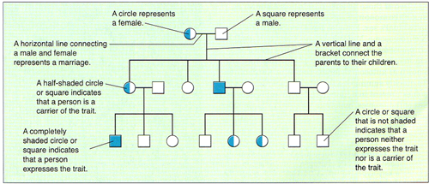
14-1 Human Heredity
Pedigrees show how traits are passed from one generation to the next

Slide 4
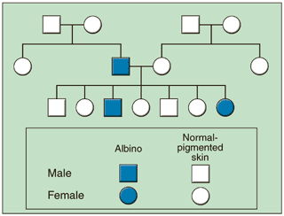
14-1 Human Heredity

Slide 5
14-1 Human Heredity
Human Genome has about 30,000 genes

Slide 6
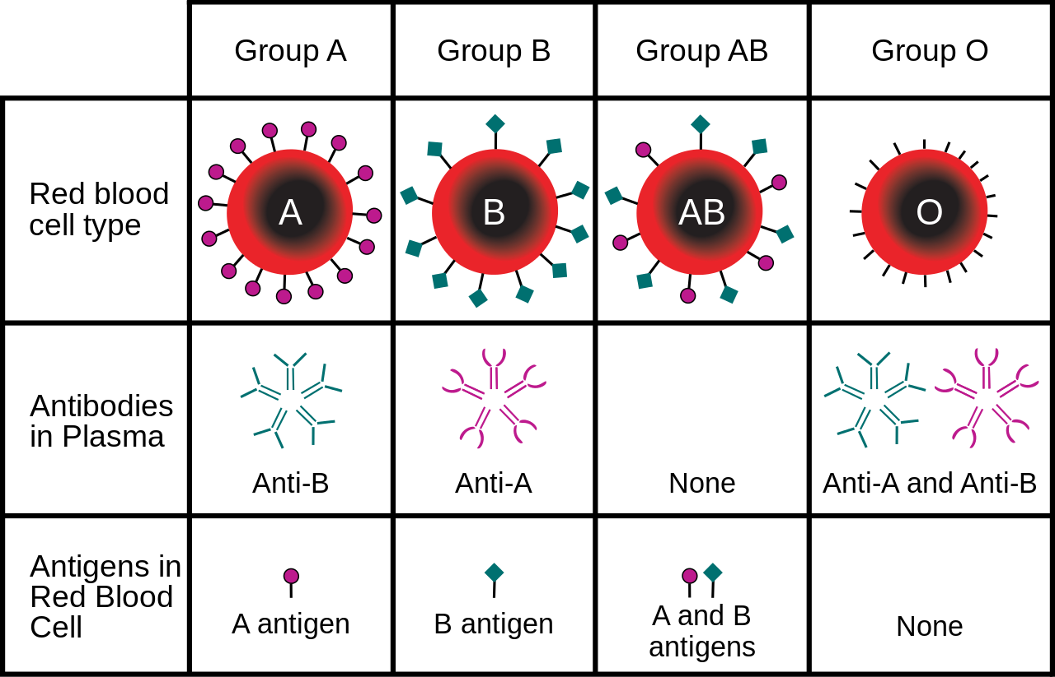
14-1 Human Heredity
Blood Group Genes-ABO and Rh groups
Rh-2 alleles, +/- (+ is dominant)
ABO-three alleles

Slide 7
14-1 Human Heredity
Recessive alleles-only see phenotype when the normal dominant allele fails
PKU-lack enzyme to break down amino acid phenylalanine
Causes severe mental retardation
Individuals need a diet low in phenylalanine
Tay-Sachs disease affects Jewish families in central and eastern Europe-causes nervous system breakdown in first 2 years of life

Slide 9
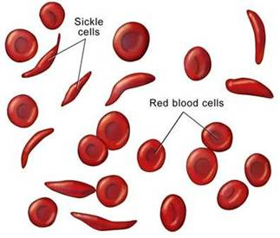
14-1 Human Heredity
Diseases can also be caused by dominant alleles-achondroplasia, Huntingtons Disease
Sickle cell anemia caused by a co-dominant allele-but cell shape protects against Malaria infection

Slide 10
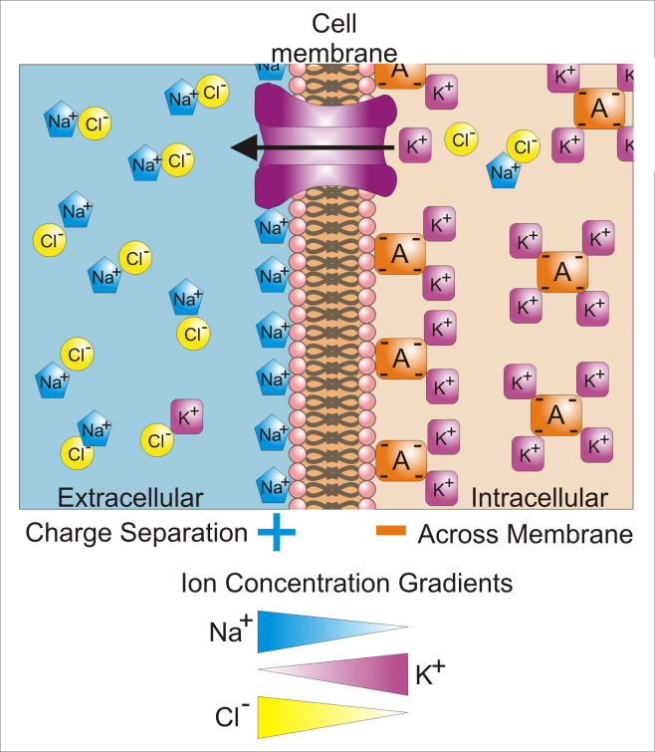
14-1 Human Heredity
Changes in DNA lead to changes in protein structure and function-that is what causes the disease
Cystic fibrosis is caused by a mutation that causes a small change in a protein
that allows Cl- ions to
pass through
membranes. Causes
tissues throughout the
body to malfunction

Slide 11
14-2 Human Chromosomes
6 billion bases in diploid cell
If a book, 4 million pages long
Smallest chromosomes (21&22) have 30-40K bases
Sex linked genes located on X&Y chromosomes
More than 100 sex-linked genes on X&Y chromosomes
All x-linked alleles are expressed in males; in females they need 2 copies of the allele to be expressed; sex-linked disorders show up more in males than in females
Hemophilia and Duchenne Muscular dystrophy are x-linked diseases

Slide 13
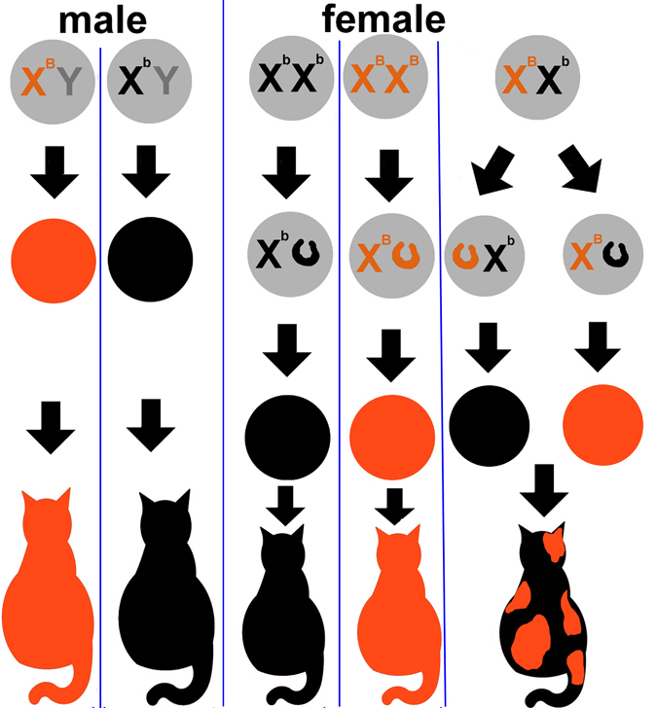
14-2 X-chromosome inactivation
In females the extra x chromosome is (randomly)turned off, called a Barr body

Slide 14
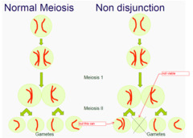
14-2 Chromosomal disorders
Nondisjunction during meiosis-when homologous chromosomes do not separate
Causes abnormal number of chromosomes
Trisomy 21-Down’s Syndrome

Slide 15
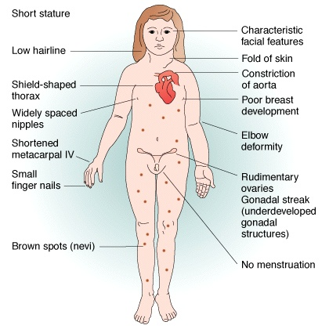
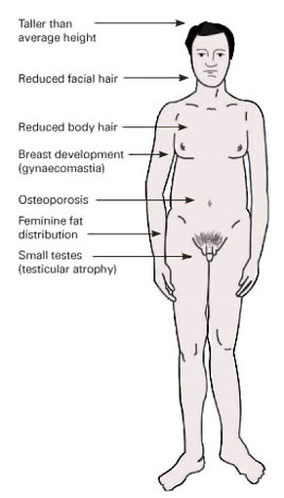
14-2 Sex chromosome Disorders
Turner’s syndrome XO
Klinefelter’s Syndrome-XXY

Slide 16
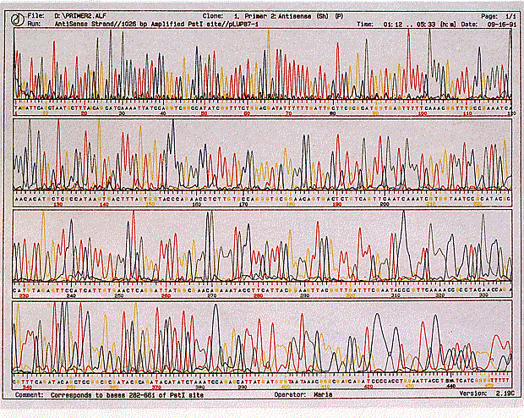
14-3 Human Molecular Genetics
Testing for alleles for hundreds of genetic disorders

Slide 17
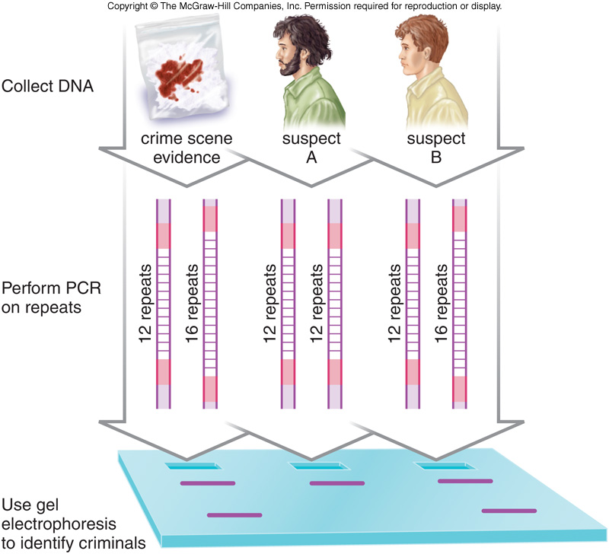
14-3 DnA Fingerprinting
Analyze sections of DNA that are of little importance BUT vary greatly between individuals
Used for identification

Slide 18
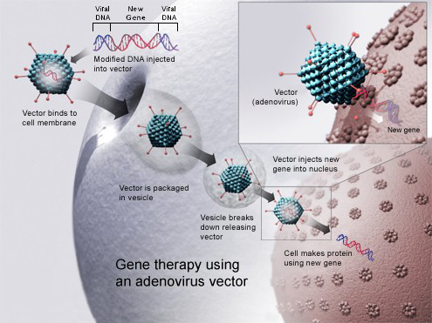
14-3 Gene Therapy
An absent or faulty gene is replaced by a normal working gene
Viruses are used to get the genes inside of cells

Slide 19
14-3 Ethical Issues in Human Genetics
What will happen to the human species if we can change and design our bodies?
Need thoughtful and ethical consensus about what is OK or not OK so we can use our new knowledge and tools wisely
Not just scientists but all of society

