Slide 1
Evolution
Darwin’s Theory
Evolution of Populations
History of Life
Classification

Slide 2
Chapter 15-Charles Darwin’s Theory of Evolution
I. 15.1-Darwin’s Observations
A. Darwin sailed on the HMS Beagle in 1831 to make observations and collect specimens of plants and animals around the world; Eventually he did most of his studies in the Galapagos Islands, near Ecuador, in northern South America (on the equator)
B. His observations about the variation among animals in a population led him to propose a hypothesis (a testable prediction) that eventually led to a theory, a well supported, testable explanation of phenomena (events) that occurred in the natural world

Slide 3
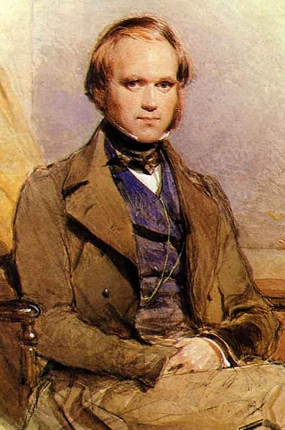
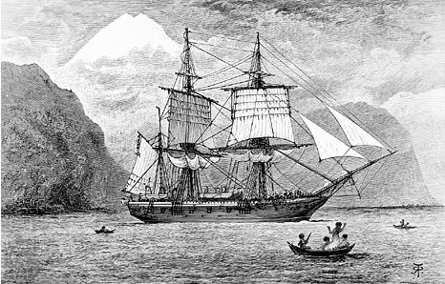

Slide 4
Chapter 15-Charles Darwin’s Theory of Evolution
I. 15.1-Darwin’s Observations (continued)
C. He observed
Plants and animals seemed well adapted to their environment
Plants and animals had many ways in which they survived and had offspring
In some places no animals lived, and wondered why!
Fossils that he found resembled organisms that were still alive

Slide 5
Chapter 15-Charles Darwin’s Theory of Evolution
II. 15.2-Ideas That Shaped Darwin’s Thinking
A. During his time, science was advancing and new ideas were being developed all the time. People still thought that most forms of life had been created only a couple thousand years before and had not changed since creation

Slide 6
Chapter 15-Charles Darwin’s Theory of Evolution
II. 15.2-Ideas That Shaped Darwin’s Thinking (continued)
B. Lyell and Hutton
Geologists
Realized that the earth was many millions of years old, and had been slowly changing over time
C. Darwin asked if the earth was so old and was changing over time, might life be changing as well?

Slide 7
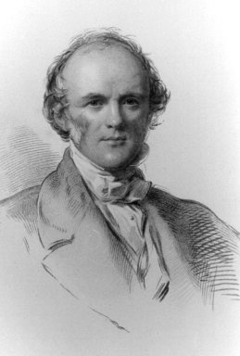
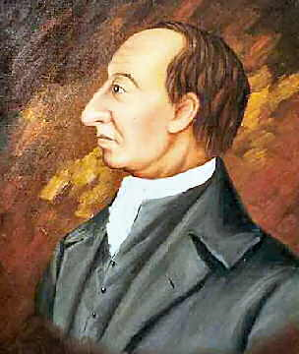
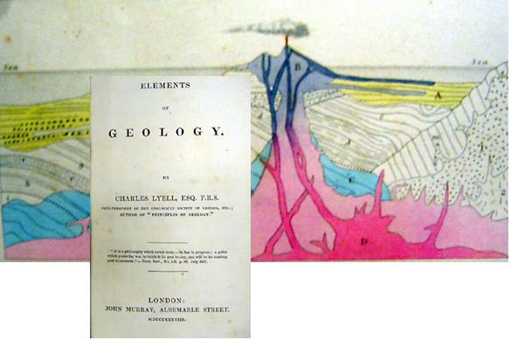

Slide 8
Chapter 15-Charles Darwin’s Theory of Evolution
II. 15.2-Ideas That Shaped Darwin’s Thinking (continued)
D. Jean-Baptiste Lamarck
Before Darwin,
His theory-by selective use of organs, organisms could acquire or lose traits during their lifetime. These traits could then be passed on to their offspring.
If this was true, you could grow your arms into wings by flapping them and trying to fly all the time! If this was true, you could pass on to your offspring the biceps that you worked on in the gym!

Slide 9
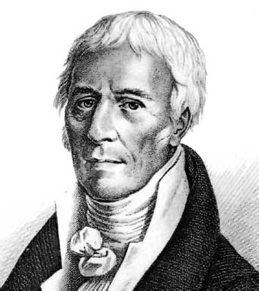
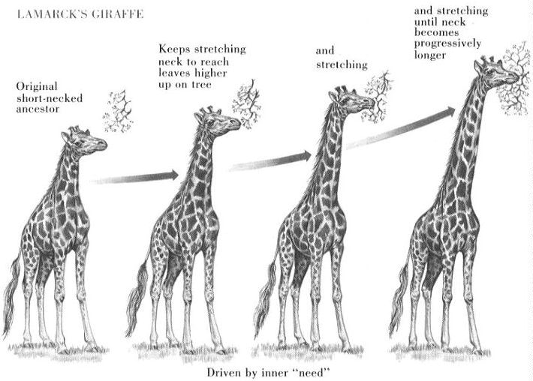

Slide 10
Chapter 15-Charles Darwin’s Theory of Evolution
II. 15.2-Ideas That Shaped Darwin’s Thinking (continued)
E. Thomas Malthus
Economist
Observed that people were being born faster than people were dying, which would eventually lead to a shortage of resources like food and space.
F. Darwin reasoned that this might be happening with plant and animal populations
Competition among organisms would lead to survival of those best adapted to survive and reproduce in their environment

Slide 11
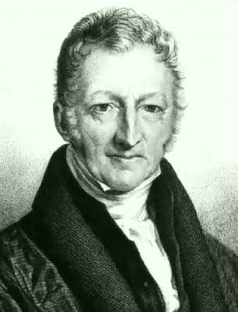
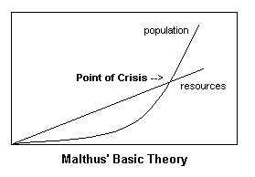

Slide 12
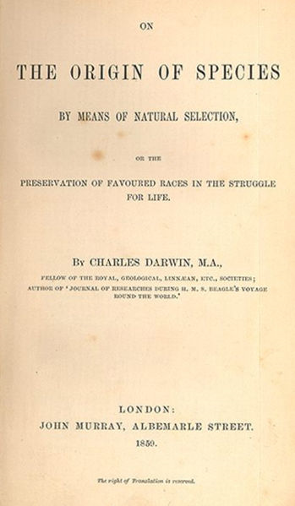
Chapter 15-Charles Darwin’s Theory of Evolution
III. 15.3- Darwin’s Theory
A. His published results of his research was called On the Origin of Species, published in 1858

Slide 13
Chapter 15-Charles Darwin’s Theory of Evolution
III. 15.3- Darwin’s Theory (continued)
B. He argued
Differences between individual organisms in a population, or variation, exists.
Farmers used this natural variation to improve their crops and livestock. Called artificial selection
In natural selection, nature provides the variation, environmental factors select which variants will survive and reproduce
The struggle for existence leads to survival of the fittest

Slide 14
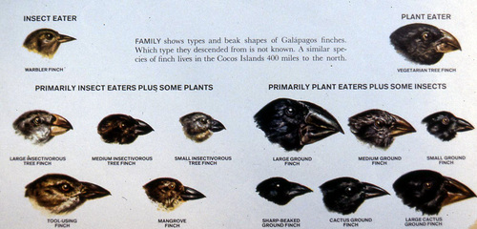
Chapter 15-Charles Darwin’s Theory of Evolution
III. 15.3- Darwin’s Theory (continued)
C. Over time, natural selection results in changes in the inherited characteristics of a population. This principle is called descent with modification

Slide 15
Chapter 15-Charles Darwin’s Theory of Evolution
III. 15.3- Darwin’s Theory (continued)
F. Evidence for evolution
Fossil record
Geographical distribution
Homologous structures
Similarities in early development

Slide 16
Evidence of Evolution- The fossil record
1. Fossil record-formed in rock and show variation over time

Slide 17
Evidence of Evolution- Geographical distribution
2. Geographical distribution of living organisms-Organisms that live in similar environments have similar features

Slide 18
Evidence of Evolution- Homologous structures
3. Homologous structures of living organisms-Structures evolved to be slightly different and adaptive, but arise from the same embryonic tissue; Ex. Arms and wings

Slide 19
Evidence of Evolution- Similarities in early development
4. Similarities in early development- Ex. Between all vertebrates, from fish to mammals, the early stages of embryonic development are very similar

Slide 20
Chapter 16- Evolution of Populations
I. 16-1 Genes and Variation
A. Darwin did not know how heredity worked since DNA or genes had not been discovered
B. Mendel Crossed pea plants in the 1860’s but the importance of that work was not recognized until the 1900’s
C. Now genetics, molecular biology and evolution explain how evolution takes place

Slide 21
Chapter 16- Evolution of Populations
I. 16-1 Genes and Variation (continued)
D. Biologists study gene pools
The combined genetic information of all individuals in a population
Gene pools contain two or more alleles or forms of a certain gene for a certain trait-Ex fur color black or brown or white
The relative frequency of an allele is the number of times the allele occurs in a gene pool compared with the number of times other alleles occur Ex 60 % of alleles are black, 20% brown and 20% white

Slide 22
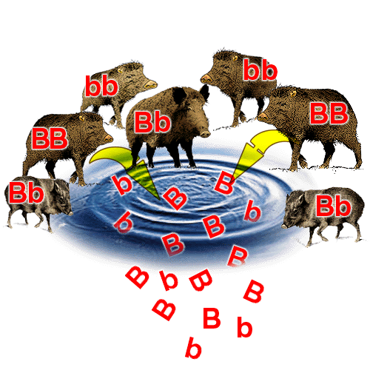

Slide 23
Chapter 16- Evolution of Populations
I. 16-1 Genes and Variation (continued)
G. Sources of genetic variation are mutation and genetic shuffling that results from sexual reproduction
Mutations, or a change in the DNA sequence occur when DNA replicates, or as a result of radiation or chemicals in the environment (mutagens)
Gene shuffling occurs when chromosomes separate during meiosis,
leads to crossing over and recombination
Like a deck of cards
shuffling leads to different hands but does not change the number of aces, kings, etc. in each deck, just mixes them up in different ways

Slide 24
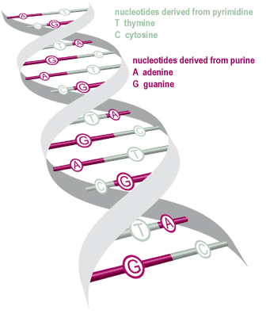
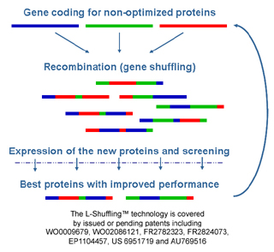
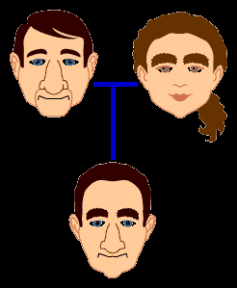

Slide 25
Chapter 16- Evolution of Populations
I. 16-1 Genes and Variation (continued)
J. The number of phenotypes produced for a trait depend on how many genes control that trait
Some controlled by one gene- Single gene trait -Ex. Hairline; single gene with 2 alleles
Most controlled by two or more genes- Polygenic-Ex. Height; many genes with 2 or more alleles
Phenotype frequencies in a population can be graphed, and form a bell shaped curve

Slide 27
Chapter 16- Evolution of Populations
II. 16-2 Evolution as Genetic Change
A. Natural selection acts on phenotypes, not genotypes. Certain phenotypes survive and reproduce
B. When an individual dies without reproducing, its genes are removed from the gene pool
C. When an individual reproduces, the proportion of that individuals genes in the gene pool increases
D. Genetically, evolution is any change in the frequency of genes in a population’s gene pool. Therefore evolution acts on populations, not on individuals

Slide 28
Chapter 16- Evolution of Populations
II. 16-2 Evolution as Genetic Change (continued)
E. Natural selection on single gene traits can lead to changes in the frequency of certain alleles, and therefore to evolution
F. The effects of natural selection on polygenic traits are more complex. Natural selection can affect the distributions of phenotypes by directional selection, stabilizing selection or disruptive selection

Slide 29
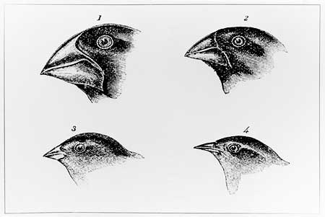
Chapter 16- Evolution of Populations
II. 16-2 Evolution as Genetic Change (continued)
G. Directional selection-When individuals at one end of the curve have a higher fitness than the middle or the other end of the curve, directional selection toward the more fit trait occurs. Ex. Increase in beak size of Galapagos finches

Slide 30
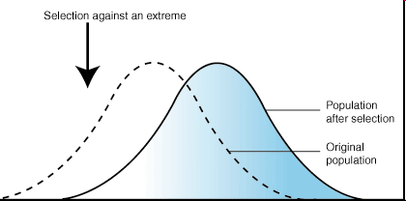
Directional selection

Slide 31
Chapter 16- Evolution of Populations
II. 16-2 Evolution as Genetic Change (continued)
H. Stabilizing selection-When individuals near the center of the bell curve have higher fitness that those at either end, stabilizing selection takes place. Ex. Birth weight of human babies

Slide 32
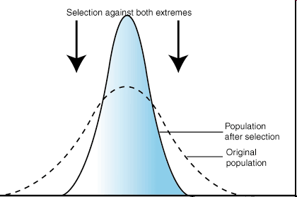
Stabilizing selection

Slide 33
Chapter 16- Evolution of Populations
II. 16-2 Evolution as Genetic Change (continued)
I. Disruptive selection-When the individuals at both ends of the curve have a higher fitness than those in the middle, disruptive selection occurs. Ex. Bird beak size-if medium size seeds disappeared, large and small beak size would be most fit.

Slide 34
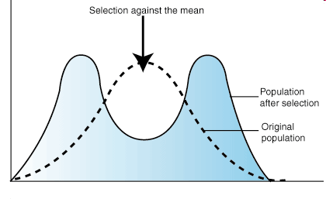
Disruptive selection

Slide 35
Chapter 16- Evolution of Populations
II. 16-2 Evolution as Genetic Change (continued)
J. Genetic Drift
Due to random changes in allele frequency
In small populations, individuals that carry a particular allele may leave more descendants than other individuals, just by chance
Over time, a series of chance occurrences can cause an allele to become common in a population
Can occur when a population colonizes a new habitat-causes the founder effect. Ex. Evolution of several hundred species of fruit flies found on the Hawaiian Islands; all descended from the same main island population

Slide 36
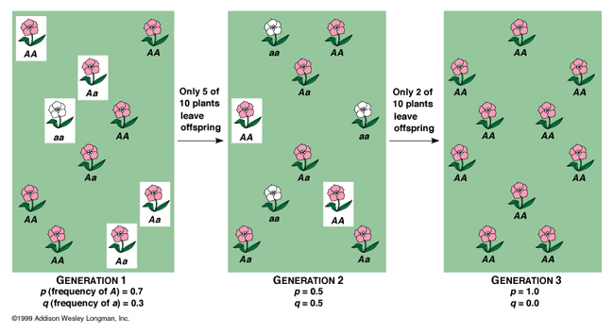

Slide 37
Chapter 16- Evolution of Populations
II. 16-2 Evolution as Genetic Change (continued)
K. The Hardy Weinberg principle explains why evolution might not occur
The allele frequencies in a population will remain constant unless one or more factors cause the frequencies to change
Requires five conditions to maintain genetic equilibrium from generation to generation:
Random mating, population must be very large, there can be no movement into or out of the population, no mutations and no natural selection
If any of these conditions are not met, evolution will occur

Slide 38
Chapter 16- Evolution of Populations
III. 16-3 The Process of Speciation
A. Definition-formation of a new species
B. As new species evolve they become reproductively isolated from each other-the new and changed populations can’t mate. This is due to:
Behavioral isolation-different courtship rules for example
Geographic isolation-river or mountain range separates the two populations
Temporal isolation-when the populations reproduce at different times

Slide 39
Chapter 16- Evolution of Populations
III. 16-3 The Process of Speciation
C. Examples In nature of natural selection
Beak size and shape of Galapagos finches-Variation existed, the selective pressure was the availability of food types. Beaks evolved to best get the available food in different regions of the Galapagos Islands

Slide 41
Chapter 16- Evolution of Populations
III. 16-3 The Process of Speciation
Speciation occurred by
the founding of a new population
geographic isolation
changes in the new population’s gene pool
reproductive isolation
ecological competition

Slide 42
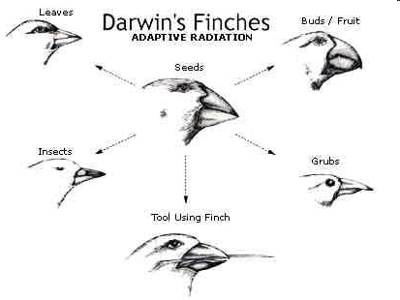
Examples In nature of natural selection

Slide 43
Chapter 17-The History of Life
The Fossil Record
Earth’s Early History
Evolution of Multicellular Life
Patterns of Evolution

Slide 44
Chapter 17-The History of Life
I. 17-1 The Fossil Record
A. Shows how different groups of organisms have changed over time
B. Certain fossils are found only in rocks from a certain age
C. More than 99% of all the species that have ever lived are extinct

Slide 45
Chapter 17-The History of Life
I. 17-1 The Fossil Record
D. Most organisms die without leaving a fossil behind.
Most fossils form in sedimentary rock (sand, clay in river or lake beds) and are exposed and weathered by wind and heat
Many do not survive or are fragmented and not intact

Slide 46
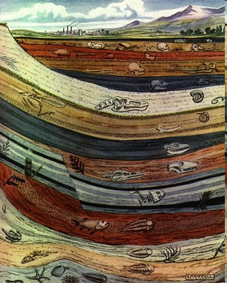
Chapter 17-The History of Life
I. 17-1 The Fossil Record
E. Forces in the earth lift up and expose the rock layers containing the fossil
F. Relative dating-the age of the fossil is determined by comparing in placement with that of other fossils in other layers
Index fossils (reference fossils) may be used

Slide 47
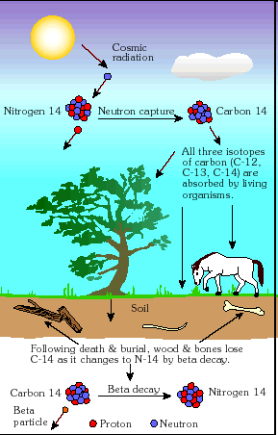
Chapter 17-The History of Life
I. 17-1 The Fossil Record
G. Radioactive dating
uses the half-life of a radioactive form of an element to determine the age of the fossil
In nature there are several forms of carbon-isotopes
Matter is a mixture of these isotopes.
C-14 is radioactive, and decays into C-12.

Slide 48
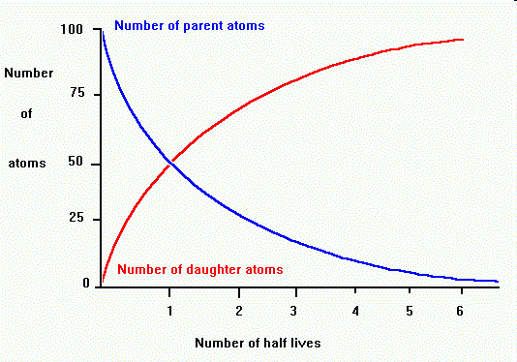
Radiometric Dating: C-14 dating
The time it takes for half of the starting material’s C-14 to decay is called the half life.
The other form of carbon, C-12, does not decay.
By comparing the amount of C-14 to the amount of C-12, scientists can calculate the age of the fossil

Slide 49
Chapter 17-The History of Life
I. 17-1 The Fossil Record
H. Geologic time scale-divisions represent evolutionary time-Eras
Precambrian (650-544 mya, 90% of the earth’s history)
Paleozoic (544-245 mya), Mesozoic (245-65 mya) and Centozoic (6.5mya-present)
Eras are divided into periods (Ex. Mesozoic is divided into Triassic, Jurrasic and Cretaceous)

Slide 50
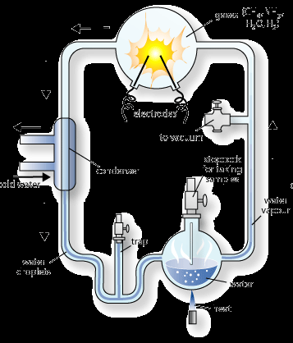
Chapter 17-The History of Life
II. 17-2 Earth’s Early History
A. Earth’s early atmosphere probably contained hydrogen cyanide, carbon dioxide, carbon monoxide, nitrogen, hydrogen sulfide and water
B. Since the 1950’s, scientists have showed that when the molecules present on earth at that time are placed in a sealed container and electrical current is passed through, amino acids and molecules used to make RNA and proteinoids form

Slide 51
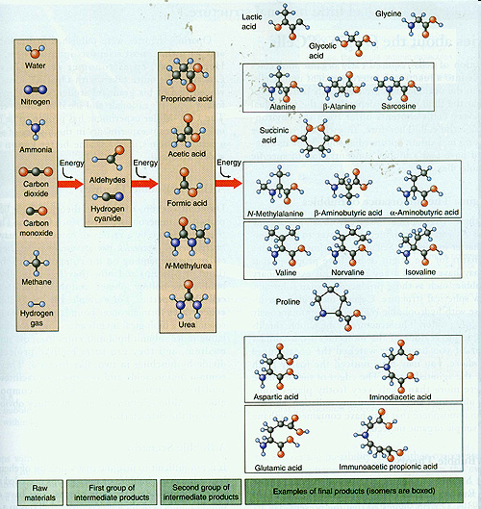
Formation of the first organic (carbon/hydrogen-based) molecules

Slide 52
Chapter 17-The History of Life
II. 17-2 Earth’s Early History
C. RNA probably evolved first, then DNA
RNA can act as an enzyme and replicate itself
DNA is more stable than RNA
D. Single celled prokaryotic organisms formed from microspheres of proteinoids and RNA and started producing oxygen
E. Eventually the atmosphere contained enough oxygen that some species died off, and others developed more efficient ways of using oxygen for respiration to produce energy

Slide 53
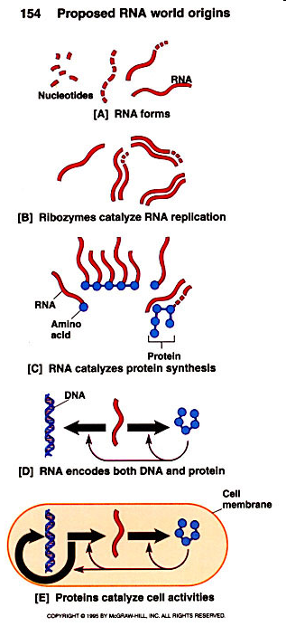
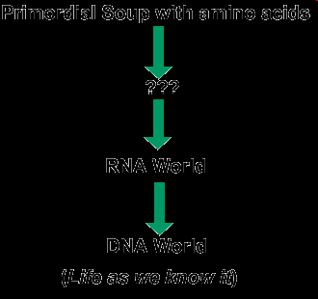
RNA World

Slide 54
Chapter 17-The History of Life
II. 17-2 Earth’s Early History
F. Small prokaryotes started living inside larger ones and this led to the evolution of eukaryotic cells
Called endosymbiotic theory
eukaryotic cells arose from living communities formed by prokaryotic organisms

Slide 55
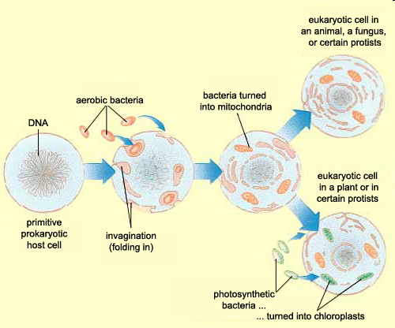
Endosymbiotic Theory

Slide 56
Chapter 17-The History of Life
II. 17-2 Earth’s Early History
G. Most prokaryotes reproduce asexually by division
H. Next, cells began to reproduce sexually
sped up the process of evolution
Led to more genetic variation in the populations of organisms
I. A few hundred million years later, multicellular life evolved

Slide 57
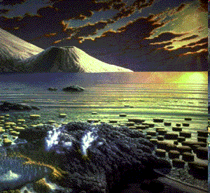
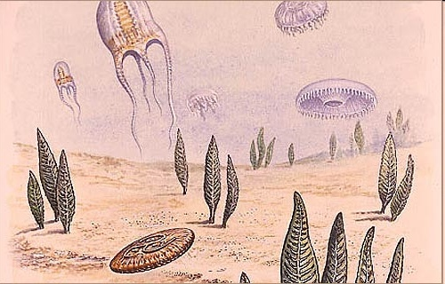
Chapter 17-The History of Life
III. 17-3 Evolution of Multicellular Life
A. As the Precambrian era ended and the Paleozoic era, Cambrian period started, multicellular life began to evolve

Slide 58
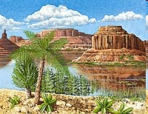
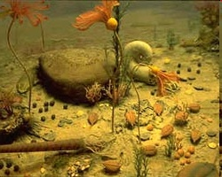
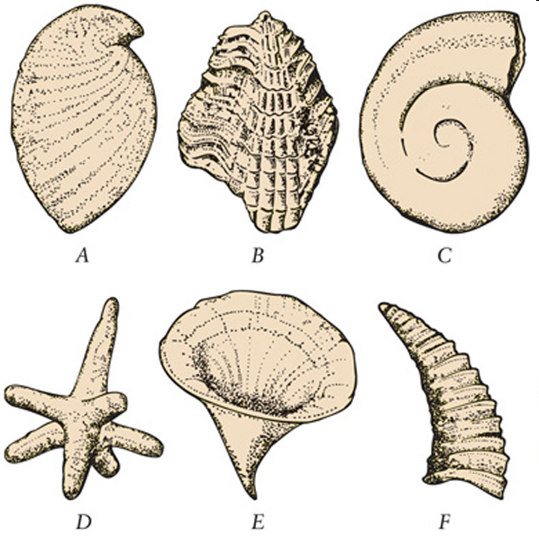
Cambrian-Paleozoic Era
B. Life diversified during this period, organisms got hard shells and outer skeleton and most animal phyla evolved-Cambrian explosion

Slide 59
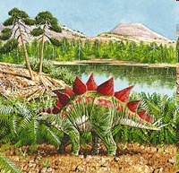
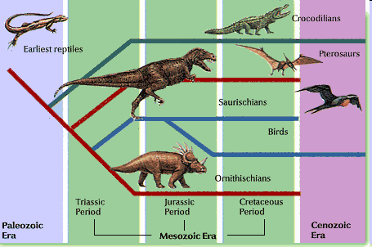
Chapter 17-The History of Life
III. 17-3 Evolution of Multicellular Life
C. By the end of the Paleozoic era, invertebrates and vertebrates evolved
D. Mesozoic era was dominated by dinosaurs and flowering plants. Dinosaurs died off at the end of the Mesozoic era

Slide 60
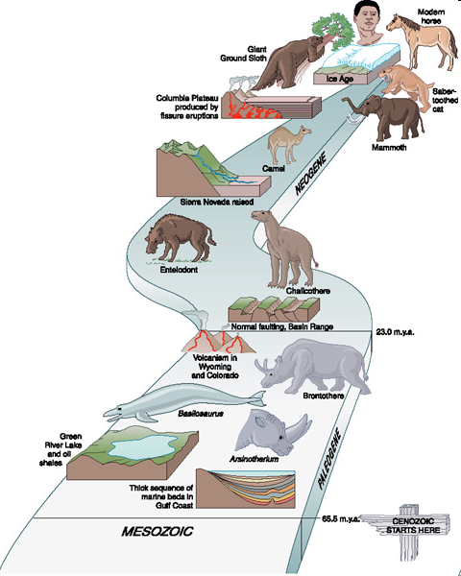
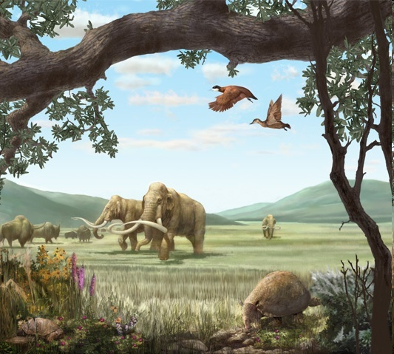
Cenozoic Era
E. During the Cenozoic era, mammals dominated

Slide 61
Chapter 17-The History of Life
IV. 17-4 Patterns of evolution
A. Macroevolution-Large-scale evolutionary changes that take place over a long period of time
B. Six patterns-mass extinctions, adaptive radiation, convergent evolution, coevolution, punctuated equilibrium and changes in developmental genes

Slide 62
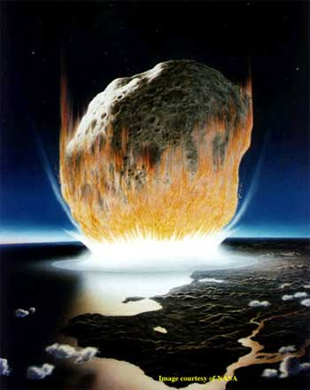
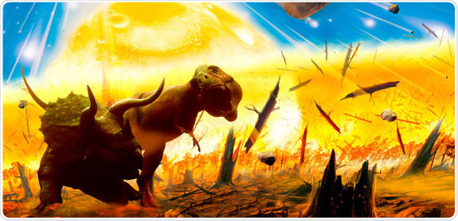
Chapter 17-The History of Life
IV. 17-4 Patterns of evolution
C. Mass extinctions-huge numbers of species disappear at one time Ex. Dinosaurs

Slide 63
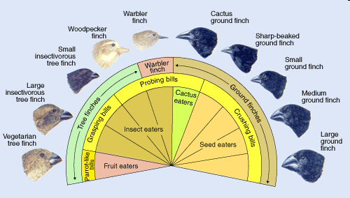
Adaptive Radiation
D. Adaptive radiation-A single species evolves into several different forms that live in different ways. Ex. Dinosaurs-why they “ruled the earth”

Slide 64
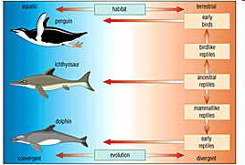
Chapter 17-The History of Life
IV. 17-4 Patterns of evolution
E. Convergent Evolution-The process by which unrelated organisms come to look like one another. Ex. Swimming animals-sharks, fish, marine mammals like whales and seals

Slide 65
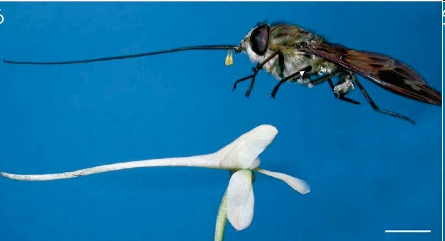
Convergent and Coevolution
F. Coevolution-organisms that are closely connected to one another by ecological interactions evolve together in response to changes in each other’s environments. Ex. Flowers and insects that pollinate them

Slide 66
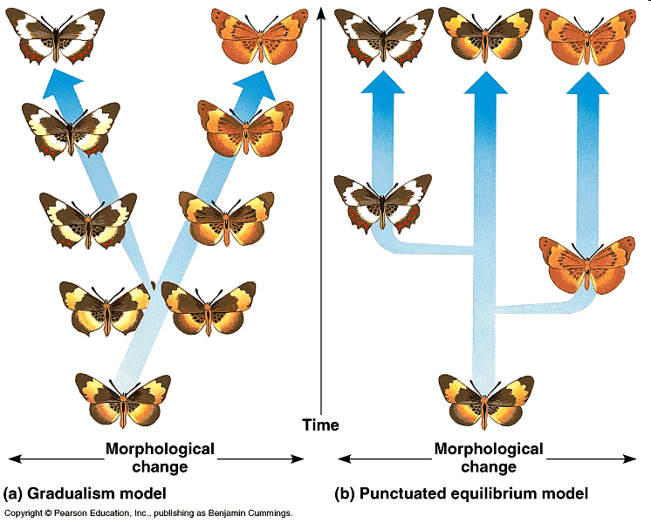
Chapter 17-The History of Life
IV. 17-4 Patterns of evolution
G. Punctuated Equilibrium
Evolution does not occur at the same rate all the time
Long stable periods where no changes occur, interrupted by brief periods of rapid change, in response to changes in the environment

Slide 67
Chapter 17-The History of Life
H. Developmental Genes and Body Plans
Master control genes (Hox genes) establish body plans in all organisms, from insects to humans.
Changes in hox genes lead to different body plans.
Small changes in the timing of expression of hox genes can lead to changes in body plans

Slide 68
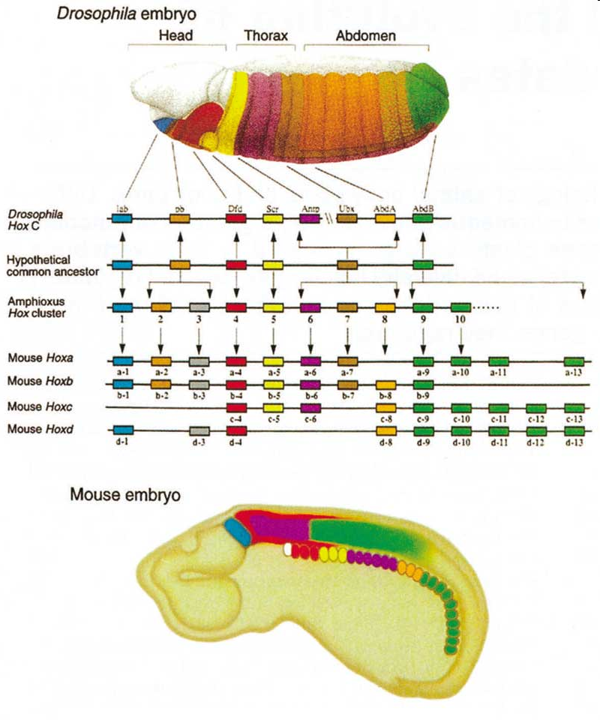
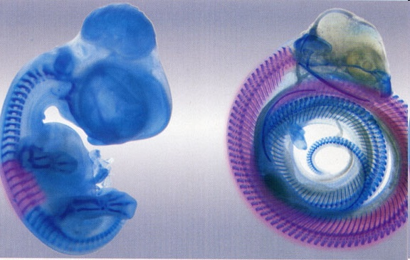
Hox Genes in Flies, Mice and Chickens and Snakes

