Slide 1
Comparing Invertebrates
Chapter 29

Slide 2
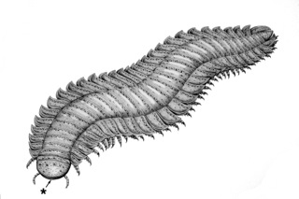
29-1 Invertebrate Evolution
Earliest and most primitive animals were
Simple
Made of soft tissue
Absorbed nutrients from surrounding water
Some had photosynthetic algae living within their tissues
Segmented
Bilateral symmetry
Little cell/internal specialization
Little organization back to front
May have been related to jellyfish and worms but body plan distinct from anything living today

Slide 3
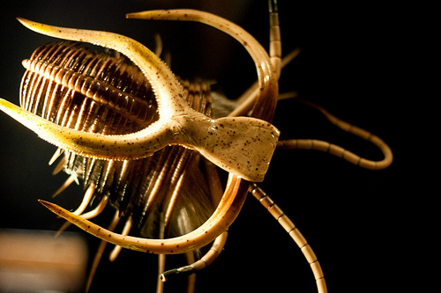
29-1 Invertebrate Evolution
Beginnings of invertebrate diversity
Cambrian period-544 mya-suddenly see an abundance of diversity in fossil record-Why?
Shells
Skeletons
Hard body parts
Burgess shale in Canada-most diverse and numerous fossils found anywhere
http://www.sciencechannel.com/tv-shows/greatest-discoveries/videos/100-greatest-discoveries-burgess-shale-discovery/

Slide 4
29-1 Invertebrate Evolution
Only a few million years later
Complex body plans
Specialized cells and tissues, organs
Body symmetry
Segmentation
Skeleton
Back and front sides
appendages
Cambrian explosion
Ancestors of modern phyla

Slide 5
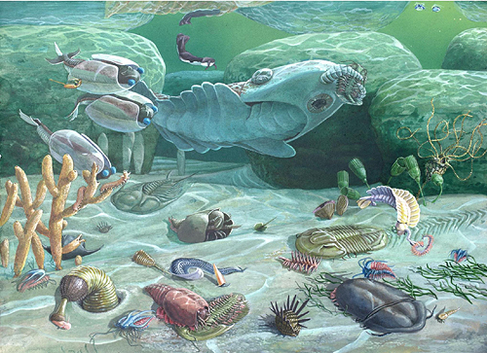
Cambrian Explosion

Slide 6
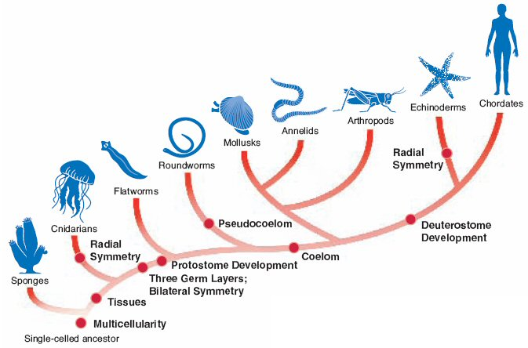
29-1 Invertebrate Evolution
Modern evolutionary relationships

Slide 7
29-1 Modern Evolutionary Trends
The appearance of each phylum in the fossil record represents the evolution of a successful and unique body plan
Specialized cells and tissues or organs
Body symmetry-radial or bilateral
Cephalization-concentration of sense organs and nerve cells in the front of the body-more sophisticated response to environment

Slide 8
29-1 Modern Evolutionary Trends
Segmentation-specialization of each segment, allows for increased body size without requiring new genetic information
Coelum formation-body cavity between the germ layers lined with mesoderm
Early development
Protosomes-opening of blastula becomes mouth
Deutersomes-opening of blastula becomes anus

Slide 9
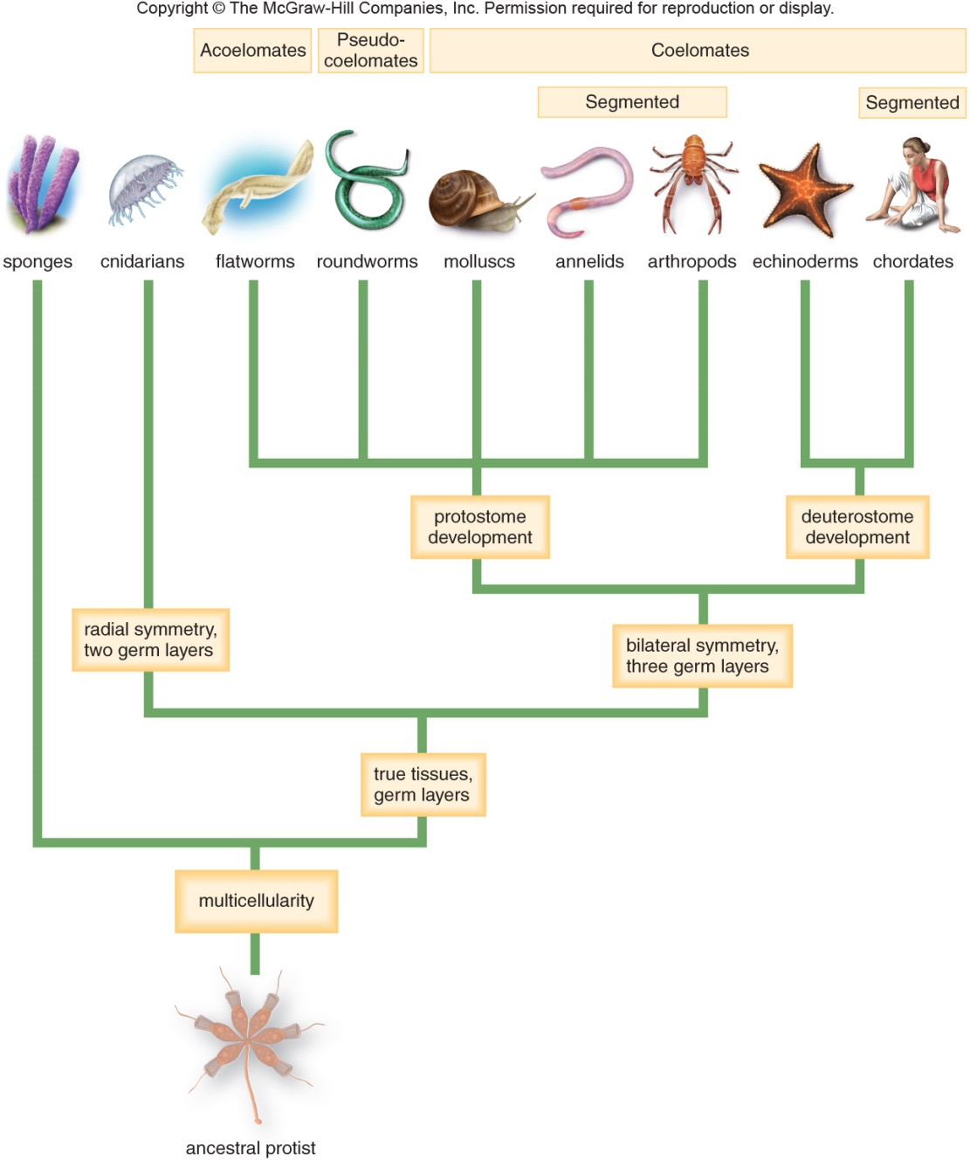
29-1 Modern Evolutionary Trends

Slide 10
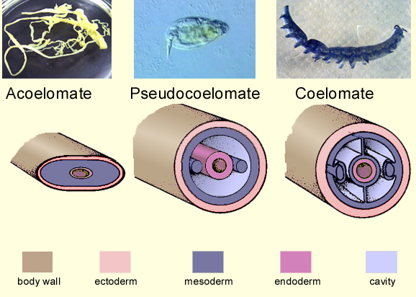
29-1 Modern Evolutionary Trends

Slide 11
29-2 Structure and Function
Feeding and Digestion
Simple animals break down food using intracellular digestion-sponges
More complex organisms do it through extracellular digestion(digestive tract)-worms, Cnidarians (jellyfish)
Some complex organisms ingest food and expel waste through same opening (flatworms), some have a one way digestive tract (roundworms, grasshoppers, etc)

Slide 12
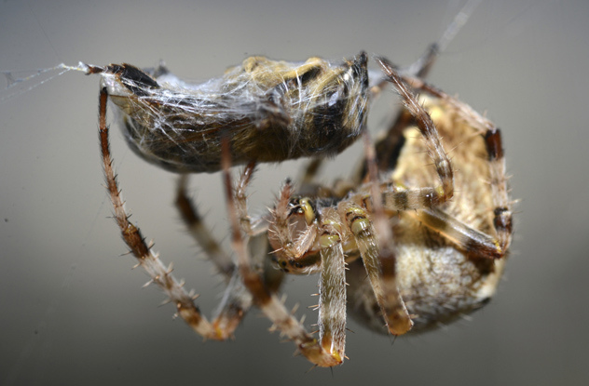
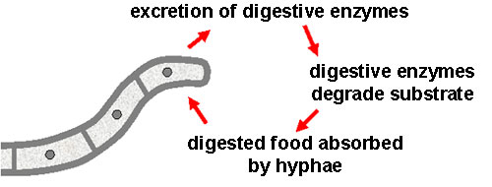
Intra- vs Extracellular digestion

Slide 13
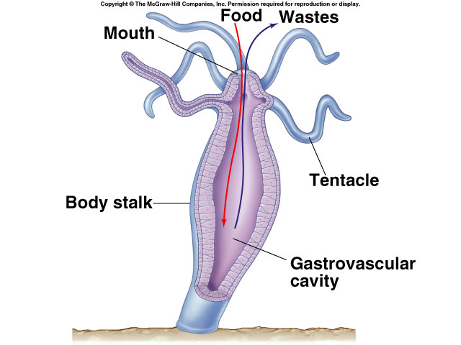
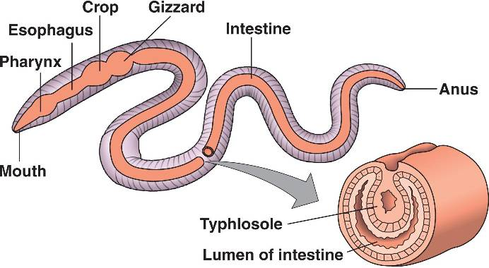
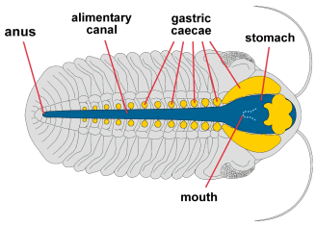
Digestive systems

Slide 14
29-2 Structure and Function
Respiration
Organs must have large surface area and be moist (for diffusion)
Aquatic animals naturally have moist surfaces
Some small animals respire through skin(worms)
For larger organisms, gills (aquatic animals), mantle cavity (snail), book lungs (spiders), spiracles (insects)
All involve diffusion of gases

Slide 15
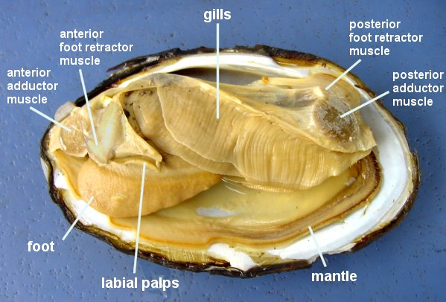
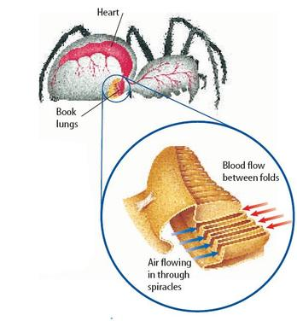
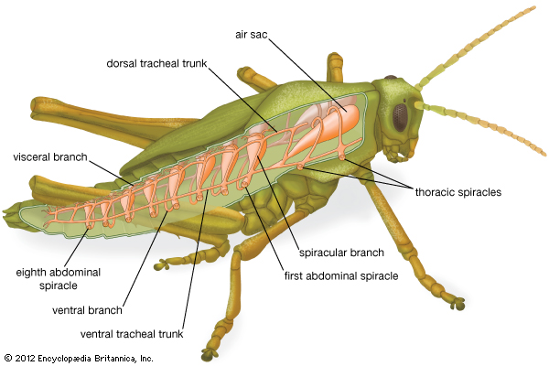
Respiration in invertebrates

Slide 16
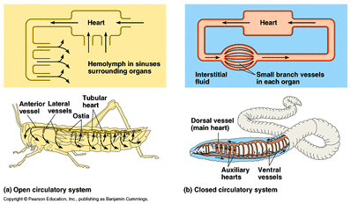
29-2 Structure and Function
Circulation
One or more hearts
Open (blood only partially contained within blood vessels) or closed circulatory system

Slide 17
29-2 Structure and Function
Excretion
Rids body of waste and maintains water levels in tissues
Diffusion of ammonia in aquatic invertebrates(sponges, jellyfish, roundworms)
Terrestrial inverts must maintain water and get rid of ammonia. Convert it to urea and eliminate in urine
Nephridia (mollusks)
Malphigian tubes (insects, spiders)

Slide 18
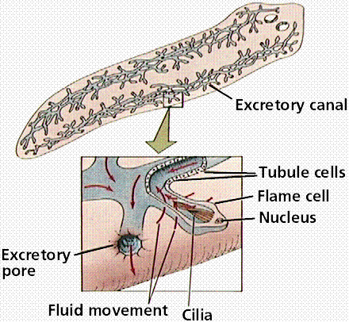
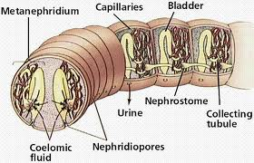
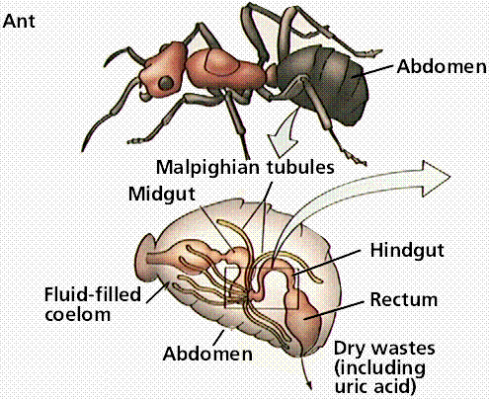
Invertebrate excretory systems

Slide 19
29-2 Structure and Function
Response
Three trends in NS development
Centralization-nerve cells are centralized and not spread out like a net
Cephalization-concentration of nerve cells in one end of the body
Specialization-specialized sense organs for light, sound, chemicals, electricity, movement

Slide 20
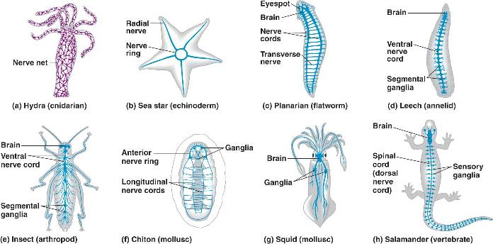
Invertebrate nervous systems

Slide 21
29-2 Structure and Function
Movement and support
Most animals use muscles to move
Muscles move organisms by contraction
Usually work with skeletal system
Hydrostatic-muscles surround a fluid filled opening, when muscles contract animal changes shape
Exoskeleton-hard body covering made of chitin, arthropods,muscles bend and straighten exoskeleton at joints
Endoskeleton-calcified plate, echinoderms and sea stars

Slide 22
Invertebrate skeletons

Slide 23
29-2 Structure and Function
Reproduction
Mostly sexual, but many may also reproduce asexually
Asexual-allows rapid reproduction, can take advantage of favorable conditions
Fragmentation
Budding
Sexual maintains genetic variation
Seperate sexes or hermaphroditic
External and internal fertilization

Slide 24
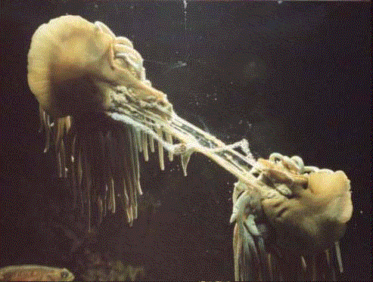
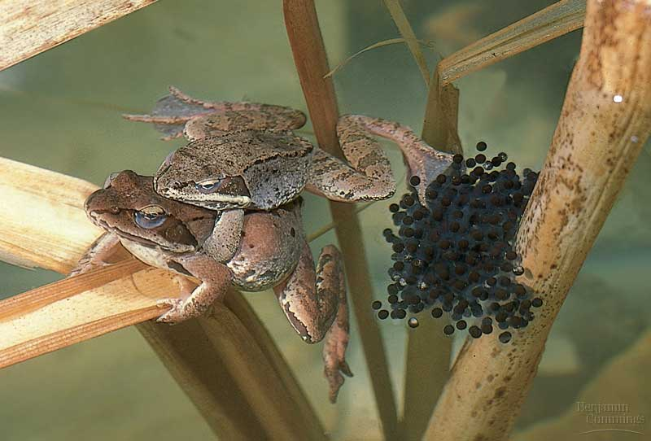
Invertebrate reproduction

