Slide 1
Comparing Chordates
Chapter 33

Slide 2
33-1 Chordate Evolution
First appeared 500 mya
Most ancient were related to the echinoderms (starfish)
Fossils present in Cambrian deposits of Burgess Shale
Most ancient relative found so far is Pikaia, like a worm with a notochord, only found in Chordates column and pairs of muscles like invertebrates

Slide 3
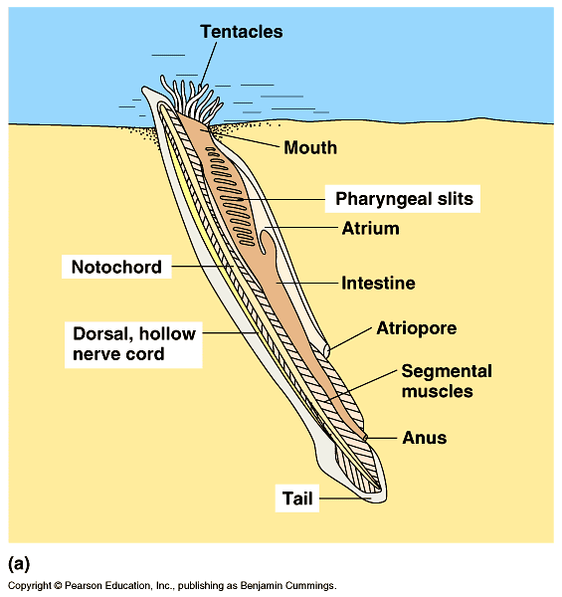
Pikaia, early Chordate

Slide 4
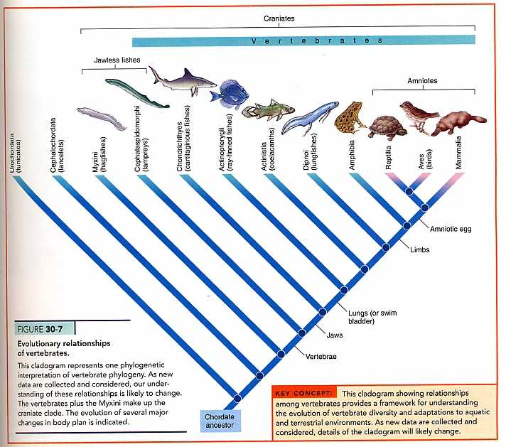
33-1 Chordate Family Tree

Slide 5
33-1 Evolutionary Trends
Good fossil record!
Adaptive radiation-Appearance of new adaptations (jaws, paired appendages) launch rapid diversification of species as they adapt to new conditions
Convergent evolation-sometimes species evolve that are similar in appearance and behavior even though they are not closely related (example birds and bats both fly)

Slide 6
33-1 Chordate Diversity
6 living groups of chordates
Non-vertebrate chordates
Fishes
Amphibians
Reptiles
Birds
Mammals

Slide 7
33-1 Chordate Diversity

Slide 8
33-2 Controlling Body Temperature
Important for maintaining homeostasis
Enzymes and other proteins work best within a certain range of temperatures
All ways of maintaining body temp incorporate
A source of heat for the body
A way to conserve heat
A way to eliminate excess heat

Slide 9
33-2 Controlling Body Temperature
Ectothermy-body temp mainly determined by the environment. Reptiles, fishes, amphibians
Warm up in sun, cool down by burrowing.
Low metabolic rate, muscles generate heat but no insulation

Slide 10
33-2 Controlling Body Temperature
Endothermy-generate and retain heat inside their bodies. Body temp controlled from within. Birds and mammals.
Have insulation like body fat, hair, feathers
Sweat or pant to remove excess heat
High metabolic rate, generate lots of heat

Slide 11
33-2 Controlling Body Temperature
Ecto- vs Endotherms
Endotherms can stay warm at night and during cold weather but require a lot of food to generate heat
Ectotherms are more energy efficient in climates that stay warm and have fairly constant temps but take a long time to warm up in cold climates

Slide 12
33-2 Controlling Body Temperature
Evolution of temperature control
First land animals were ectoderms
Reptiles are ectotherms but dinosaurs may have been endotherms
Endothermy may have evolved more than once
Along the evolutionary line when reptiles evolved into birds
Along the evolutionary line when reptiles evolved into mammals

Slide 13
33-3 Form and Function in Chordates
Feeding
Non-vertebrate chordates (tunicates, lancelets) are filter feeders
Remove plankton from water in pharynx
Skulls and teeth of vertebrates are adapted to feed on wide variety of foods
Insects, meat, seeds, nuts, leaves, nectar, etc.
Some vertebrates (Baleen whales) are filter feeders which strain food in their mouths

Slide 14
33-3 Form and Function in Chordates
Digestive systems
Organs are well adapted for different feeding habits
Carnivores have short digestive tracts that produce fast acting meat digesting enzymes
Herbivores have long digestive tracts that have bacteria that produce plant digesting enzymes

Slide 15
33-3 Form and Function in Chordates

Slide 16
33-3 Form and Function in Chordates
Respiration
Aquatic animals have gills
Land animals have lungs
Both allow for gas exchange
Some fish have extra respiratory organs-air sacs
Lancelets and sea snakes, amphibians also respire by diffusion across body surfaces

Slide 17
33-3 Form and Function in Chordates
Respiration (continued)
Gills-water flows over, gas exchanged. Oxygen goes into capillaries, carbon dioxide diffuses into water
Lungs-Oxygen and carbon dioxide exchanged
Surface area in mammals greater than in amphibians
Amphibian lungs sacs with ridges
Reptile lungs have small chambers
Mammals have alveoli, oxygen rich and poor air move in and out through same passage, always oxygen poor air trapped in lungs
Birds have one way air flow so always have fresh oxygen, allows flight at high altitudes

Slide 18
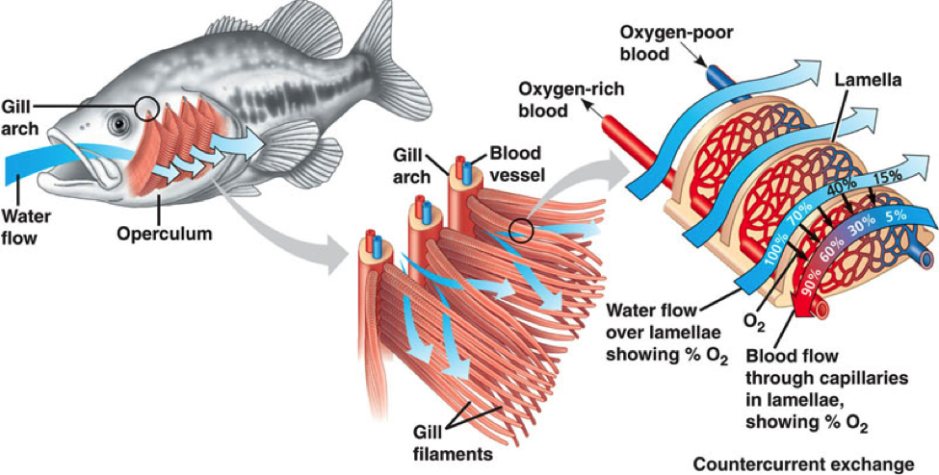
33-3 Form and Function in Chordates
Gills

Slide 19
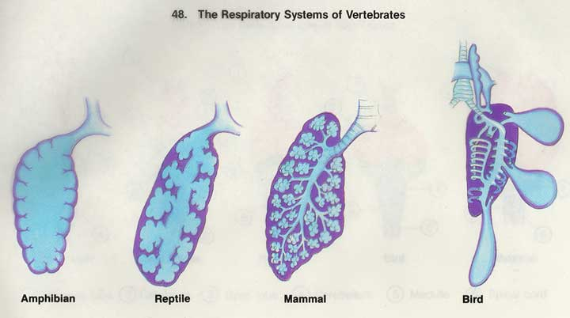
33-3 Form and Function in Chordates

Slide 20
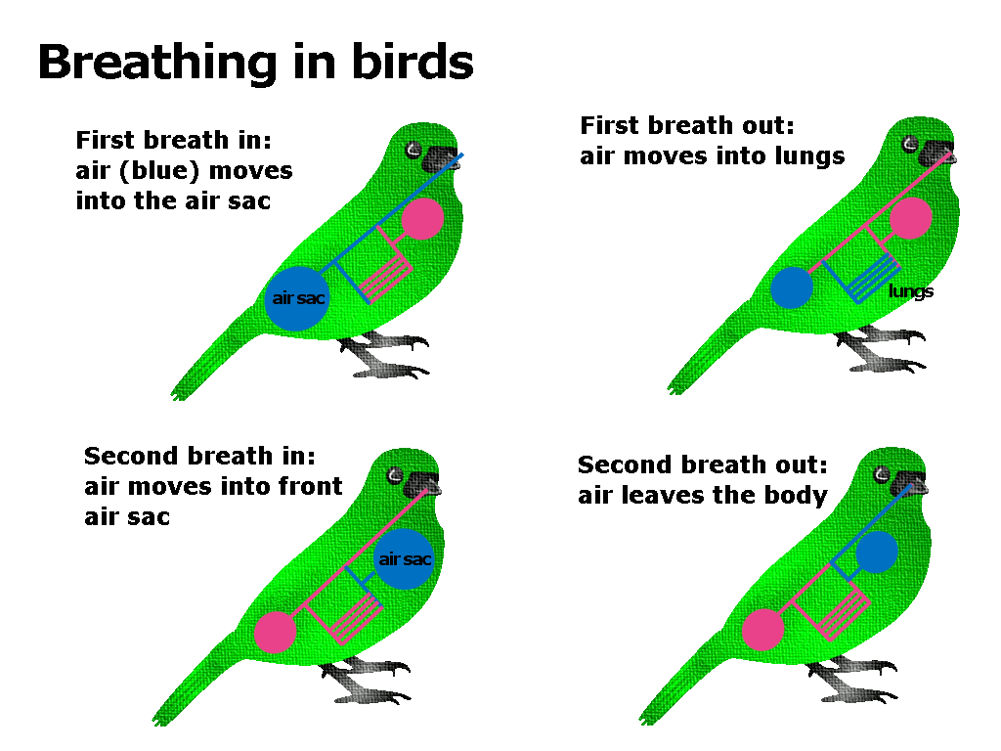
33-3 Form and Function in Chordates

Slide 21
33-3 Form and Function in Chordates
Circulation
Lancelets and tunicates have short tubelike hearts with a simple pump, no true chambers in heart or no true heart
Single loop circulation-animals that have gills
Blood moves from heart to gills to body to heart
Double loop circulation-animals that have lungs
Blood moves from heart to lungs to heart to body to heart

Slide 22
33-3 Form and Function in Chordates
Heart Chambers
Partitions evolved that separate oxygen rich and poor blood
Fish-2 chambers, one atrium, 1 ventricle, some mixing of blood
Most reptiles-3 chambers, 2 atria, 1 ventricle with partial division, some mixing of blood
Crocs, birds, mammals-2 atria, 2 ventricles, no mixing of blood

Slide 23
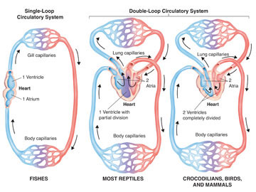
33-3 Form and Function in Chordates

Slide 24
33-3 Form and Function in Chordates
Excretion
Ammonia must be eliminated or converted to urea
Tunicates-ammonia leaves through outflow siphons
Vertebrates-kidneys
Aquatic amphibians and most fish also excrete ammonia through gills
Land animals-urea or uric acid excreted by kidneys
Also maintain water and salt levels

Slide 25
33-3 Form and Function in Chordates
Response
Non-vertebrate chordates have simple nervous systems with a mass of neurons that form the brain
No specialized sensory organs but may have sensory cells
Vertebrates have complex brains with regions that perform different functions
Cephalization of sense organs and neurons

Slide 26
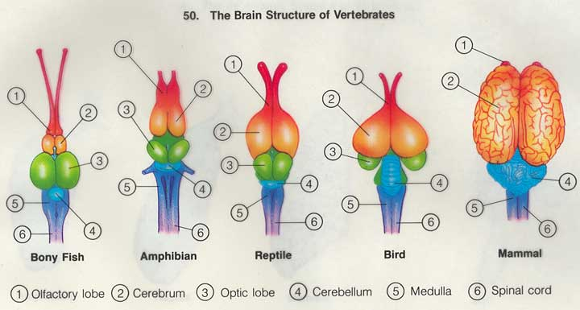
33-3 Form and Function in Chordates

Slide 27
33-3 Form and Function in Chordates
Movement
Non-vertebrates lack bones but have muscle, use muscle contraction or water flow to move
Vertebrates have skeletal and muscular systems internal skeletons (except hag fish)
Bones or cartilage
Backbone with vertebrae
Limb girdles that appendages attach to

Slide 28
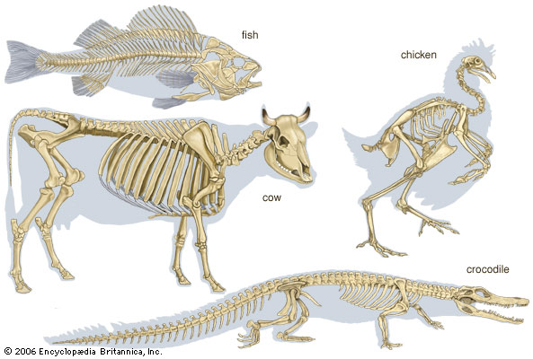
33-3 Form and Function in Chordates

Slide 29
33-3 Form and Function in Chordates
Reproduction
Almost all reproduce sexually
Trend is from external to internal fertilization
Oviparous- fertilized egg develops outside body
Ovoviviparous-fertilized egg develops inside body, nutrients from yolk in egg, young born alive
Viviparous-fertilized egg develops inside body, nutrients directly from mother, young born alive

Slide 30
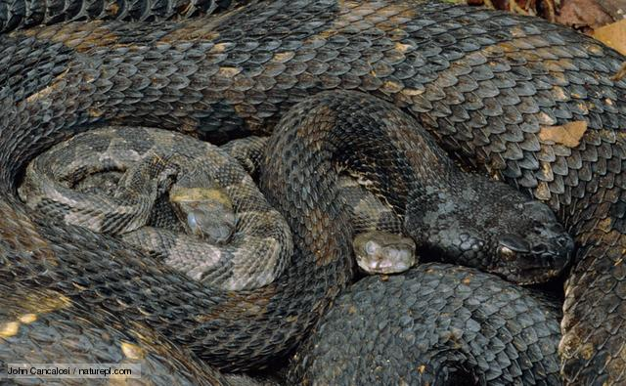
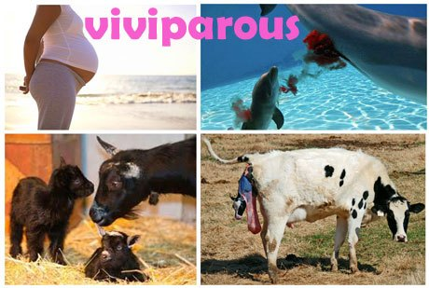
33-3 Form and Function in Chordates

