Slide 1
The Skeletal, Muscular and Integumentary Systems
Chapter 36

Slide 2
36-1 The Skeleton
Functions:
Supports body
Protects organs
Provides movement
Stores minerals
Provides site for blood cell formation

Slide 3
36-1 The Skeleton
Structure
206 bones in adult
Axial-supports center of body, includes skull, vertebral column and rib cage
Appendicular-includes arms, legs, pelvis and shoulders

Slide 4
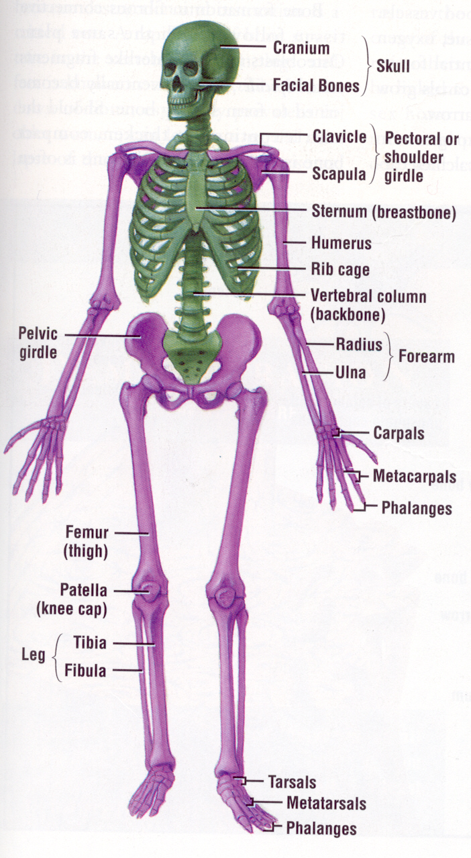

Slide 5
36-1 Structure of Bones
Most of the mass is minerals (salts)
A solid network of living cells and protein fibers surrounded by calcium and phosphorus

Slide 6
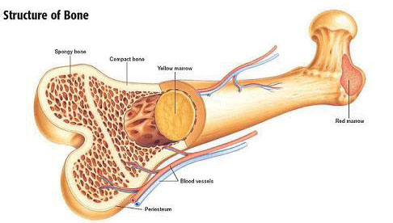
36-1 Structure of Bones
Outer layer
Periosteum-tough layer of connective tissue
Blood vessels inside to carry oxygen and nutrients to bones

Slide 7
36-1 Structure of Bones
Compact bone
Thick, dense, not solid
Haversian canals run through that have blood vessels and nerves
Spongy layer on inside at end of long bones and center of short flat bones, provides latticework/structure without a lot of mass

Slide 8
36-1 Structure of Bones
Bone marrow
Yellow-mainly fat cells
Red-produce red blood cells, some white blood cells and platelets

Slide 9
36-1 Structure of Bones

Slide 10
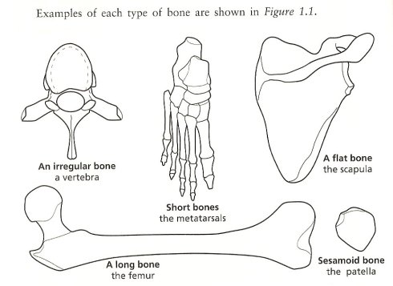
36-1 Structure of Bones

Slide 11
36-1 Development of Bones
As newborns, comprised of cartilage
Cartilage cells in a network of protein fibers-collagen, elastin. Dense, fibrous supportive and flexible
As we age, ossification (bone formation) occurs-cartilage is replaced by bones

Slide 12
36-1 Development of Bones
Osteoblasts create bone
Osteo-bone
Blast-cells that form new cells
Osteoclasts break down bone
Osteo-bone
Clast-cells that break cells

Slide 13
36-1 Development of Bones
Ossification-begins 7 months before birth
Osteoblasts secrete mineral deposits
Osteoblasts become surrounded by bone and become osteocytes (-cyte=cell)
Occurs at end of bones at growth plates
Stops when you stop growing

Slide 14
36-1 Development of Bones
Also occurs when bones are broken
Osteoclasts remove damaged bone
Osteoblasts provide new bone
Cartilage remains in places where flexibility is needed
Tip of nose, external part of ears, where rib bones are attached to sternum (breast bone at center of rib cage)

Slide 15
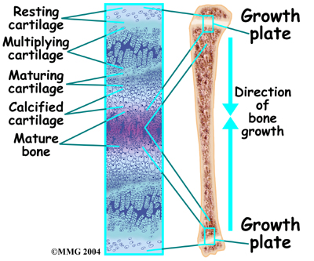
36-1 Development of Bones

Slide 16
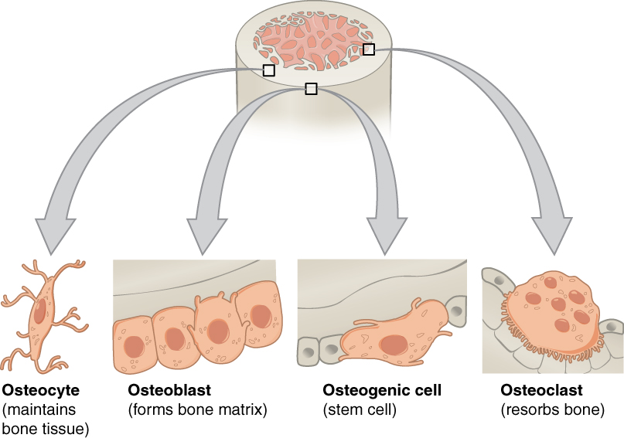
36-1 Development of Bones

Slide 17
36-1 Types of Joints
Immovable-bones in skull
Slightly movable-joints between vertebrae
Freely moving joints-ball and socket, pivot, hinge, saddle joints

Slide 18
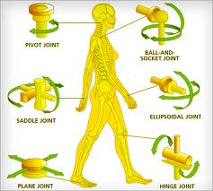
36-1 Types of Joints

Slide 19
36-1 Structure of Joints
In freely movable joints, ends are covered by cartilage to protect bones from rubbing against each other
Surrounded by a fibrous joint capsule
Ligaments
Layer of cells that produce synovial fluid
Bursa are sacs of synovial fluid (knees, some other joints)

Slide 20
36-1 Structure of Joints
When tissue is damaged, inflammation is the body’s response
Swelling, redness, heat, pain
Bursitis-occurs in bursa
Arthritis-100 types, affects 10% world’s population

Slide 21
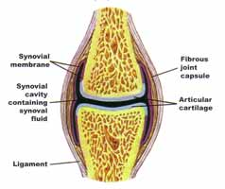
36-1 Structure of Joints

Slide 22
36-2 The Muscular System
40% of mass of your body is muscle
Function:
Moves bones, maintains blood pressure, moves food through digestive system, all movement

Slide 23
36-2 The Muscular System
Three types of muscle
Skeletal
Smooth
Cardiac

Slide 24
36-2 The Muscular System
Skeletal muscle
Attached to bone
Voluntary movement, most controlled by CNS
Under microscope, alternating light and dark bands-striations
Large (1mm-30 cm) and multinucleated
Made of muscle fibers, connective tissue, blood vessels and nerves

Slide 25
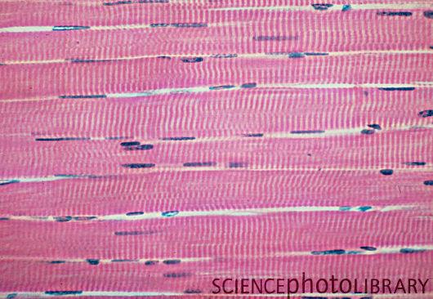
36-2 Skeletal Muscle

Slide 26
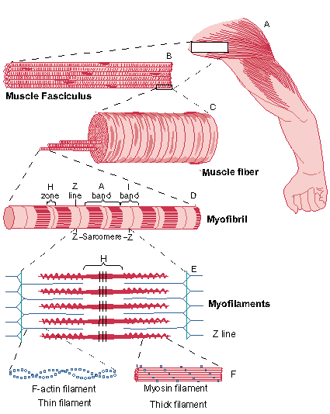
36-2 Skeletal Muscle
Muscle
Bundle muscle fibers
Muscle fiber (cell)
Myofibril
Z disc and sarcomere
Myosin, actin

Slide 27
36-2 Smooth Muscle
Usually not under voluntary control
Spindle shaped
Not striated
Not multinucleated
Found in hollow structures-intestines, blood vessels
Most can function without nervous stimulation, are connected to each other trough gap junctions so nerve impulses can pass from one cell to the next

Slide 28
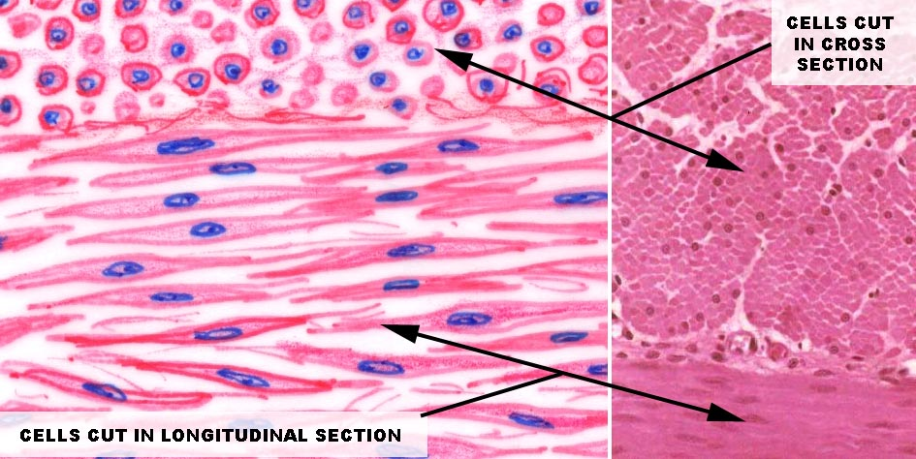
36-2 Smooth Muscle

Slide 29
36-2 Cardiac muscle
Found only in heart
Striated
Cells smaller than skeletal muscle
One or two nuclei
Can function without nervous stimulation, are connected to each other trough gap junctions so nerve impulses can pass from one cell to the next

Slide 30
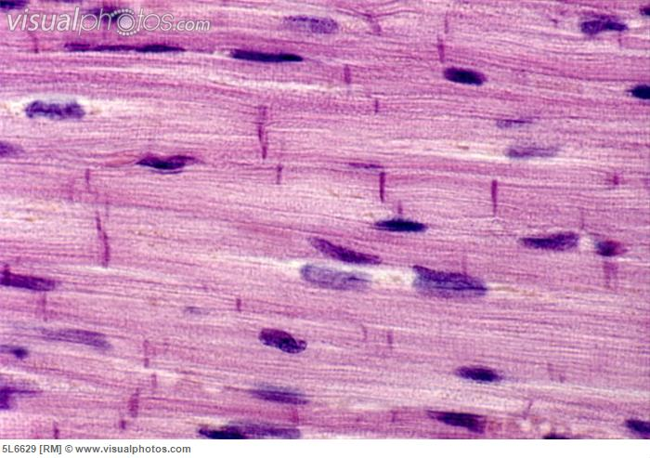
36-2 Cardiac muscle

Slide 31
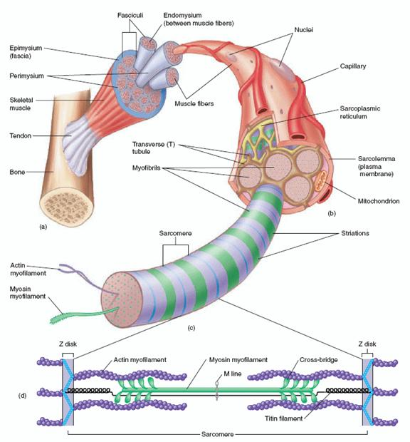
36-2 Muscle Contraction
Myofibrils
Myofilaments
Thick and thin
Myosin and actin

Slide 32
36-2 Muscle Contraction
Contraction occurs when thick and thin filaments (myosin and actin proteins) move past each other
Cross bridges form between the two protein molecules
Cross bridge changes shape, pulls on actin filament which slides toward center of sarcomere (smallest unit of muscle proteins that can contract) and distance between the Z discs (ends of sarcomeres) decreases
Cross bridge released
Process repeated

Slide 33
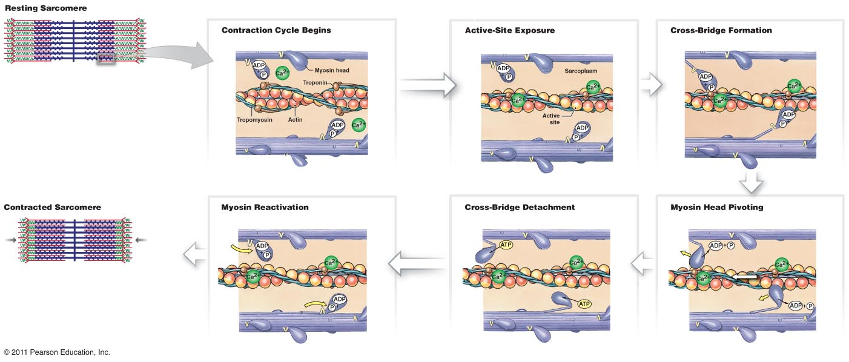
36-2 Muscle Contraction

Slide 34
36-2 Control of muscle contraction
Skeletal muscle must contract in a controlled fashion
Controlled by CNS and PNS, brain to motor neurons to muscle

Slide 35
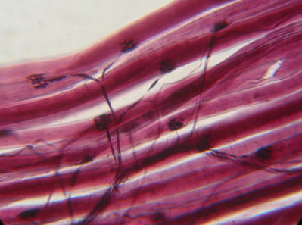
36-2 Control of muscle contraction
Neuromuscular junction-where motor neuron meets muscle

Slide 36
36-2 Control of muscle contraction
Pockets (vesicles) in axons of motor neuron release acetycholine
Acetycholine molecules diffuse across synapse
Causes an “impulse” that causes the release of Ca ⁺⁺ (Ca ²⁺, calcium ions)
Ca ²⁺ causes proteins to make actin and myosin form cross bridges to cause contraction

Slide 37
36-2 Muscle Contraction
https://www.youtube.com/watch?v=BMT4PtXRCVA

Slide 38
36-2 How muscles and bones interact
Skeletal muscles generate force by contracting and pulling on bones
Muscles are attached to bone by connective tissue called tendons
Tendons pull on bones and make them act as levers
Joint is the fulcrum
Usually several muscle pull the lever (bone) in different directions
Most skeletal muscles work as opposing pairs, when one contracts the other relaxes

Slide 39
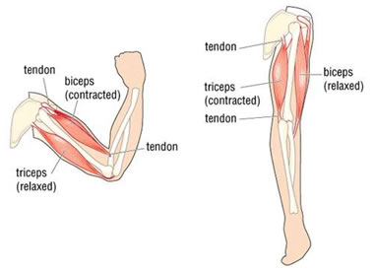
36-2 How muscles and bones interact

Slide 40
36-2 How muscles and bones interact
Skeletal muscle mainly partially contracted, some of the cells are contracted, some are not-resting muscle tone
Keeps back and legs straight
Regular exercise increases muscle tone
Muscles grow by making new material within the muscle cells
Muscles not used get smaller and weaker

Slide 41
36-3 The Integumentary System
The Skin-Functions
Barrier against infection and injury
Regulates body temperature
Removes waste products
Provides protection against UV radiation

Slide 42
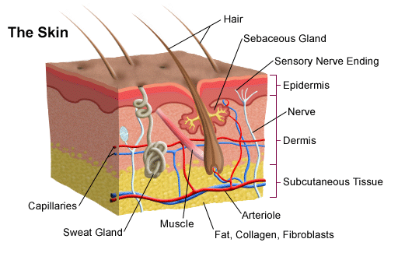
36-3 The Skin
2 main layers-epidermis, dermis
Underneath subcutaneous fat, connective tissue

Slide 43
36-3 The Skin
Epidermis
Outer layer of skin
No blood vessels
Outside made of dead cells
Inside made of living cells
Cells reproduce rapidly
Cells form keratin
Melanocyte-pigment cells-melanin

Slide 44
36-3 The Skin
Dermis
Inner layer of skin
Contains collagen, blood vessels, nerve endings, glands, sense organs, smooth muscles and hair follicles
Blood vessels narrow when cold, widen when hot to regulate body temperature (change surface area of heat exchange between cells and blood)

Slide 45
36-3 The Skin
Dermis (continued)
Two types of glands
Sebaceous glands-oil-secrets sebum which makes keratin waterproof
Sweat glands-perspiration (water, salts, minerals) evaporates to regulate body temperature

Slide 46
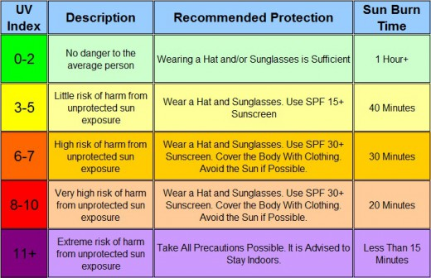
36-3 UV Index

Slide 47
36-3 Monthly UV Index in San Jose 2014
Month Average
January 2.0
February 2.79
March 4.74
April 7.3
May 8.42
June 9.61
July 10.03
August 8.55
September 7
October 4.57
November 2.63
December 1.69

Slide 48
36-3 Hair and Nails
Basic structure is keratin (same as bird feathers, reptile scales)
Hair-protects from UV, provides insulation, prevent dirt and particles from entering eyes, nose, ears
Grow from hair follicles that are in close contact with sebaceous glands
Cells fill in with keratin as they grow, then die

Slide 49
36-3 Hair and Nails
Nails-protect tips of fingers and toes
Grow from nail root
Cells fill in with keratin as they grow, then die
Fingernails-3mm per month, toenails 4X as fast

Slide 50
36-2 Uses and Making of artificial skin
https://www.youtube.com/watch?v=5A3VlwNHGII

