Slide 1
Circulatory and Respiratory Systems
Chapter 37

Slide 2
37-1 Functions of the Circulatory System
Transport of oxygen, nutrients and waste
Humans are too big for this to occur through simple diffusion
Heart, blood vessels and blood

Slide 3
37-1 Heart
Hollow, size of clenched fist
Enclosed in a sac called pericardium
In heart wall, thick muscle called myocardium
Contracts about 72 times per minute
Pumps 70 ml blood per contraction
During a year pumps enough blood to fill an Olympic sized pool

Slide 4
37-1 Heart
Septum divides the heart into 2 halves
Upper chamber-2 atria-receives blood
Lower chamber-2 ventricles-pumps blood out of the heart
4 chambers total

Slide 5
37-1 Heart
Acts as two separate pumps
Right ventricle pumps blood to lungs-Pulmonary circulation (CO₂ is released to the lungs)
Left atrium receives oxygen rich blood from lungs
Left ventricle pumps blood to body-systemic circulation
Right atrium receives oxygen poor blood from the body

Slide 6
37-1 Heart
Valves separate the atria and the ventricles
Blood moving into the atria hold the valves open
When ventricles contract, valves close so blood does not flow back into the atria
Valves prevent blood leaving the ventricles from flowing back in
Valves are one-way

Slide 7
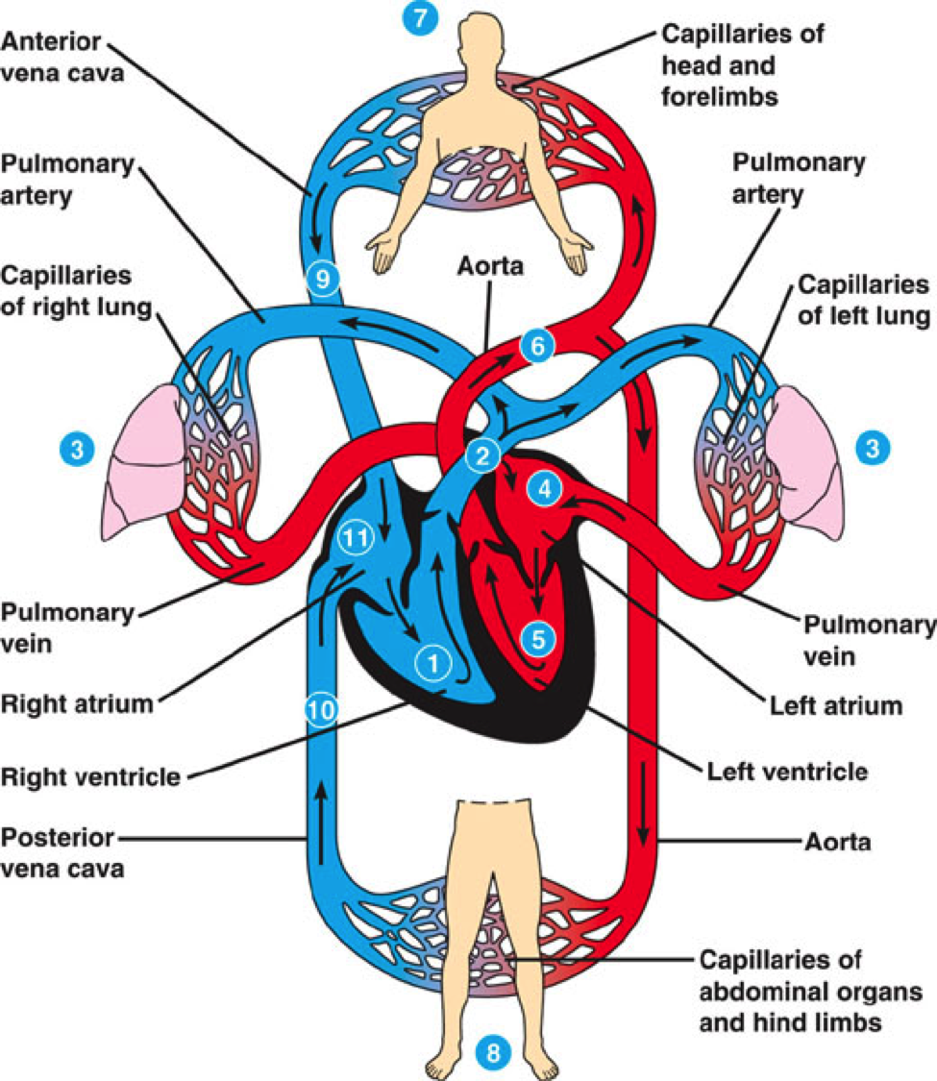
37-1 Heart

Slide 8
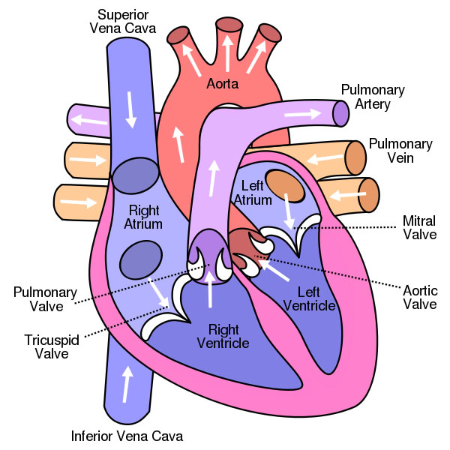
37-1 Heart

Slide 9
37-1 Heartbeat
Two networks of muscle fibers, one in atria, one in ventricles
When 1 fiber is stimulated, all fibers become stimulated (remember-signal transmitted through gap junctions between muscle fibers)
Each contraction begins in the right atrium-sinoatrial node-Pacemaker

Slide 10
37-1 Heartbeat
Impulse then spreads to all fibers in atria
Picked up by atrioventricular node and carried to muscle fibers in ventricles
When atria contracts, blood flows into ventricles
When ventricles contract blood flows out of heart

Slide 11
37-1 Heartbeat
Heart can beat up to 200 bpm when exercising and you need more oxygen in the body tissue
Autonomic nervous system controls heart rate
Neurotransmitters released by neurons in the sympathetic NS increase heart rate
Neurotransmitters released by neurons in the parasympathetic NS decrease heart rate

Slide 12
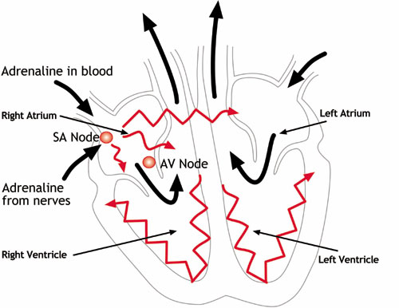
37-1 Heartbeat

Slide 13
37-1 Blood Vessels
Blood leaves the left ventricle through the aorta
Passes through arteries, capillaries, veins

Slide 14
37-1 Blood Vessels
Arteries-largest
Except for pulmonary artery, arteries carry oxygen rich blood
Thick walls that can withstand pressure produced when heart contracts and pushes the blood into the arteries
Walls contain connective tissue (elastic, allows expansion), smooth muscle (allows contraction) and epithelial cells

Slide 15
37-1 Blood Vessels
Capillaries
Smallest
Walls are only one cell thick, blood cells pass through in single file
Thin walls allow diffusion of oxygen, waste, nutrients

Slide 16
37-1 Blood Vessels
Veins
Returns blood from capillaries to the heart
Walls contain connective tissue and smooth muscle
Largest veins contain 1-way valves that keep blood flowing toward the heart
Many are located near skeletal muscle, muscle contraction helps force blood through the veins
Exercise helps keep blood from accumulating in the limbs and stretching the veins out of shape

Slide 17
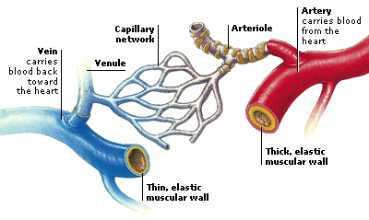
37-1 Blood Vessels

Slide 18
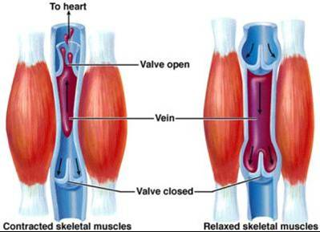
37-1 Blood Vessels

Slide 19
37-1 Blood Pressure
Pumps produce pressure
Force of blood on artery walls when heart contracts is blood pressure
Blood pressure decreases when the heart muscle relaxes
Sphygmomanometer measures blood pressure
First measurement is systolic pressure, when ventricles contract
Second measurement is diastolic pressure, when ventricles are relaxed

Slide 20
37-1 Blood Pressure
Blood pressure regulated by sensory neurons in several places in the body that signal back to the medulla oblongata
When pressure too high, autonomic NS releases neurotransmitters that cause the smooth muscle in the walls of the arteries and veins to relax, lowering BP
When pressure too low, autonomic NS releases neurotransmitters that cause the smooth muscle in the walls of the arteries and veins to contract, raising BP

Slide 21
37-1 Blood Pressure
BP also regulated by kidneys
Kidneys remove water from the blood to regulate BP
Hormones produced by the heart and other organs cause the kidneys to remove water from the blood when BP is too high, reducing blood volume and pressure

Slide 22
37-1 Disorders of the circulatory system
Atherosclerosis-fatty deposits (plaques) build up on walls of arteries
Can get large and obstruct blood flow and cause increased BP
Plaques can increase chances of getting blood clots
Clots can break free and obstruct blood flow to the brain, heart or lungs

Slide 23
37-1 Disorders of the circulatory system
High BP-hypertension
Forces the heart to work harder which can damage or weaken the heart muscle and blood vessels
People with high BP are more likely to have heart disease or other diseases of the circulatory system like heart attack or stroke

Slide 24
37-1 Disorders of the circulatory system
Heart attack-Herat muscle dies due to lack of oxygen
Caused by blockage of flow of blood to heart
Symptoms-nausea, shortness of breath, severe crushing chest pain

Slide 25
37-1 Disorders of the circulatory system
Stroke-blood clot in a vessel that leads to the brain, or a blood vessels that bursts
Brain cells die due to lack of oxygen
Can cause paralysis, loss of ability to speak or death

Slide 26
37-1 Prevention of Disorders of the circulatory system
Easier to prevent than cure
Exercise, weight control, sensible diet, not smoking
Exercise increases strength of cardiac and smooth muscle, controls weight and body fat and reduces stress

Slide 27
37-2 Blood and Lymphatic system
Blood is a connective tissue
Contains dissolved substances and specialized cells
Collects oxygen from lungs, nutrients from digestive tract and waste products from tissues
Helps regulate factors in the body like temperature
Blood components fight infections and form clots to repair damaged blood vessels

Slide 28
37-2 Blood and Lymphatic system
Blood Plasma
Body contains 4-6 liters of blood, 8% of body mass
45% of blood is cells
55% is plasma, a straw colored liquid
Plasma is 90% water, 10% dissolved gases, salts, nutrients, enzymes, hormones, waste products and plasma proteins

Slide 29
37-2 Blood and Lymphatic system
Blood Plasma (continued)
Three plasma proteins
Albumins, globulins transport fatty acids, hormones and vitamins
Albumins regulate osmotic pressure and blood volume
Some globulins fight infections
Fibrinogen helps clot blood

Slide 30
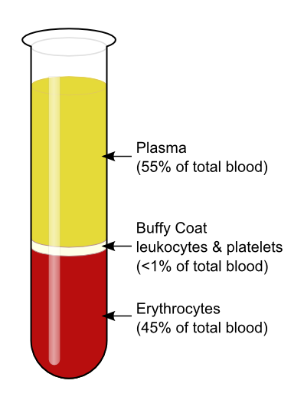
37-2 Blood and Plasma

Slide 31
37-2 Blood Cells
Red blood cells (RBC’s), also called erythrocytes
Most abundant
1 ml blood contains 5 million cells (5x10 ⁶ )
Transport oxygen
Color is from protein hemoglobin
Hemoglobin contains iron which binds to oxygen and transports it from lungs to tissues

Slide 32
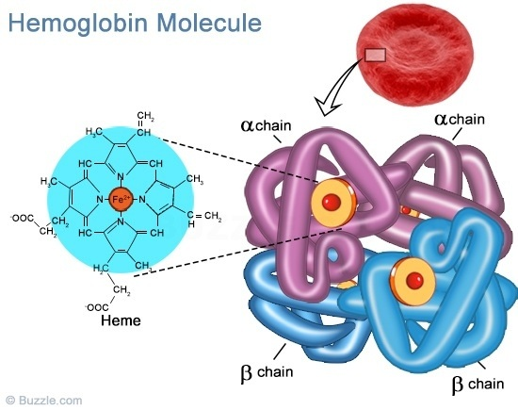
37-2 Blood Cells
Hemoglobin structure

Slide 33
37-2 Blood Cells
RBC’s produced in bone marrow
No nuclei or organelles (forced out as hemoglobin builds up in cells)
Circulate for 120 days
Get worn out by squeezing through capillaries
Destroyed in liver and spleen

Slide 34
37-2 Blood Cells
White blood cells (WBC’s)-also called leukocytes
Outnumbered by RBC’s 700-1
Produced in marrow
Have nuclei
No hemoglobin
Some live for months, others live for days

Slide 35
37-2 Blood Cells
WBC’s (continued)
Attack foreign substances or organisms, including cancer cells, substances that cause allergic reactions and transplanted organs
Phagocytes engulf and digest foreign cells
Some WBC’s cross through the capillaries and attack invading organisms in body tissue
Some WBC’s release chemicals that fight disease and resist infection
Body can increase numbers of WBC’s when infection occurs

Slide 36
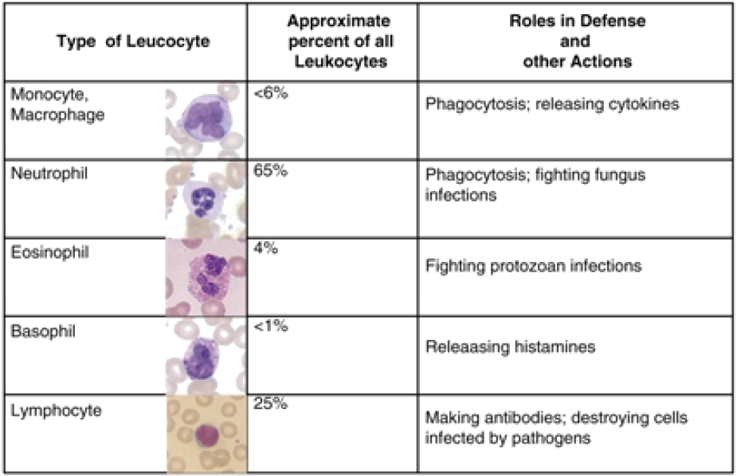
37-2 Types of WBC’s

Slide 37
37-2 Blood Cells
Platelets and blood clotting
Blood clotting occurs by plasma proteins and platelets (fragments of cells broken down in the bone marrow and released into the blood)
When platelets contact the edge of a broken blood vessel, their surface becomes sticky, and platelets cluster up
Platelets release clotting factors that start a series of chemical reactions that converts fibrinogen (in the plasma) into a sticky mesh of fibers that stop the bleeding

Slide 38
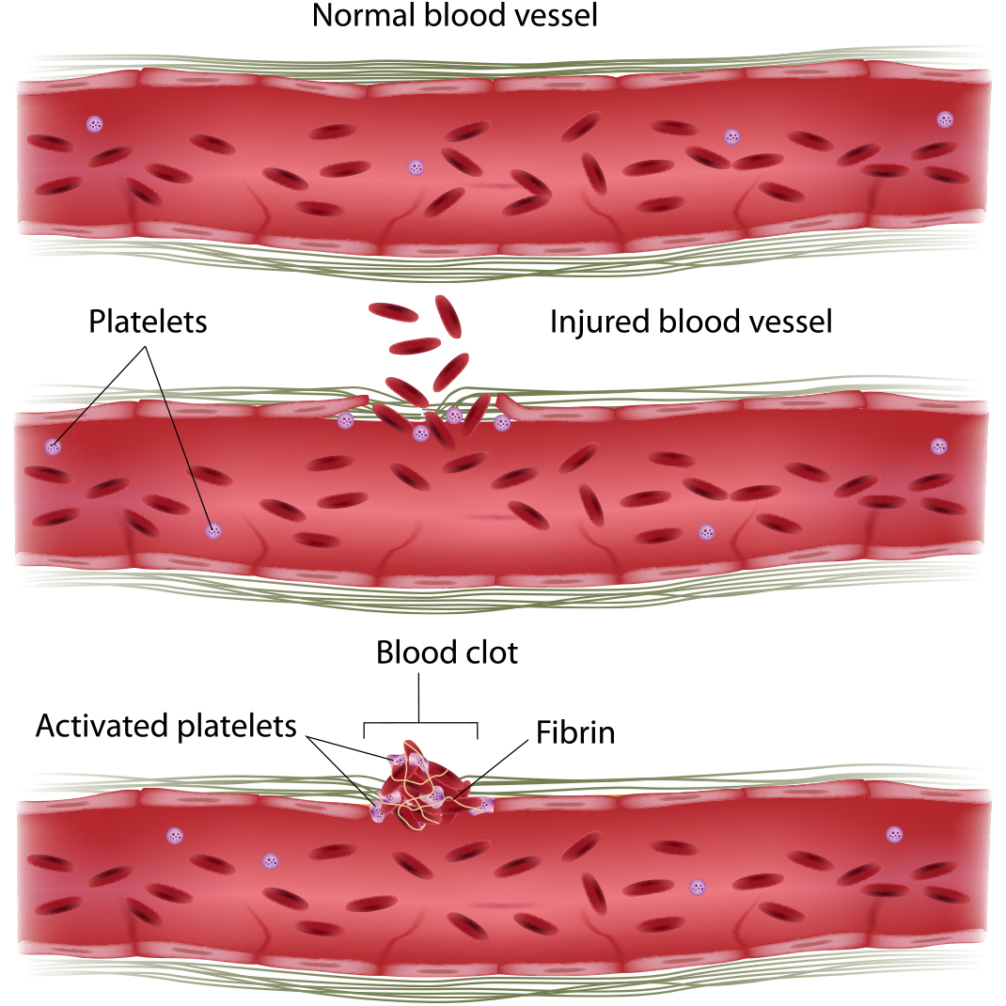
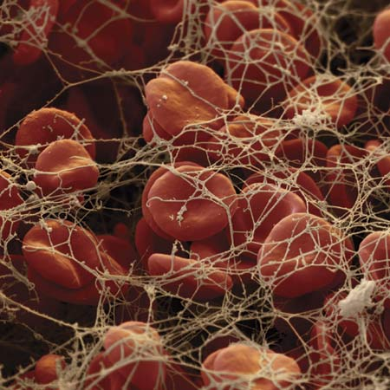
37-2 Blood Clotting

Slide 39
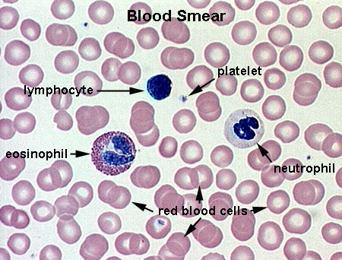
37-2 Blood Cells

Slide 40
37-2 Lymphatic System
Some fluid leaks out of the blood into surrounding tissue
Helps to move salts and nutrients into tissues
Fluid needs to be returned to the blood to restore the blood volume
Network of vessels called lymphatic system returns the lymph fluid to blood
Collects in lymphatic capillaries, slowly flows into larger vessels called lymph nodes
Ducts from lymph nodes return lymph to blood
Also line intestines and help absorb vitamins A,D,E,K

Slide 41
37-2 Lymphatic System
Fluid moves by osmotic pressure
When fluid is not returned from tissue, causes edema, or swelling

Slide 42
37-2 Lymphatic System

Slide 43
37-3 Respiratory System
Respiration
At cellular level, release of energy from food in the presence of oxygen, produces ATP, and cells produce CO₂ which is carried away from the cells
At the System level, function of respiration is to exchange oxygen and CO₂

Slide 44
37-3 Respiratory System
Organs in respiratory system
Nose, pharynx, larynx, trachea, bronchi, lungs
Epiglottis is a flap of tissue that closes over your trachea when you swallow

Slide 45
37-3 Respiratory System
Air entering lungs must be warm, moist and filtered
Air warms up as it passes through the Nose, pharynx, larynx and trachea
Air gets moistened with mucous
Air gets filtered by small hairs called cilia

Slide 46
37-3 Respiratory System
Larynx-vocal cords-elastic muscles that vibrate when air passes between them to make your voice
Trachea-wind pipe
Bronchi-2-each one leads to a lung
Bronchioles-smaller than bronchi-surrounded by smooth muscle that can expand or contract as directed by the autonomic NS

Slide 47
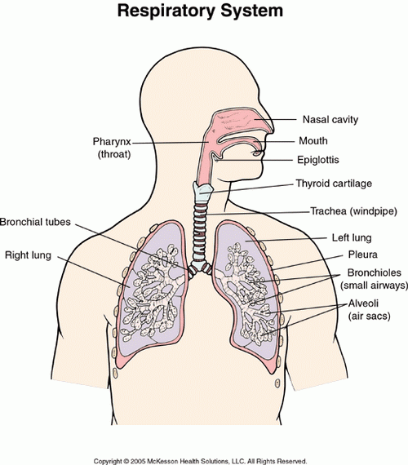
37-3 Respiratory System

Slide 48
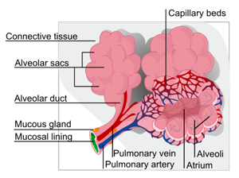
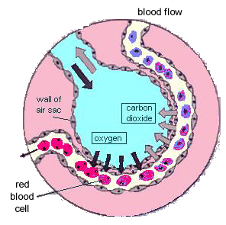
37-3 Respiratory System
Alveoli are in the bronchioles
350X10 ⁶ in a healthy lung
Gas exchange occurs here
Lots of capillaries, therefore surface area for gas exchange

Slide 49
37-3 Respiratory System
Gas Exchange
O₂ diffuses into capillaries, CO₂ diffuses out
Air is 21% O_{2,} .04% CO₂
Exhaled air is 15% O_{2,} 4% CO₂
Hemoglobin increases the efficiency of the oxygen carrying capacity of the lungs by 60 fold
Without Hb, you would need 300 L of blood to get the same results

Slide 50
37-3 Respiratory System
Breathing
Lungs do not have muscle, air moves in and out of lungs by changes in pressure
Diaphragm, a large flat muscle contracts and expands the volume in the chest cavity causing the pressure outside lungs to be less than inside. This makes air flow into the lungs due to atmospheric pressure

Slide 51
37-3 Respiratory System
Diaphragm relaxes and decreases the volume in the chest cavity causing the pressure outside lungs to be greater than inside. This makes air flow out of the lungs
Chest cavity must be sealed for this to work
A puncture to the chest cavity will allow air to leak in and make breathing impossible

Slide 52
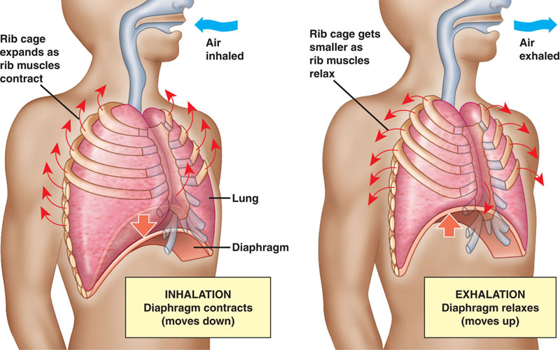
37-3 Respiratory System

Slide 53
37-3 Respiratory System
How breathing is controlled
Medulla oblongata is the breathing center in the brain
Autonomic nerves come from the Medulla oblongata to the diaphragm and chest muscles
Cells in the Medulla oblongata sense CO₂ levels
CO₂ too high, diaphragm contracts
Why could sensing CO₂ instead of O₂ be a problem?

Slide 54
37-3 Respiratory System
Diseases caused by smoking
Chronic bronchitis, emphysema, chronic obstructive pulmonary disease (COPD) and emphysema
Children who are exposed to second-hand smoke (passive smoking) are twice as likely to have respiratory disease

Slide 55
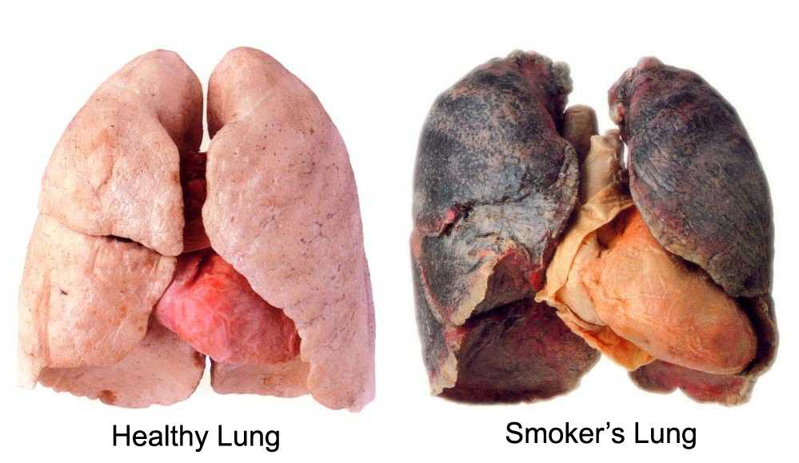
37-3 Respiratory System
Smoking and your lungs

Slide 56
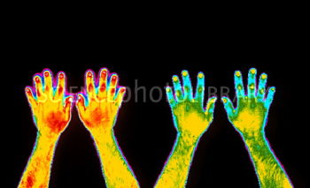
37-3 Respiratory System
Smoking and your circulation

