Slide 1
Endocrine and Reproductive Systems
Ch 39

Slide 2
39-1 Endocrine System
Endocrine system consists of glands that release their products into the blood stream
Like a radio broadcast system

Slide 3
39-1 Endocrine System
Hormones- chemicals that travel through the blood and affect activities of other cells (target cells)
Only work on cells with receptors for those hormones
Responses are slow and long lasting
Exocrine glands-release substances into ducts that lead to other organs (sweat, tears, digestive juices)
Endocrine glands-release hormones directly into blood

Slide 4
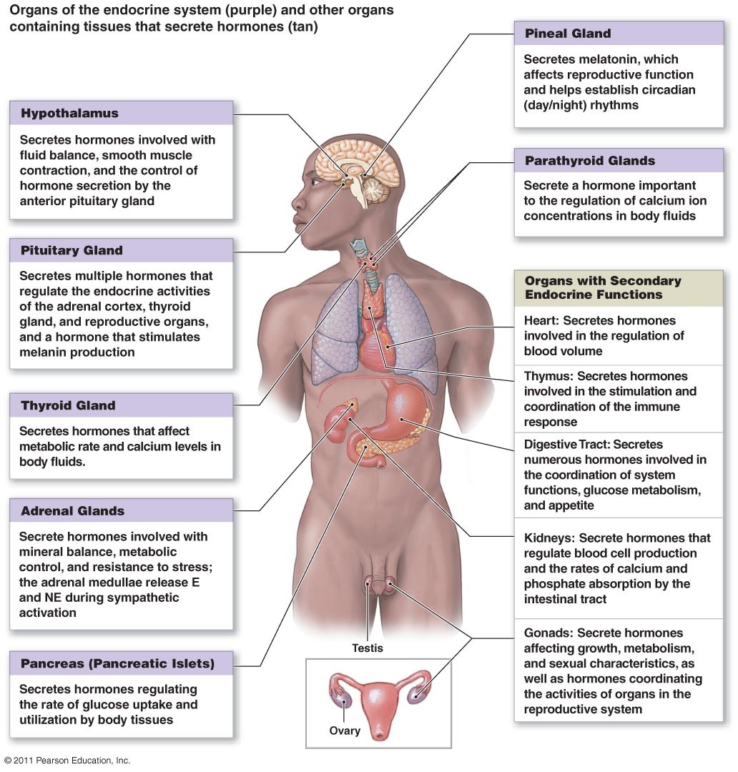
39-1 Endocrine System

Slide 5
39-1 Endocrine System
Hormone Action
Steroid and Non-steroid
Steroids
Lipids
Enters cell by passing through cell membrane
Binds to steroid receptor inside cell
Hormone-receptor complex enters nucleus
Initiates transcription and translation of new proteins

Slide 6
39-1 Endocrine System
Non-steroids
Bind to receptors on cell surface
Binding activates enzymes on inner surface of membrane
Messengers get activated (fatty acids, calcium, nucleotides)
Messengers activate or inhibit other activities

Slide 7
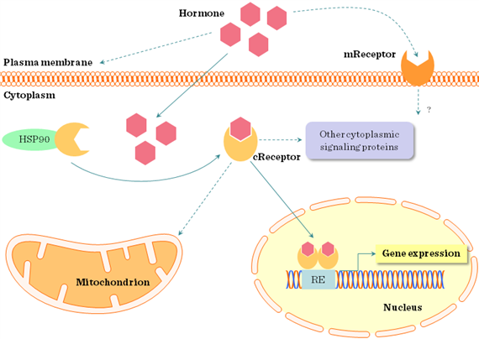
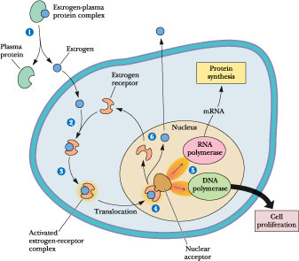
39-1 Endocrine System

Slide 8
39-1 Endocrine System
Prostaglandins-hormone like substances released in small amounts by all cells (except RBCs)
Modified fatty acids
Cause smooth muscles to contract, causes pain of some headaches (Aspirin block these)

Slide 9
39-1 Endocrine System
Control of endocrine system
Regulated by feedback to maintain homeostasis
Thyroxine
Released by thyroid gland
stimulates the activity of all cells
Controlled by hypothalamus and pituitary gland
Thyroxine low, thyroid releasing hormone (TRH)released, that stimulatest hyroid stimulating hormone (TSH) from pituitary, TSH stimulates release of thyroxine by thyroid
Also happens when body temperature drops

Slide 10
39-1 Endocrine System
Maintaining water balance and levels of Calcium, Sodium and Potassium, even when you are sweating
Hypothalamus senses water concentration in blood
As water decreases, concentration of salts increases
Hypothalamus signals pituitary to release anti-diuretic hormone (ADH), which goes to kidneys
Removal of water by kidneys slows down, you get thirsty
When water concentration increases, ADH secretion is slowed down, kidneys remove more water

Slide 11
39-1 Endocrine System
Complementary Hormone Action
Two hormones can have opposite effects
Calcium regulated by calcitonin (from thyroid gland) and parathyroid hormone (PTH, from parathyroid gland)

Slide 12
39-2 Human Endocrine Glands
Pituitary-bean shaped, on the brain stem
Secretes 9 hormones
Master regulator
Essential to good health
Growth hormone, anti-diuretic hormone (ADH), oxytocin, follicle stimulating hormone (FSH), leutinizing hormone (LH), thyroid stimulating hormone (TSH), adreno-corticotropic hormone, prolactin, melanocyte stimulating hormone (MSH)

Slide 13
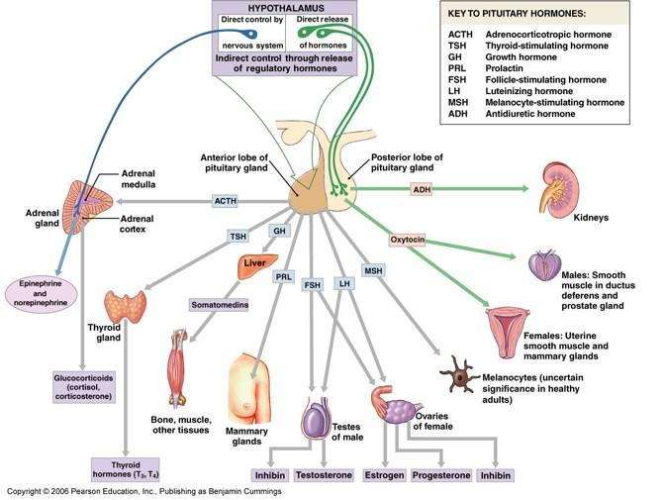
39-2 Pituitary Hormones

Slide 14
39-2 Human Endocrine Glands
Hypothalamus
Above and attached to pituitary
Affected by levels of other hormones in blood and input from CNS
Interactions between endocrine and NS take place here
Cell bodies of neurons from pituitary found in hypothalamus
When cell bodies stimulated, axons in posterior pituitary release hormones
Produces small amounts of releasing hormones that stimulate the anterior pituitary to release other hormones

Slide 15
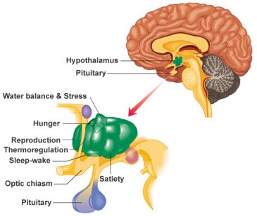
39-2 Hypothalamus

Slide 16
39-2 Human Endocrine Glands
Thyroid Gland
Base of neck, wraps around trachea
Regulates metabolism
Thyroxine-amino acid tyrosine and iodine
Regulates cellular respiration
Hyper- and hypo-thyroidism
Hyperthyroidism-nervousness, elevated body temp,heart rate, BP
Hypothyroidism-lack of energy, low body temp, nervous system and skeleton don’t develop properly (cretinism)

Slide 17
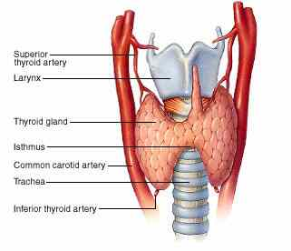
39-2 Thyroid Gland

Slide 18
39-2 Human Endocrine Glands
Parathyroid
On back of thyroid
Works with thyroid to maintain calcium levels in blood
PTH-parathyroid hormone increases resorption of calcium in the kidneys, increases uptake of calcium from digestive system, maintains proper nerve and muscle function and bone structure

Slide 19
39-2 Human Endocrine Glands
Adrenal Glands
Pyramid shaped, on kidneys
Help body prepare for and deal with stress
Cortex (outer, largest part)and medulla(inner)
Cortex produces more than 2 dozen hormones called corticosteroids
Aldosterone regulates resorption of sodium and excretion of potassium in kidneys
Cortisol controls metabolism of carbs, fats and proteins

Slide 20
39-2 Human Endocrine Glands
Adrenal Glands
Medulla
Release of hormones controlled by sympathetic nervous system
Epinephrine (80% of secretion of adrenal medulla), norepinephrine
Fight or flight response
Nervous or frightened
Increase heart rate, BP and blood flow to muscles, airways open, extra glucose in the blood
Causes a sudden burst of energy

Slide 21
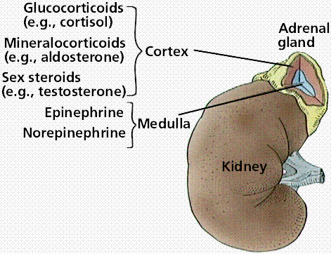
39-2 Adrenal glands

Slide 22
39-2 Human Endocrine Glands
Pancreas
Right side of and behind stomach
Digestive organ (exocrine)
Endocrine because also releases hormones into blood
Islets of Langerhans
beta cells-insulin-stimulates cells to take up glucose from blood
Alpha cells-glucagon-stimulates liver to break down glycogen (stored form of sugar) and release into blood

Slide 23
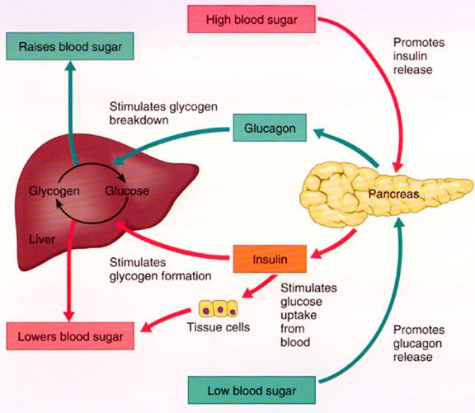
39-2 Pancreas

Slide 24
39-2 Pancreas
Diabetes
Can’t regulate blood sugar levels, damages tissues and organs, arteries, excrete glucose in urine
Type I-little or no secretion of insulin
Juvenile, born with it
Type II-cells don’t respond to insulin
Adult onset-poor diet and unhealthy lifestyle, no exercise

Slide 25
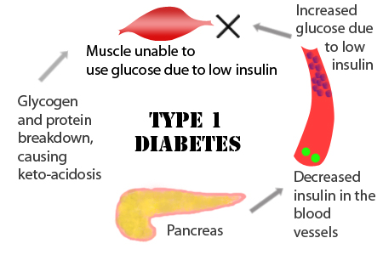
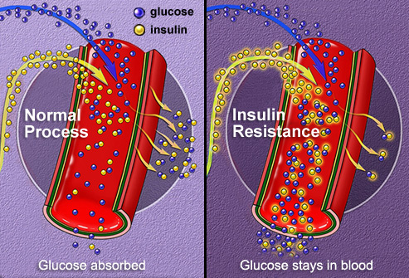
39-2 Diabetes

Slide 26
39-2 Reproductive glands
Gonads
Production of gametes
Secretion of hormones
Ovaries and testes

Slide 27
https://www.youtube.com/watch?v=WVrlHH14q3o

Slide 28
39-3 Reproductive system
Sex organs don’t develop until 7th week of development in utero
Controlled by hormones testosterone, estrogen and progesterone
Puberty is when sex organs are fully functional

Slide 29
39-3 Reproductive system
Male reproductive system
FSH and LH stimulates release of testosterone
Target cells all over body
Facial and body hair, growth, deepening of voice
FSH and testosterone make sperm develop
Testes (in the scrotum), epididymis, vas deferens, urethra, penis

Slide 30
39-3 Male Reproductive system
Within testes are tiny tubules called seminiferous tubules, sperm produced here
Sperm are derived from cells that undergo meiosis
Move to epididymis where they mature and are stored in nutrient rich seminal fluid
Then move through vas deferens to urethra
Released through penis when autonomic NS causes ejaculation
2-6 ml semen contain 200-600 million sperm

Slide 31
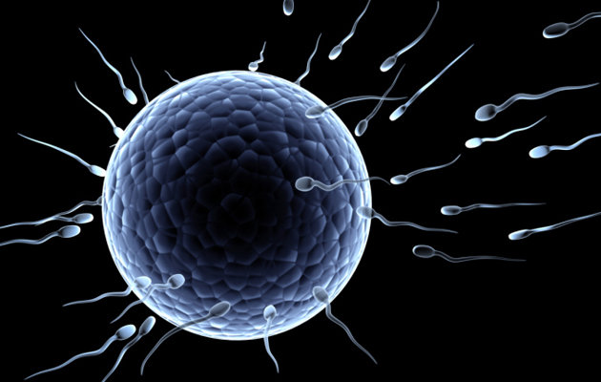
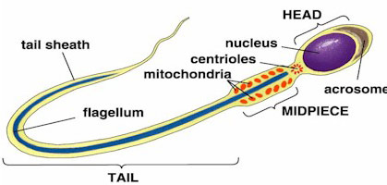
39-3 Male Reproductive system

Slide 32
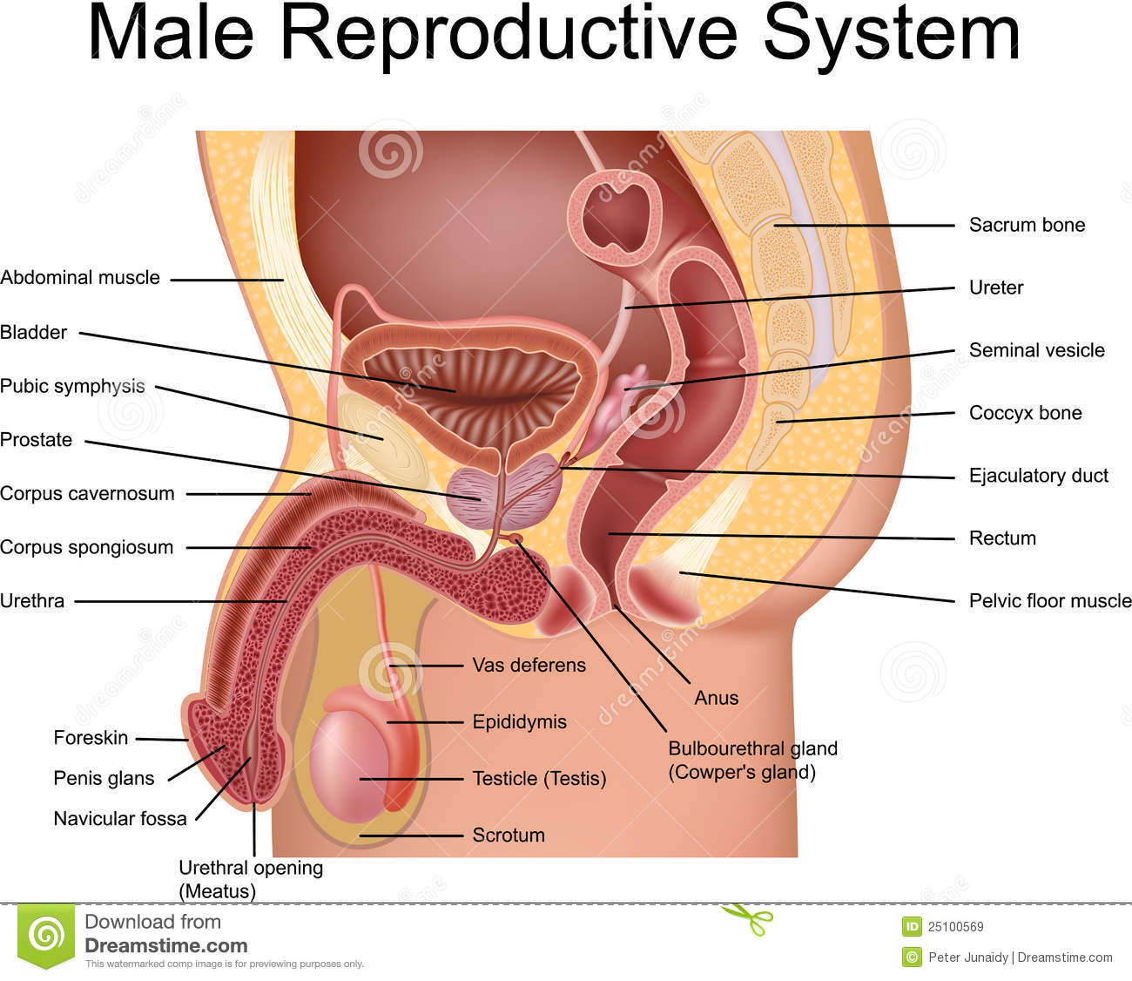
39-3 Male Reproductive system

Slide 33
39-3 Female Reproductive system
FSH and LH stimulate production of estrogen in ovaries
Target organs all over body
Maturation of reproductive system, widening of hips, breasts
Ovaries, fallopian tubes, uterus and vagina
Produces eggs and prepares body to nourish developing embryo
One ovum (egg) produced per month

Slide 34
39-3 Female Reproductive system
Development of egg
Occurs in primary follicles in ovary-400,000 per ovary
Cells in follicles help egg develop
Egg released into fallopian tube during ovulation
400 eggs released in a lifetime
Egg first undergoes meiosis when stimulating by FSH-forms 1 egg and 3 polar bodies
Egg can be fertilized in fallopian tube, then goes to uterus

Slide 35
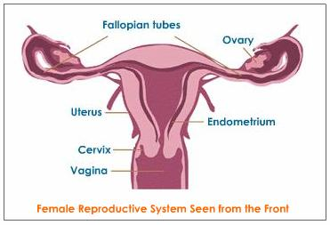
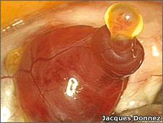
39-3 Female Reproductive system

Slide 36
39-3 Menstrual Cycle
Egg develops and is released
Mensis=month
Controlled by hormones and negative feedback mechanisms
4 phases
Follicular-estrogen low, hypothalamus produces hormone that goes to pituitary
Pituitary produces FSH and LH, which travel to ovaries
Makes cells surrounding egg produce estrogen which thickens lining of uterus
10 days

Slide 37
39-3 Menstrual Cycle
Ovulation
3-4 days
Hypothalamus send releasing hormone to pituitary which produces FSH and LH
Egg released into fallopian tube
Luteal phase
Begins after egg released
Ruptured follicle becomes corpus luteum which releases estrogen and progesterone, finishes preparing lining of uterus
During first 2 days are highest chance of fertilization (10-14 days after end of last menstrual cycle)
If egg is fertilized will start to divide, then implant in uterus

Slide 38
39-3 Menstrual Cycle
Menstruation
After 2-3 days after ovulation, if egg not fertilized, passes through uterus without implantation
Corpus luteum disintegrates
Less estrogen and progesterone produced
Lining of uterus detaches
After menstruation ends, cycle begins again

Slide 39
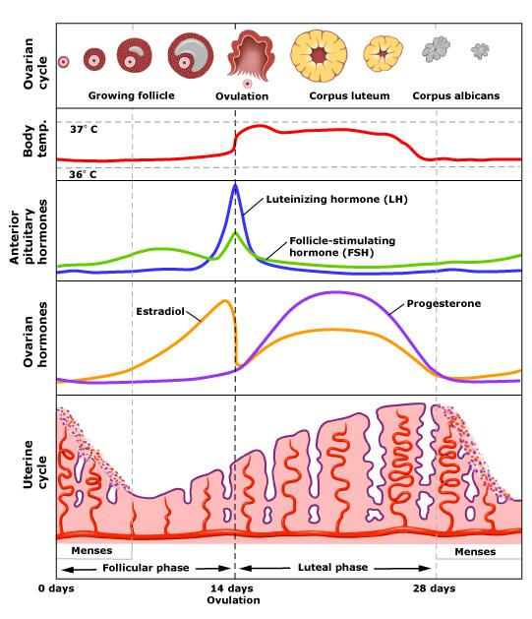
39-3 Menstrual Cycle

Slide 40
39-4Fertilization and Development
Fertilization-sperm joins egg to make a zygote
Divides until 8 cells in fallopian tube, then implants in uterus
50 cell stage-morula
Becomes a hollow blastocyst, then attaches to uterus (6-7 days after fertilization)-implantation

Slide 41
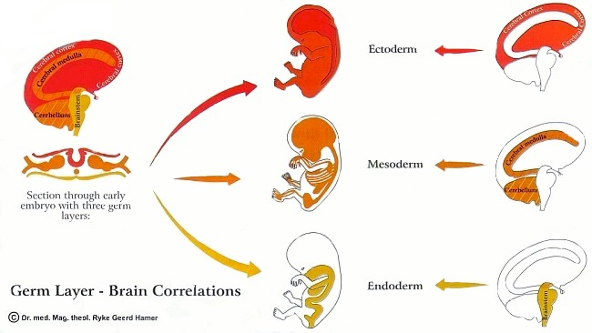
39-4Fertilization and Development
Gastrulation-blastocyst cells start to organize into layers
Ectoderm
Mesoderm
Endoderm
Primary germ layers
Blastocyst produces membranes that surround and protect embryo, amnion and chorion

Slide 42
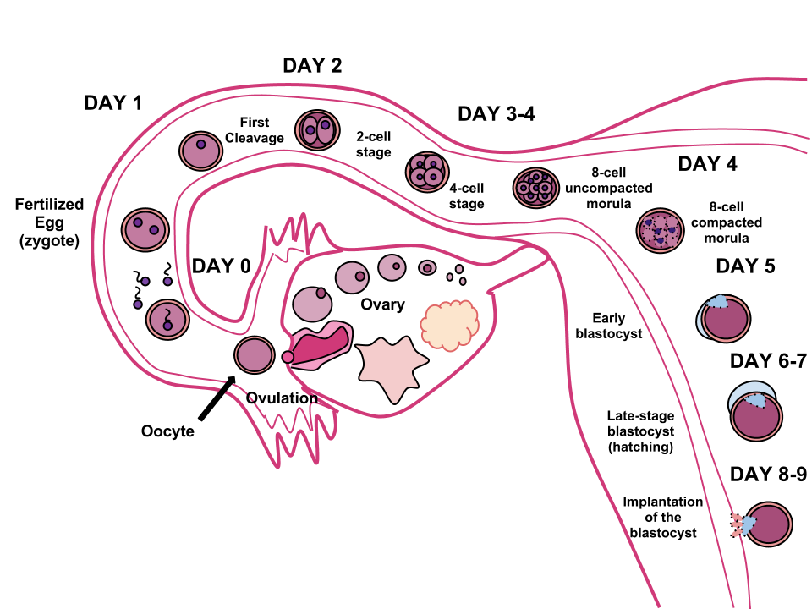
39-4 Fertilization and Early Development

Slide 43
39-4 Development
By end of third week, NS and digestive systems start to develop
Chorion grows into placenta
Fetal and mother’s blood are kept separate but pass near each other so that gases, nutrients and waste can diffuse (respiration, nourishment and excretion)

Slide 44
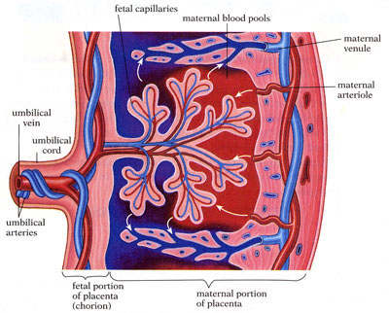
39-4 Development

Slide 45
39-4 Development
After 8 weeks embryo becomes a fetus
By three months most of tissues and organs are formed, including umbilical cord

Slide 46
Development of a human embryo
https://www.youtube.com/watch?v=UgT5rUQ9EmQ
http://www.babycenter.com/2_inside-pregnancy-early-fetal-development_10354436.bc

Slide 47
39-4 Later Development
By months 4-6, tissues and organs become more complex
After 6 months, fetus can survive outside placenta, but lungs are not fully developed until 8 months

Slide 48
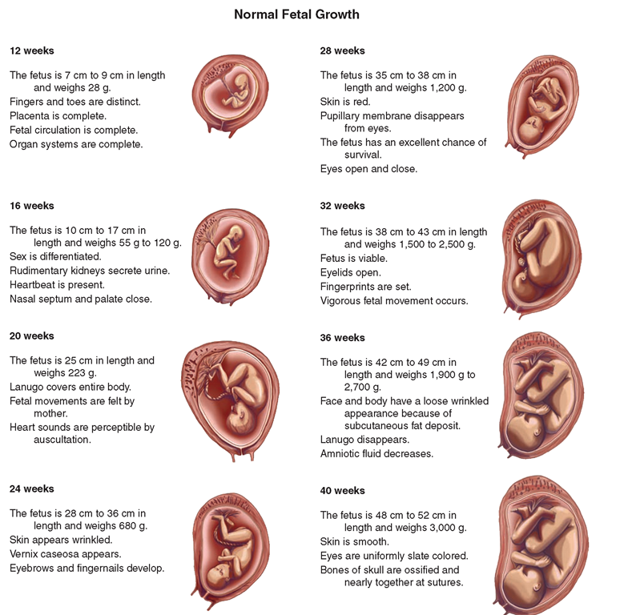
39-4 Later Development

Slide 49
39-4 Later Development
https://www.youtube.com/watch?v=RS1ti23SUSw

Slide 50
39-4 Birth
Hormone oxytocin is released from pituitary gland to start contractions of uterus
Cervix (opening of the uterus) widens or dilates
Baby usually born head first (if not, breach)
Placenta is expelled after baby born
Prolactin is released from pituitary to produce milk in breast tissue

Slide 51
39-4 Birth
Multiple births
2 eggs released in one menstrual cycle (fraternal twins)
One zygote splits in two (identical twins)

Slide 52
39-4 Early childhood development
Infancy-up to 12 months
Rapid growth and development, coordination of movement, teeth
Childhood- 1-13 years
Language acquired, motor skills refined, personality and social skills develop
Adolescence-puberty-adulthood
Sex hormones, growth, continued personality development

Slide 53
39-4 Adulthood
Highest level of physical strength and development between 25-35
Then physiological signs of aging begin
Mental and physical function
Reproductive capacity declines for females
Good health, diet and exercise important!

