Slide 1
The Immune System
Ch 40

Slide 2
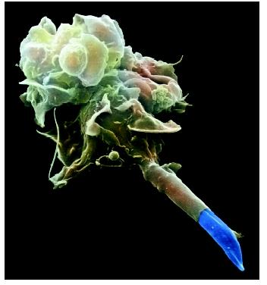
Macrophage engulfing a parasite

Slide 3
40-1
Disease-any change, besides injury, that interferes with normal body functions
Caused by inheritance, environmental factors or infectious agents (pathogens-bacteria, viruses, fungi, parasites)

Slide 4
40-1 Germ Theory of Disease
Louis Pasteur and Robert Koch
Infectious diseases are caused by microorganisms (germs)

Slide 5
40-1 Koch’s Postulates
1. Pathogen should be found in sick organism and not in a healthy one
2. The pathogen should be isolated and grown in pure culture
3. When pure pathogen is placed in a new host it gets the same disease as the original host
4. The injected pathogen should be reisolated and should be identical to the original

Slide 6
40-1 Agents of Disease
Humans are good hosts for many microorganisms-water, good temp, nutrients
Most are harmless
Pathogens cause disease
Produce toxins that disrupt cell function, live in and feed off of infected organism, remove nutrients from digestive system, use host cells to replicate itself
Fig 40-3

Slide 7
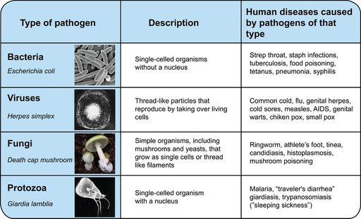
40-1 Pathogens and Disease

Slide 8
40-1 How Diseases Are Spread
Person to person through coughing, sneezing, physical contact
Contaminated food and water
Infected animals

Slide 9
40-1 How Diseases Are Spread
Vectors-when animals spread a disease from person to person
Tick, human, mosquito

Slide 10
40-1 Fighting Diseases
Prevention
Antibiotics
Penicillin-inhibits cell wall synthesis
Streptomycin-inhibits protein synthesis
Antivirals, antiretrovirals-stop virus from getting into cells or replicating
Antifungals-various mechanisms
Fungi are eukaryotic like humans so drugs must target some difference between fungus and humans
Harder to find good treatments without side effects

Slide 11
40-2 The Immune System
Nonspecific Defenses-like fortress walls
First Line of Defense
Skin-oil and sweat acidic
Mucous, cilia in mouth and nose
Acid and digestive enzymes in digestive system
Tears, saliva, mucous, sweat contain lysozyme (enzyme that breaks down cell walls of bacteria)

Slide 12
40-2 Nonspecific Defenses
Second Line of Defense-Inflammatory response
Response to toxins in tissue, or tissue damage caused by injury and infection
Blood vessels near injury expand and white blood cells leak out
Phagocytes engulf and destroy bacteria
Causes swelling and pain
Some immune cells also release chemicals that cause fever
Kills pathogens and speeds up enzyme activitythat repair damaged tissue

Slide 13
40-2 Nonspecific Defenses
Interferon-proteins that virus-infected cells produce that helps other cells resist infection
Inhibits production of viral proteins and block viral replication

Slide 14
40-2 Specific Defenses
Specific Defenses-like security guards
Immune response triggered by antigen
Humoral and Cell-mediated

Slide 15
40-2 Specific Defenses
Humoral Immunity-immunity against pathogens in blood and lymph fluids
Functional unit is antibody
Produced by B-lymphocytes
Antibodies are proteins that help destroy pathogens
Antibodies bind viruses and bacteria and clump them together so phagocytes can engulf and destroy them

Slide 16
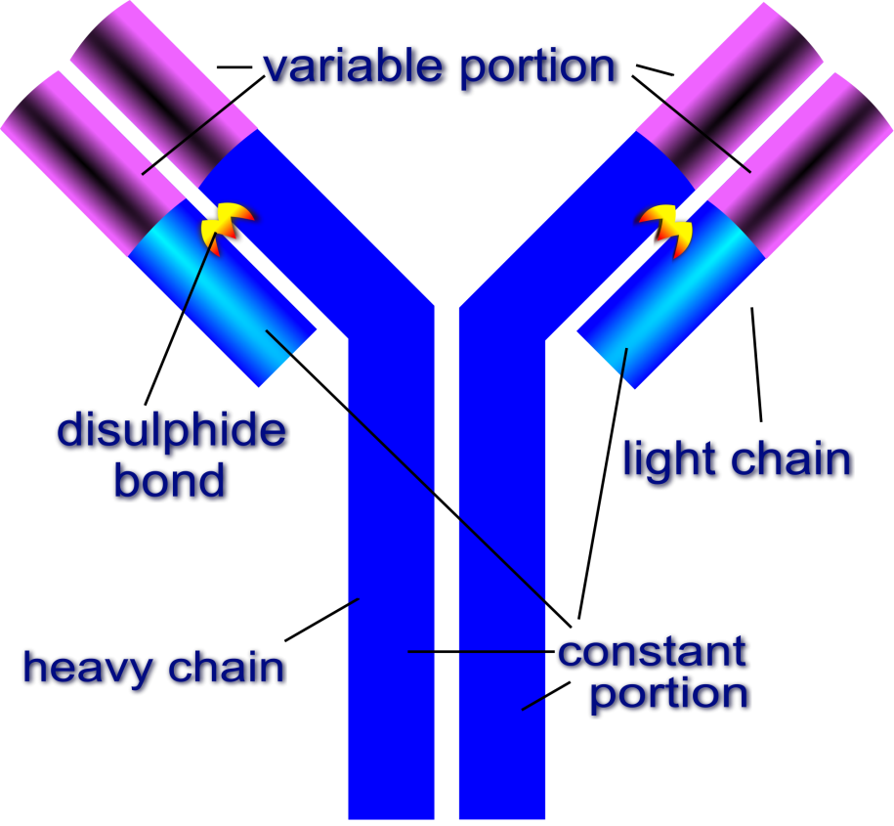
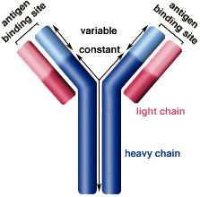
40-2 Antibodies

Slide 17
40-2 Specific Defenses
Antibody production
In B-lymphocytes genes rearrange to give different amino acid sequences in the variable antigen binding region so they make antibodies that recognize different antigens
When a pathogen invades the body only certain antibodies recognize it
This activates the B-plasma cells that produced those antibodies to divide and make more of those antibodies
Activation of B plasma cells is helped by T-lymphocytes/cells

Slide 18
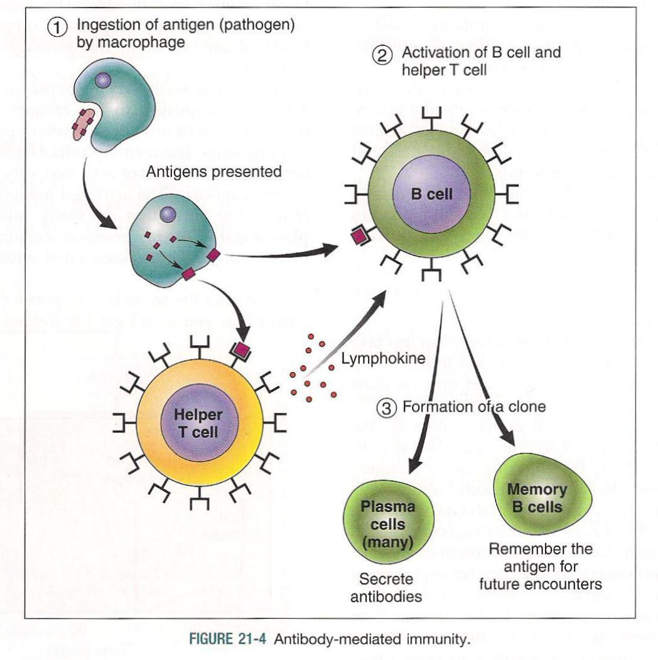
40-2 Humoral Immunity

Slide 19
40-2 Cell Mediated Immunity
T-cells help B-cells produce antibodies but can also attack antigen bearing cells directly
Killer or cytotoxic T cells can inject proteins into cell membrane of pathogen which causes fluid to leak out then cells die
Cell-mediated immunity
Causes organ rejection; anti-rejection drugs target this process

Slide 20
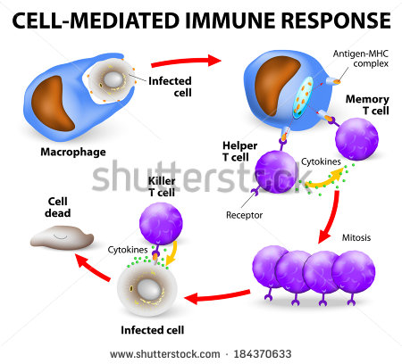
40-2 Cell Mediated Immunity

Slide 21
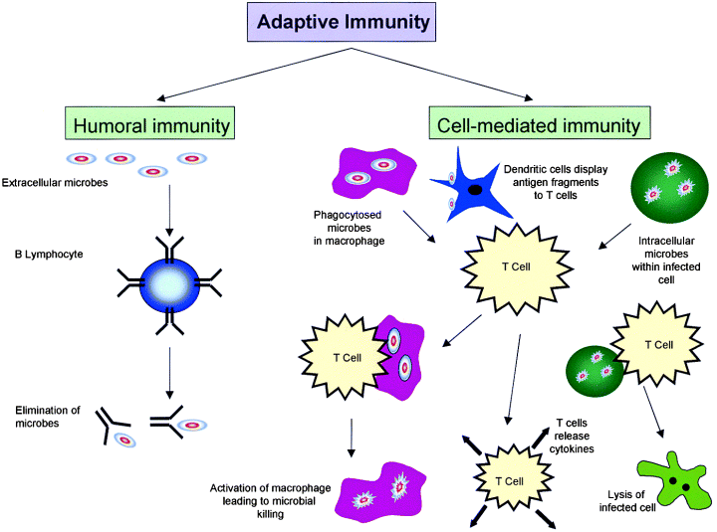
40-2 Adaptive Immunity

Slide 22
40-2 Permanent Immunity
Memory B and T cells remain capable of producing antibodies to a pathogen long after first exposure

Slide 23
40-2 Active Immunity
Vaccination-injection of weakened or inactivated form of a pathogen to produce immunity
Active immunity-body of recipient has the ability to mount an immediate immune response against the pathogen

Slide 24
40-2 Passive Immunity
Antibodies from another animal for a pathogen are injected
Gives short term immunity
Travelers
Maternal immunity through antibodies in milk or through placenta

Slide 25
40-3 Immune System Disorders
Allergies-overreaction to antigen
Antigens bind to mast cells in nasal passages
Activated mast cells produce histamines
Histamines increase blood and fluid flow to area
Antihistamines counteract

Slide 26
40-3 Immune System Disorders
Asthma is caused by allergic reaction
Smooth muscle in airways contract and narrow airways
Caused by specific antigens
Drugs relax smooth muscle

Slide 27
40-3 Immune System Disorders
Autoimmune Disease
Immune system attacks the body’s own cells
Strep throat can lead to autoimmune attack on cardiac muscle cells
Diabetes, arthritis, multiple sclerosis

Slide 28
40-3 Immune System Disorders
AIDS
Acquired immune deficiency syndrome
Caused by HIV (human immunodeficiency virus, a retrovirus) that attaches to T-cells and prevents them from activating B cells and fighting infections, eventually kills them
Susceptible to infections by fungal and protozoan infections, cancer
Drugs prevent DNA from being made from the virus genetic material, RNA
Reverse transcription

Slide 29
40-4 Cancer
Occurs when some molecular event that regulates cell growth goes wrong in the cell
Growing mass of cell is tumor
Spread of tumors beyond original tumor is metastasis
Changes in intercellular or intracellular signaling, transcription, post translational events

Slide 30
40-4 Causes of Cancer
Viruses-viruses can have genes that affect mitosis of host cells
Radiation-can mutate or break DNA
Chemicals-same as radiation
Mutations-changes genetic code, and therefore protein sequences, which affect normal functions of those proteins

Slide 31
40-4 Fighting Cancer
Regular checks
Treatments
Surgery-for localized tumors
Radiation-for localized tumors
Chemotherapy- for localized and metastasized cancer

Slide 32
40-4 Fighting Cancer
All affect dividing cells
Cancer cells divide more so are more susceptible to chemotherapy
All dividing cells are affected therefore side effects
Now analyzing cancer tissue for markers that indicate specific gene or protein changes and making drugs specific for these cancers so less side effects and more effective

