Slide 1
Cellular Respiration
Chapter 9

Slide 2
9.1 Chemical Pathways
1 g sugar stores 3811 calories
1 cal is the amount of heat required to raise 1 gram of H₂O 1 degree celsius
1Cal=1000 cal or 1 kcal
Energy is released from glucose in 3 stages-glycolysis, Krebs cycle and Electron Transport Chain (ETC). Each stage releases some ATP
C₆H₁₂O₆ + 6O₂→6CO₂ + 6H₂O

Slide 3
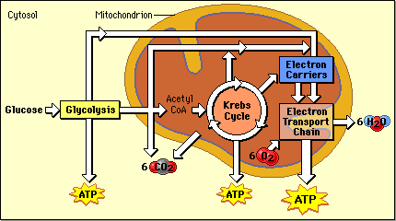
9.1 Chemical Pathways

Slide 4
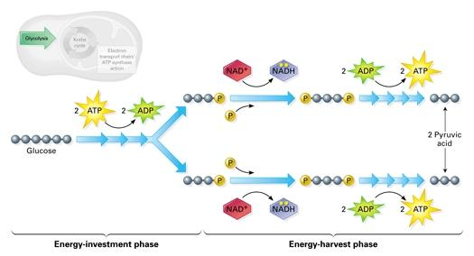
9.1 Chemical Pathways
Glycolysis
1 glucose makes 2 pyruvates

Slide 5
9.1 Chemical Pathways
When oxygen is not available, after glycolysis, instead of the Krebs cycle occurring, another pathway occurs
Glycolysis and this alternative pathway together are called fermentation
2 types of fermentation-alcoholic and lactic acid fermentation

Slide 6
9.1 Chemical Pathways
Alcoholic fermentation
Pyruvic acid + NADH→alcohol + CO₂+NAD⁺
Also causes bread to rise
Lactic acid fermentation
Pyruvic acid + NADH→lactic acid+NAD⁺

Slide 7
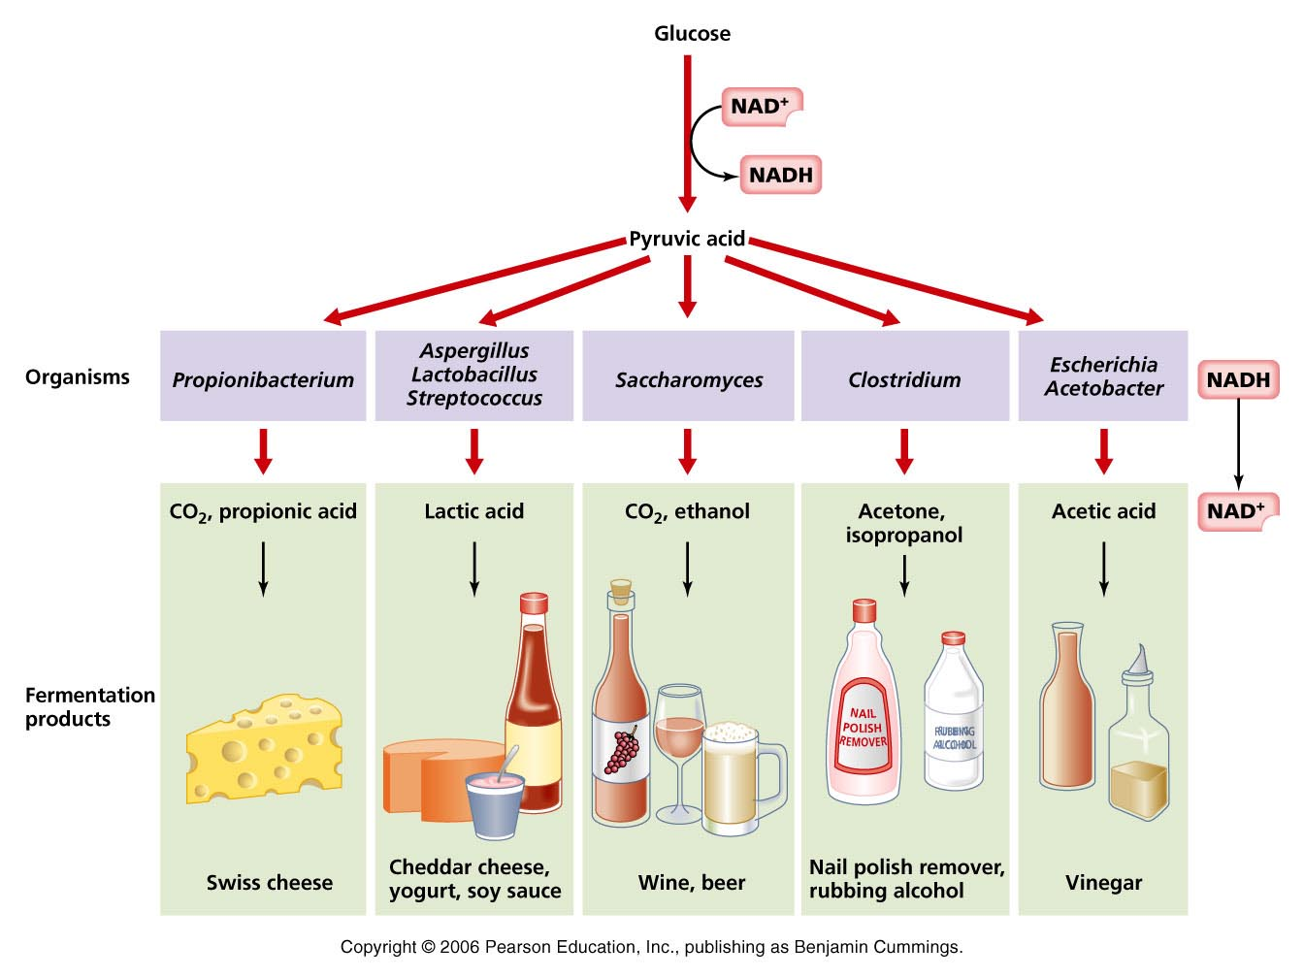
9.1 Chemical Pathways-Alcoholic Fermentation

Slide 8
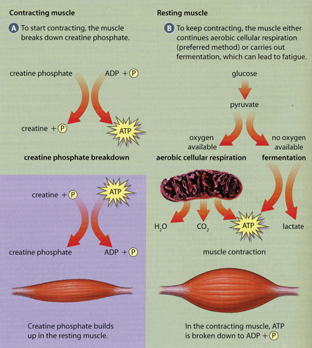
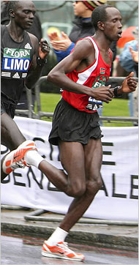
9.1 Chemical Pathways-Lactic Acid Fermentation

Slide 9
9.2 Krebs Cycle and ETC
After gycolysis, 90% of the energy stored in glucose is still available
Cellular respiration is the process of releasing all the energy from glucose
Requires oxygen
Respiration and cellular respiration are connected in that we need to breathe (respire) so that are cells can do cellular respiration

Slide 10
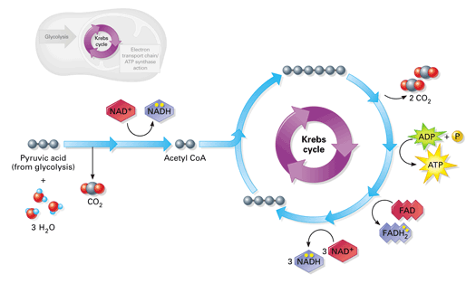
9.2 Krebs Cycle
Pyruvic acid is converted to CO₂ in the mitochondria; every step is catalyzed by enzymes that require cofactors which are our “vitamins”

Slide 11
9.2 Krebs Cycle
https://www.youtube.com/watch?v=jsMNyGbKxqk

Slide 12
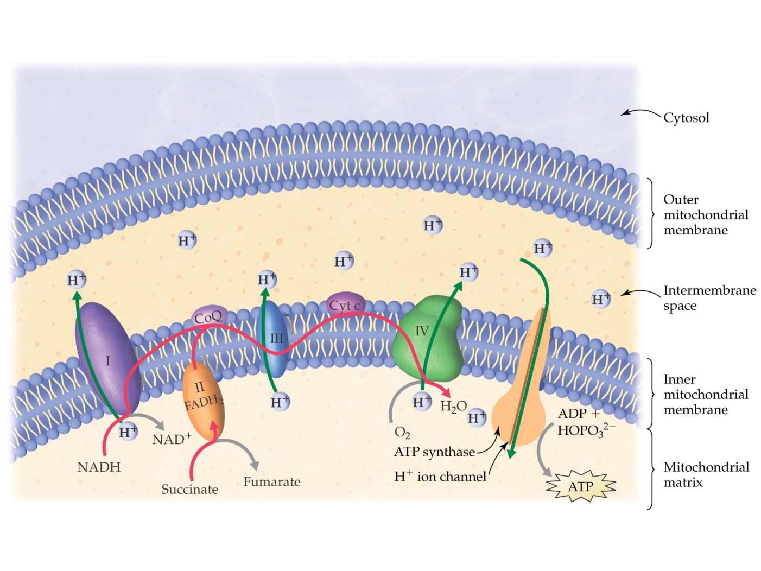
9.2 ETC
After Krebs cycle the high energy e⁻ in NADH and FADH are passed to other molecules in the electron transport chain (ETC) and used to convert ADP to ATP

Slide 13
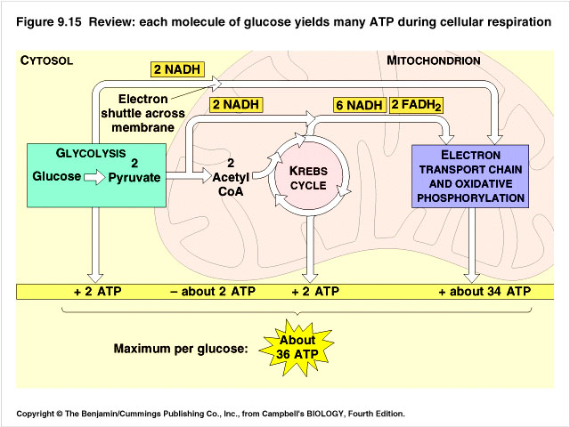
9.2 Total ATP Produced

Slide 14
9.2 Cellular Respiration review
http://www.discovery.com/tv-shows/other-shows/videos/assignment-discovery-shorts-06-07-07-08-cellular-respiration.htm

Slide 15
9.2 Energy and Exercise
When you exercise, the energy stored in ATP, blood glucose and lactic acid is used very quickly. After that you use glycogen, a storage form of energy in the liver
https://www.youtube.com/watch?v=K_JFBxRBe9Q
https://www.youtube.com/watch?v=oBL0OC3IavI

Slide 16
9.2 How Cells Obtain Energy-An overview
https://www.youtube.com/watch?v=i8c5JcnFaJ0

Slide 17
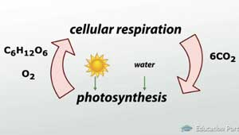
9.2 Comparing Cellular Respiration and Photosynthesis
 | Photosynthesis | Cellular Respiration
Function Location Reactants Products | Energy storage Chloroplasts CO₂&H₂O C₆H₁₂O₆&O₂ | Energy Release Mitochondria C₆H₁₂O₆&O₂ CO₂&H₂O
Equation | CO₂&H₂O →C₆H₁₂O₆&O₂ | C₆H₁₂O₆&O₂ →CO₂&H₂O

