Slide 1
Chapter 18
Classification

Slide 2
Why Classify?
To name organisms and group them in a logical manner
Taxonomy-a universal system to name each organism
Binomial Nomenclature-Developed by Linnaeus; each species has a two-parted name
First word is capitalized
2nd word is not
Both are italicized
Ex. Homo sapien

Slide 3
Linnaeus’s System of Classification
From largest to smallest, most inclusive to least
Kingdom
Phylum
Class
Order
Family
Genus
Species
Kings play chess on fine grained sand
KPCOFGS

Slide 4
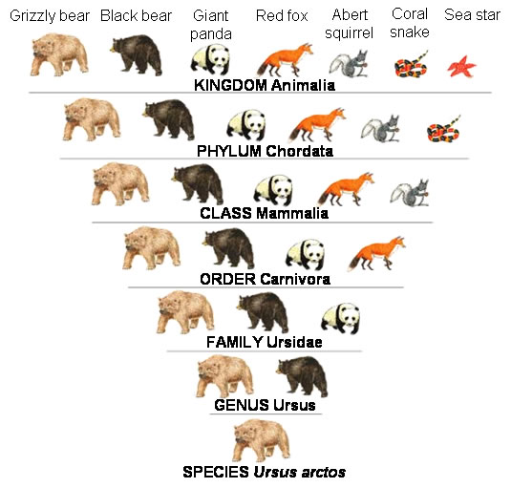
Linnaeus’s System

Slide 5
Modern Classification
Early taxonomists relied on body structures to classify organisms
After Darwin, we knew that animals shared traits due to common ancestors
Now we classify organisms based on evolutionary descent, not just physical similarities

Slide 6
Modern Classification
Derived characteristics-appear in recent parts of a lineage but not its older members
Cladogram-diagram based on derived characteristics

Slide 7
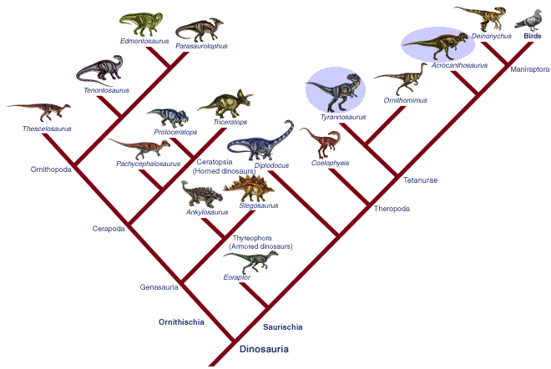
Cladogram

Slide 8
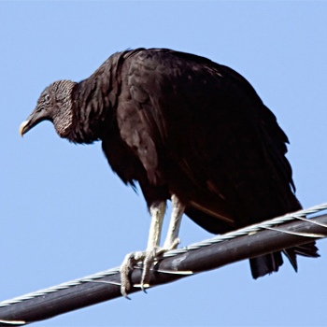
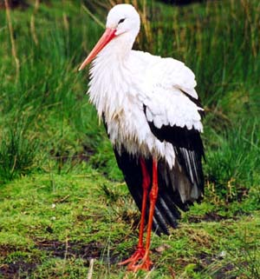
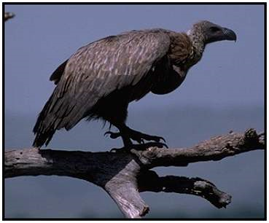
Similarities in DNA and RNA
Classification based on genetics, not just physical characteristics
Ex.-African vultures and American vultures were both grouped into the vulture family based on physical characteristics
Genetic analysis revealed that the American vulture is more closely related to the stork

Slide 9
Molecular Clocks
Uses DNA comparisons to estimate the length of time two species have been evolving independently
Some mutations occur that do not affect phenotype-called neutral mutations
Neutral mutations accumulate over time, so by comparing shared and unique genes, one can estimate how long ago two species diverged from each other

Slide 10
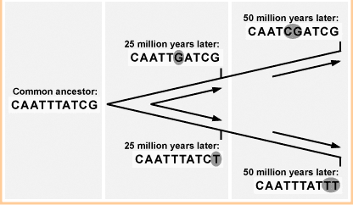
Molecular Clocks

Slide 11
Kingdoms and Domains
Six Kingdoms (old)-Eubacteria, Archaebacteria, Protista, Fungi, Plantae, Animalia
Three Domain System (new)
Bacteria (Eubacteria)
Archaea (Archaebacteria)
Eukarya (Plants, Animals, Fungi, Protists)
See Figure 18-12 p. 459

Slide 12
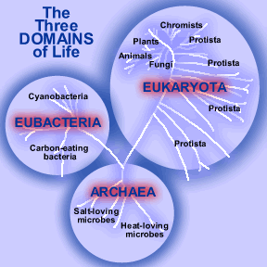
Three Domain System

Slide 13
Bacteria
Eubacteria-cell walls contain peptidoglycan
Archaea-cell walls lack peptidoglycan; live in extreme environments (volcanic hot springs, brine pools)

Slide 14
Eukarya
Consist of all organisms that have a nucleus
Protista-includes anything that cannot be classified as a plant, animal or fungus
Lot of diversity-auto- or heterotrophs, most unicellular but some multicellular (some algae)
Fungi-heterotrophs, multicellular (mushrooms) or unicellular (yeast)

Slide 15
Eukarya
Plantae- muticellular, autotrophs, non-motile
Animalia- muticellular, heterotrophic

