Slide 1
Chapter 4
Ecosystems and Communities

Slide 2
4-1 The Role of the Climate
Weather-the day to day condition of the Earth’s atmosphere
Climate-the average year after year conditions of temperature and precipitation in a particular region
The Greenhouse Effect-Heat is retained near the Earth by a layer of gases in the Earth’s atmosphere
Gases include CO2, H2O and CH4(methane)
Called greenhouse gases

Slide 3
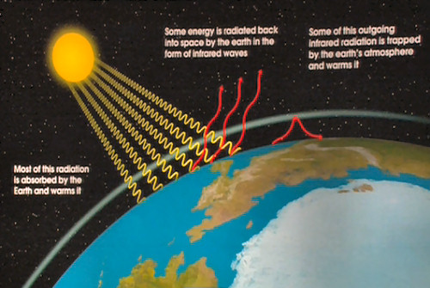
Greenhouse Effect

Slide 4
4-1 The Role of Climate
The Effect of Latitude on Climate
The earth is tilted on its axis so solar radiation strikes different parts of the earth with different angle and energy
As a result of different latitudes and the angle of heating, earth has 3 main climate zones
Polar
Temperate
Tropical

Slide 5
4-1 The Role of Climate-The Effect of Latitude on Climate
Polar-sun strikes at a low angle; between 66.5 and 90 north and south
Temperate-between polar zones and the tropics; more affected by the changing angles of the sun throughout the year; climate ranges from hot to cold, depending on the season
Tropical zone-Near the equator, between 23.5 north and south of the equator; receives direct or near direct sunlight all year round

Slide 6
4-1 The Role of Climate

Slide 7
4-1 The Role of Climate
Heat Transport in the Biosphere-The unequal heating of the earth’s surface drives winds and ocean currents because warm air rises and cold air sinks under the warm air
Land masses can also affect weather-mountain ranges cause moist air to rise and cool, then it condenses and form clouds, which precipitate

Slide 8
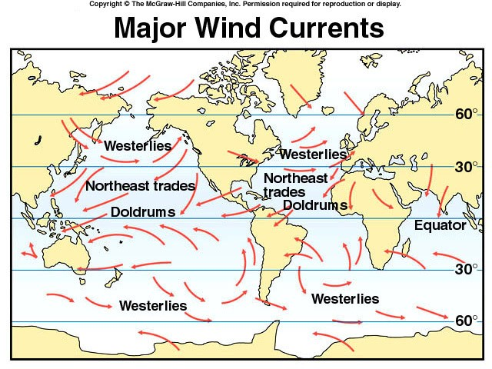
The Role of Climate-Wind and Ocean Currents

Slide 9
4-2 What Shapes an Ecosystem
Biotic and Abiotic factors
Biotic factors-biological influences on organisms within the ecosystem
Abiotic factors-physical or non-living factors that shape an ecosystem
Together, biotic and abiotic factors determine the survival and growth of an organism and the productivity of the ecosystem in which the organism lives

Slide 10
4-2 What Shapes an Ecosystem
The area where an organism lives is its habitat
A habitat includes biotic and abiotic factors
A habitat is like an address; a niche is like a job
Niche is a full range of physical and biological conditions in which the organism lives and the way in which the organism uses these conditions
Could include what is eaten, how the food is obtained, and what other species uses the organism as food, when and how it reproduces and physical conditions needed to survive

Slide 11
4-2 What Shapes an Ecosystem-Niches

Slide 12
4-2 What Shapes an Ecosystem
Community Interactions affect an ecosystem
Competition-occurs when organisms of the same or different species attempt to use the same resources in the same place at the same time
Resource-any necessity of life-water, nutrients, light, food
Direct competition often results in a winner and a lose, the losing organism failing to survive
Competitive exclusion principle-no two species can occupy the same niche in the same habitat at the same time

Slide 13
4-2 What Shapes an Ecosystem
Predation-an interaction in which one organism captures and feeds on another organism
The organism that does the eating is the predator
The organism that is killed and eaten is the prey

Slide 14
4-2 What Shapes an Ecosystem
Symbiosis-Any relationship in which two species live closely together
Mutualism-both species benefit-Ex: flowers and insects
Commensalism-one species benefits, the second is neither helped nor harmed-Ex: barnacles on a whale’s skin
Parasitism-one organism lives on or inside another and harms it-Ex: tapeworms, fleas and ticks

Slide 15
4-2 What Shapes an Ecosystem
Ecological Succession
Ecosystems are constantly changing in response to natural and human disturbances. As an ecosystem changes, older inhabitants gradually die off and new organisms move in, causing further changes in the community
Called ecological succession

Slide 16
4-2 What Shapes an Ecosystem
Primary Succession-succession that takes place on surfaces where no soil exists
The first species to appear are the pioneer species
Example lichen growing on volcanic rocks
Secondary Succession-when a disturbance of some kind changes an existing community without removing the soil
Example new plants growing back after a forest fire

Slide 17
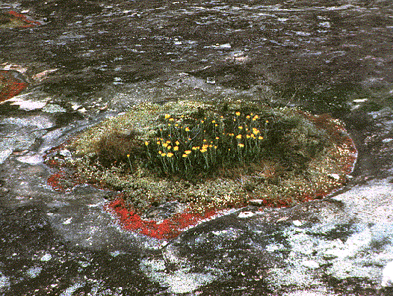
4-2 What Shapes an Ecosystem

Slide 18
4-2 What Shapes an Ecosystem
Succession in a Marine Ecosystem
A large whale died and sunk to the bottom of the ocean
Scavengers and decomposers are attracted to the carcass
Small fish, crabs, snails and other marine animals are supported by the carcass
Finally, heterotrophic bacteria decompose the oils in the whale bones, and release chemicals that attract other chemotropic bacteria
Chemotropic bacteria support snails, mussels, crabs, etc.

Slide 19
4-2 Succession in a Marine Ecosystem

Slide 20
4-3 Land Biomes
Biome-a particular physical environment that contains a characteristic collection of plants and animals. Example: temperate grasslands-large areas of flat land in regions with dry, temperate climates on several continents
Microclimate-climate within a small area within a small area of a biome that is significantly different from the climate around it. Example: Sunset area in San Francisco, or at the northern coast of California

Slide 21
4-3 Land Biomes
Major Biomes
Tropical rain forest, tropical dry forest, tropical savanna, desert, temperate grassland, temperate woodland and shrubland, temperate forest, northwestern coniferous forest, boreal forest and tundra
Boundries are transitional area between the biomes

Slide 22
4-3 Major Biomes

Slide 23
4-3 Major Biomes
See pages 100-102
Make a chart in your notes summarizing the information
6 columns, one for each biome
4 rows
Abiotic factors
Dominant plats
Dominant wildlife
Geographic distribution

Slide 24
4-3 Other Land Areas
Some areas of land don’t fall neatly into a category
Mountain Ranges
Polar Ice Caps

Slide 25
4-4 Aquatic Ecosystems
Determined primarily by the depth, flow, temperature and chemistry of the overlying water
Freshwater Ecosystems
Flowing water-stream, creek, river
Water flows through(in and out)
Standing water-Lakes and ponds
Circulation within the body of water distributes nutrients
Phytoplankton-algae; free floating; base of many food webs
Zooplankton-Planktonic animals that feed on the phytoplankton
Freshwater wetlands
Water covers the soil or is at or near the surface of the soil for at least part of the year
Includes bogs, marshes and swamps
-

Slide 26
4-4 Aquatic Ecosystems
Estuaries-wetlands formed where rivers meet the sea
Fresh and salt water
Food web different from most ecosystems-most primary production is not consumed by herbivores, but enters food web as detritus
Provides food for clams, worms and sponges
Contain lot of biomass but few species
Serve as a spawning nursery for snails and crabs
Many animals and water fowl feed and nest there
Salt marshes and mangrove swamps

Slide 27
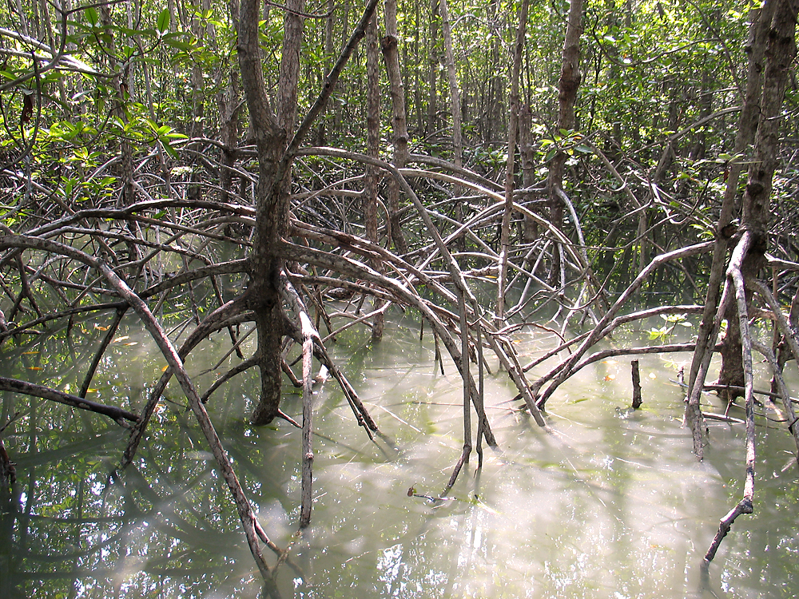
4-4 Estuaries

Slide 28
4-4 Marine Ecosystems
Photic zone-photosynthesis can occur
Aphotic zone-permanently dark; no photosynthesis
Zones are also based on depth and distance from shore
the intertidal zone
the coastal zone
the open ocean

Slide 29
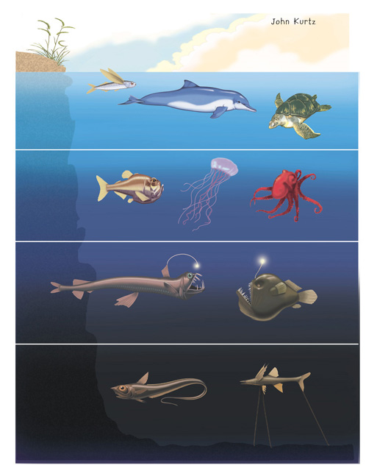
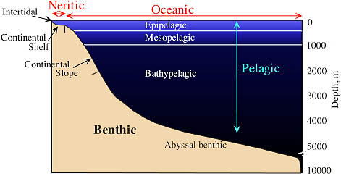
4-4 Marine Ecosystems

Slide 30
4-4 Marine Ecosystems
Intertidal Zone
Organisms exposed to extreme changes in their surroundings every day
Competition leads to zonation, or horizontal banding of organisms that live in a habitat
Coastal Ocean
Extends from low tide mark to the outer edge of the continental shelf
Often shallow and photic
Kelp forests-giant brown algae that can grow 50 cm/day

Slide 31
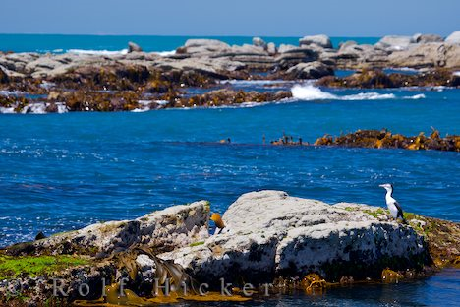
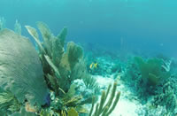
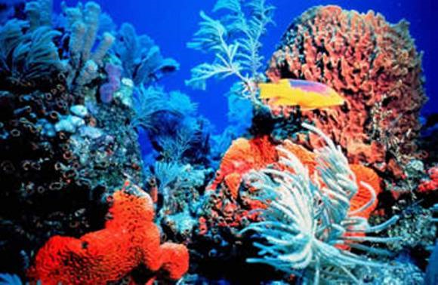
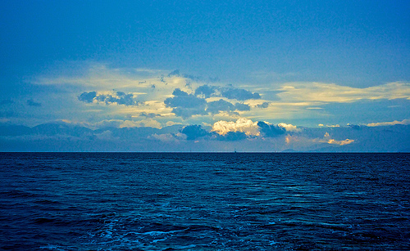
Marine Ecosystems

Slide 32
4-4 Marine Ecosystems
Coral Reefs
Warm shallow coastal water, less than 40 feet deep
Most diverse and productive environments on earth
Animals have hard CaCO3 exoskeletons
Coral animals are relatives of jellyfish
Live in symbiosis with algae that carry out photosynthesis

Slide 33
4-4 Marine Ecosystems
Open Ocean
Begins at end of continental shelf
500-11,000 meters deep
Exposed to high pressure, cold temperatures, total darkness
Low productivity, photic zone is responsible for much of the photosynthesis that happens on earth because the oceans are so large

Slide 34
4-4 Marine Ecosystems
Bethnic Zone
Ocean floor
Sea stars, anemones, marine worms
Wait for nutrients produced in the photic zone above to drift down with cold ocean water currents
Deep sea vents-openings in the earth’s crust-chemosynthetic bacteria live there; remember Taq DNA polymerase from Thermopolis aquaticus?!

