Slide 1
Chapter 5
Populations

Slide 2
5-1 How Populations Grow
Three important characteristics of a population
Geographic distribution-area inhabited by the population
Density-number of individuals in a certain area
Growth Rate-how fast the density of the population is increasing

Slide 3
5-1 How Populations Grow
Population Growth-Three factors affect population size
# of births
# of deaths
# of individuals that enter or leave the population
Immigration-movement of individuals into a population
Emigration-movement of individuals out of a population

Slide 4
5-1 How Populations Grow
Exponential growth occurs when the individuals in a population reproduce at a constant rate
Happens under ideal conditions with unlimited resources
Example-bacteria grown in culture in the lab
Logistic growth occurs when a population’s growth slows or stops
Happens when resources become limited
Example-yeast fermenting grain in beer-making

Slide 5
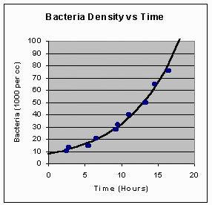
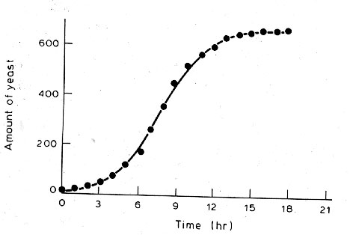
Exponential and Logistic Growth

Slide 6
5-2 Limits to Growth
Limiting factor is a factor that causes population growth to decrease
Competition
Predation
Parasitism and disease
Drought and other climate extremes
Human disturbances

Slide 7
5-2 Limits to Growth-Density dependent factors
Some limiting factors are density dependent-only has an effect when the population reaches a certain density
Competition-organisms compete for resources-food and space; Puffins nesting on a rocky shore
Predation-one species is a predator and predates on the other, the prey; wolf and moose
Parasitism and Disease-Parasites take nutrients from the host at the host’s expense; tapeworm

Slide 8
5-2 Limits to Growth-Density independent factors
Other factors affect all populations the same and are not dependent on the density of the population-Called density independent factors
Unusual weather
Seasonal cycles
Certain human activities like damming rivers or clear-cutting forests
Read and discuss-Does the Gray Wolf need protection p. 128

Slide 9
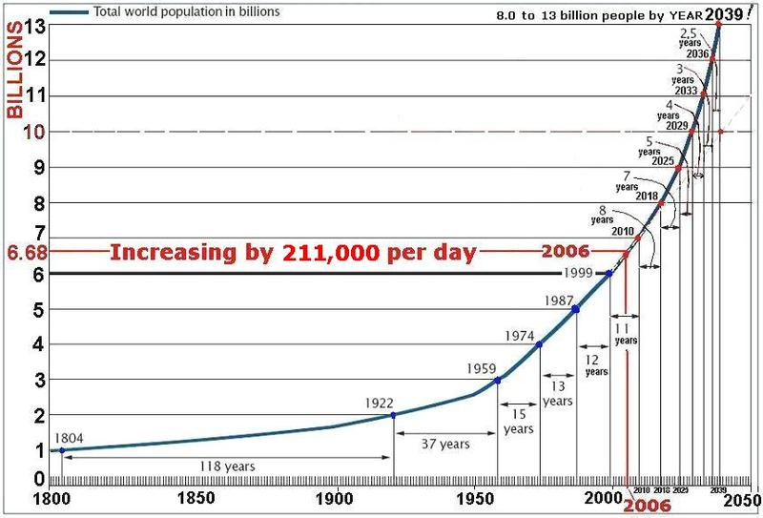
5-3 Human Population Growth
The size of the human population has increased with time

Slide 10
5-3 Human Population Growth
Patterns of population growth
Demography- the study of human populations
Examines characteristics of human populations and attempts to explain how those populations change over time
Birthrates, death rates and the age structure help predict growth rates
A demographic transition is a dramatic change in birth and death rates
Has happened in several modernized countries-USA, Japan and some European countries

Slide 11
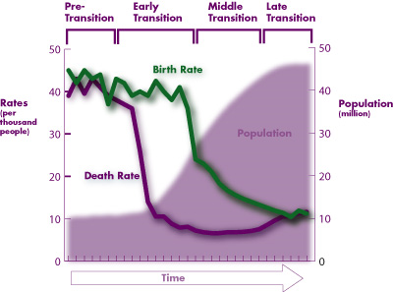
The demographic transition

Slide 12
5-3 Human Population Growth
Age structure
Population growth depends in part on how many people of different ages make up a given population
Demographers use models to predict population growth
Use age structure diagrams or population profiles

Slide 13
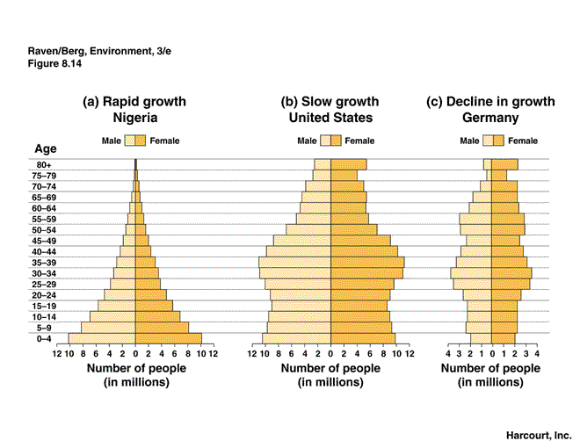
Age structure diagrams

Slide 14
5-3 Human Population Growth
Future population growth
Some models predict that by 2025 the word population will be 7.8 billion
By 2050, 9 billion
Will it grow exponentially or logistically?
How will human population growth affect the environment?
The global economy?
How can science, technology and societal change help?

Slide 15
