Slide 1
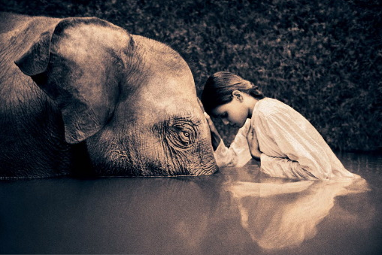
Chapter 6: Humans in the Biosphere

Slide 2
Think about this:
How do you impact your environment by every day actions? Write a brief paragraph explaining your impact on the world, why it is an impact, and whether it is positive or negative.

Slide 3
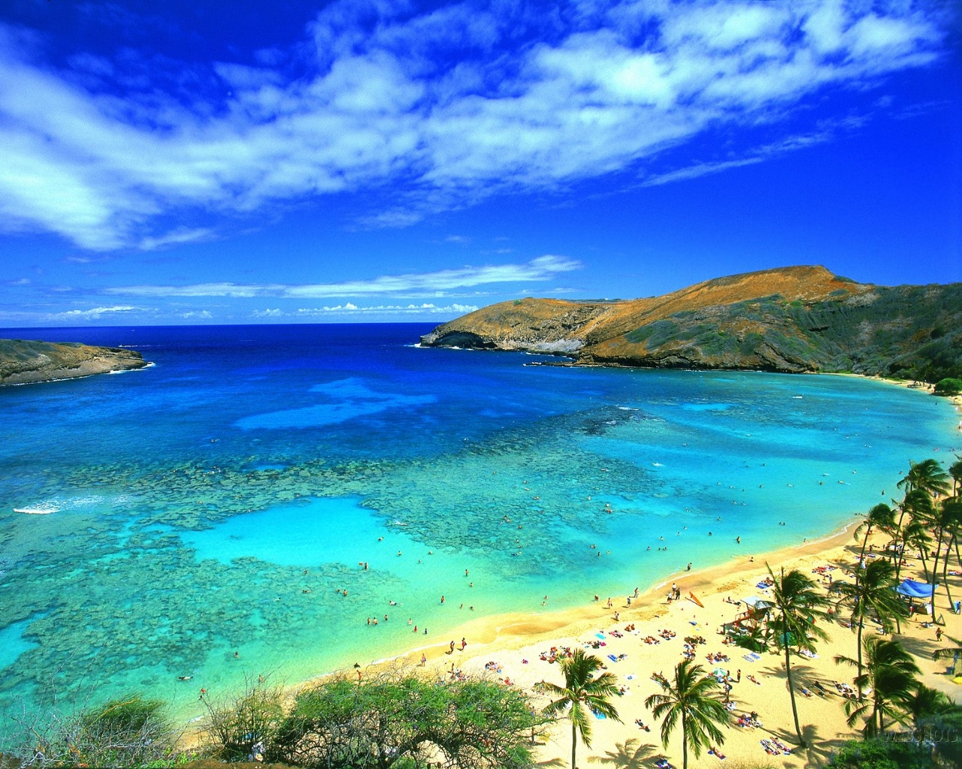
The Effect of Human Activity – 6.1
What happens when a growing human population doesn’t adequately manage natural resources that are both vital and limited?

Slide 4
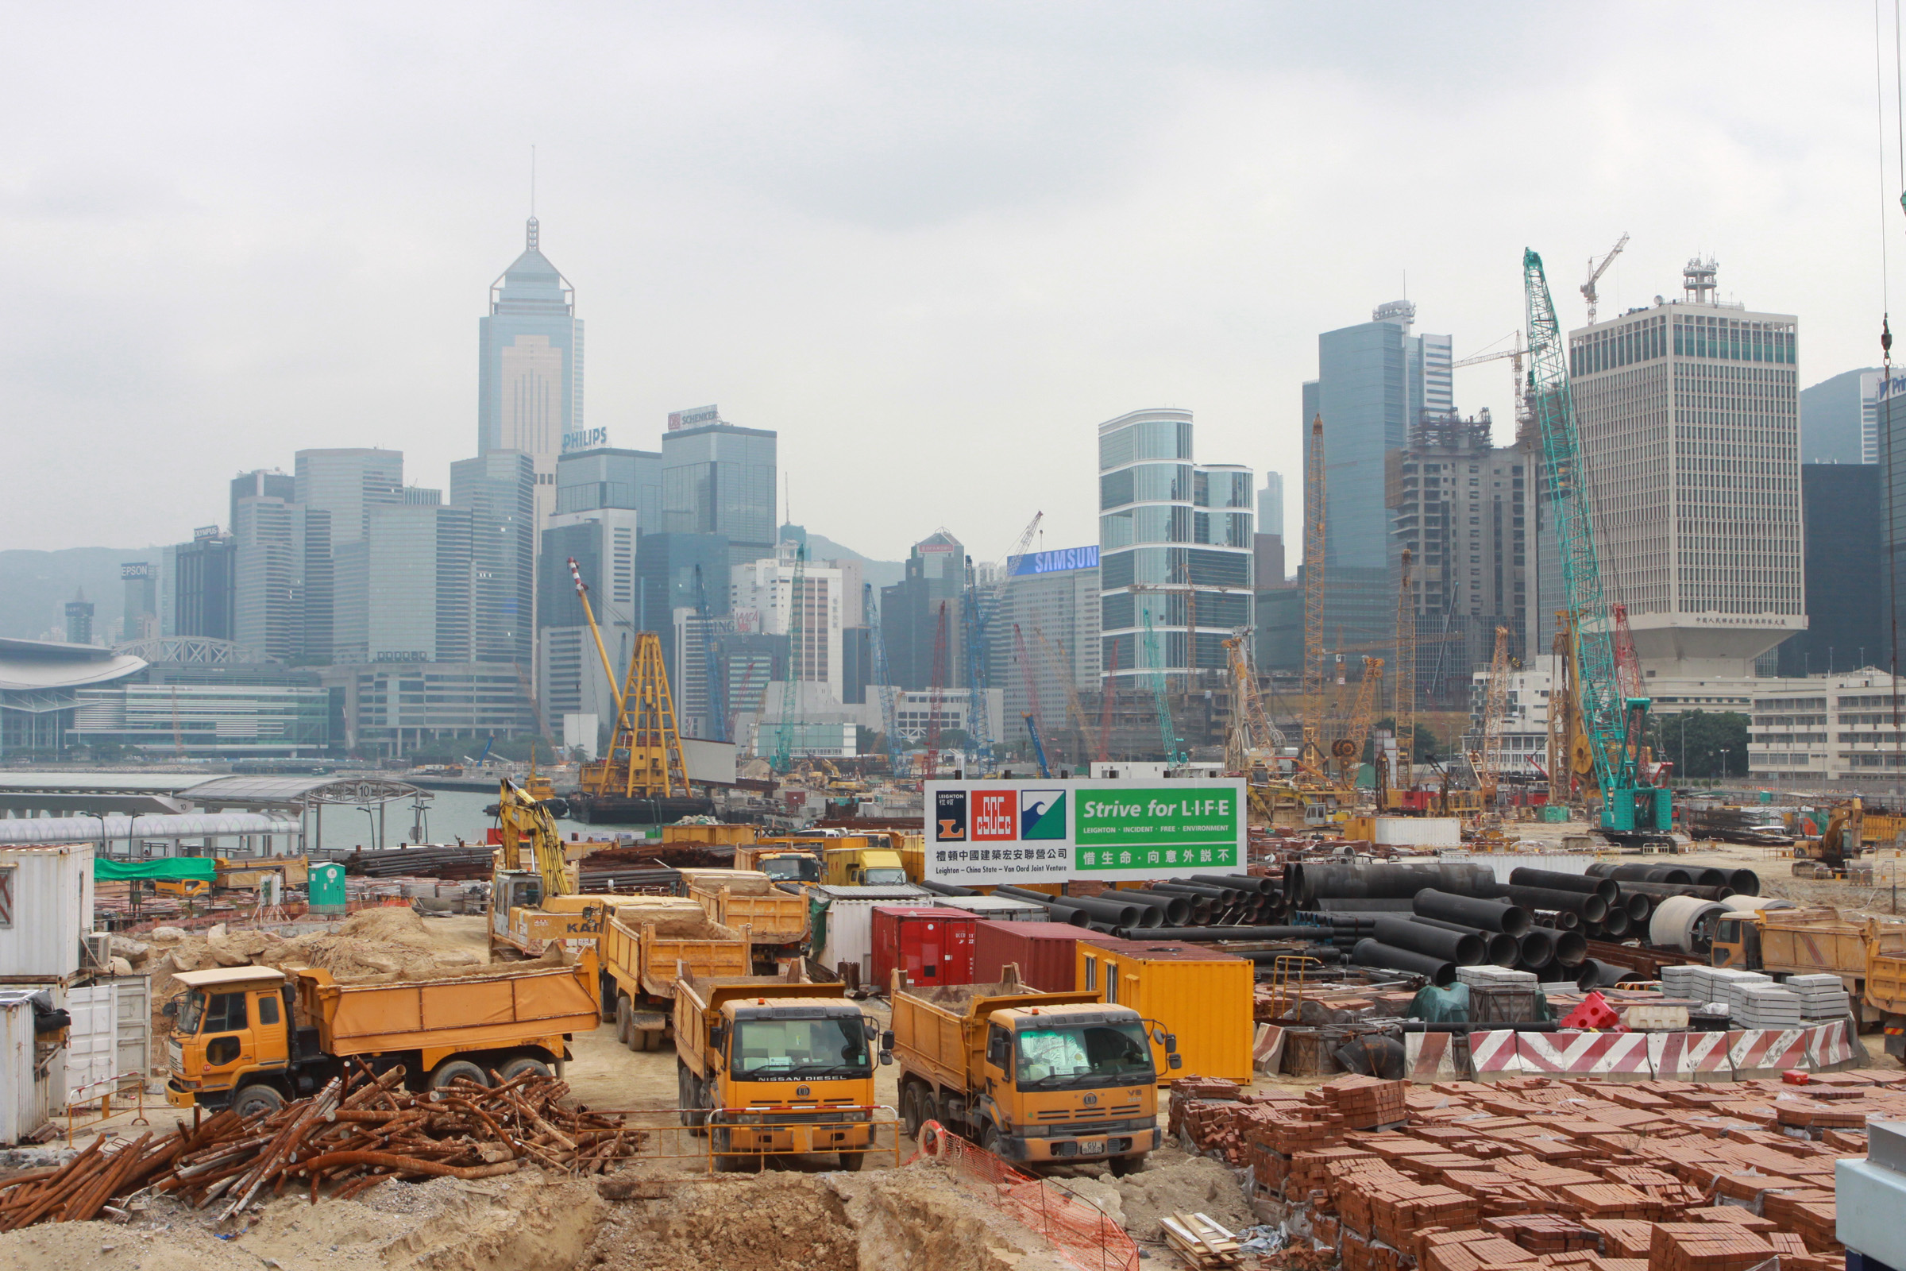
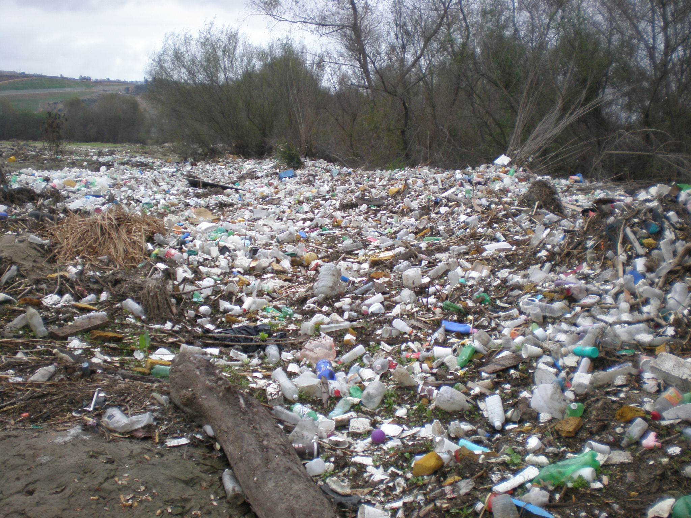
The Effect of Human Activity
We affect the environment when we obtain
Food
Eliminate waste products
Build places to live
Effects may not be very large here, but in islands like Hawaii with a small surface area, they are huge!

Slide 5
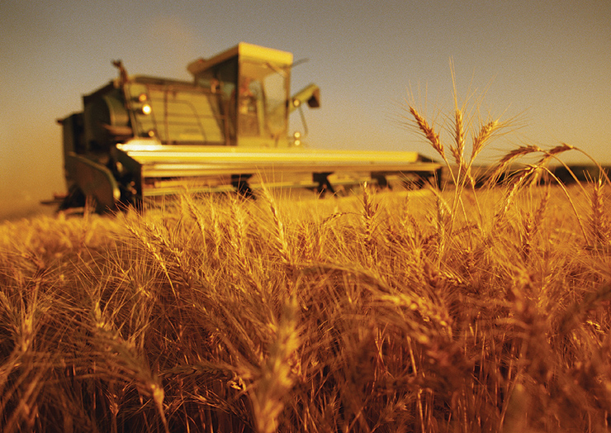
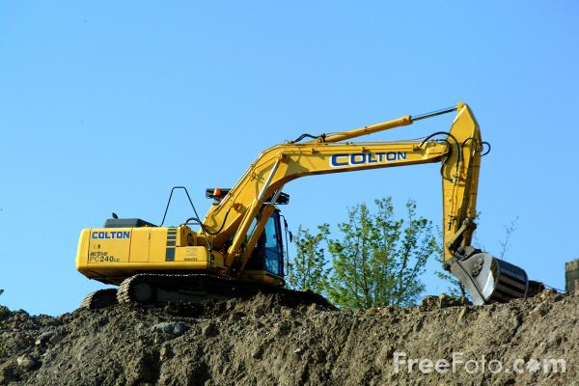
The Effect of Human Activity
Humans affect regional and global environments through agriculture, development, and industry
Huge impact on the quality of Earth’s natural resources (including soil, water, and the atmosphere).

Slide 6
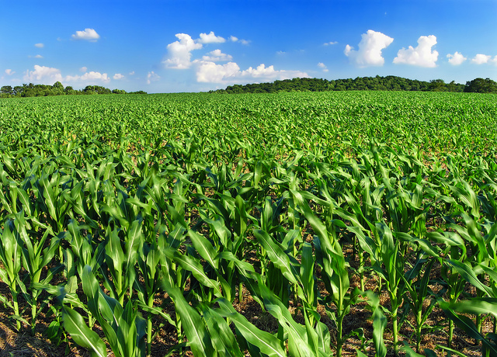
Agriculture
Modern agricultural practices have enabled farmers to double world food production over the last 50 years
Much more food and it can be stored for long periods
Monoculture: the practice of clearing large areas of land to plant a single highly productive crop year after year
Ex: Soybeans

Slide 7
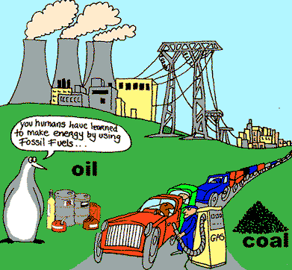
Agriculture
Providing food for 7 billion people, though, puts a strain on natural resources like water and fertilized land
This is why we invented fertilizers and farm machinery (which also takes a lot of fossil fuel)

Slide 8
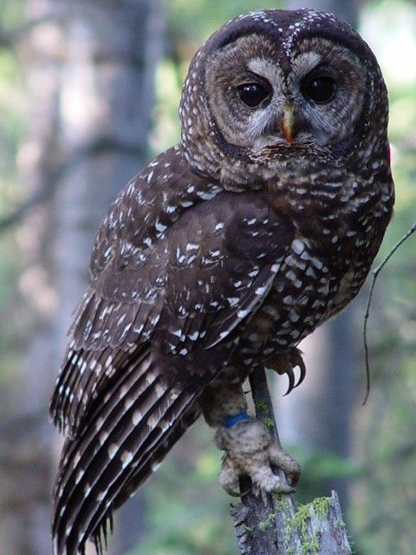
Development
Densely populated human communities use up a lot of resources and produce a lot of waste
If we don’t dispose of the waste properly, it affects air, water and soil resources
Development also divides natural habitats into fragments
Ex: Spotted owls in the old growth redwood forests

Slide 9
Forest Fragmentation

Slide 10
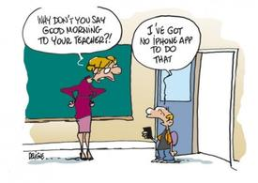
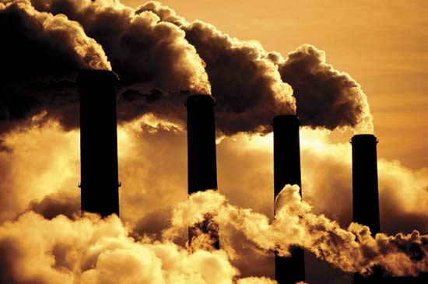
Industrial Growth
We have a lot of conveniences now that allow us comfy homes, clothes and electronic devices… but these all require energy to produce and power!
We get most of this energy from fossil fuels (coal, oil and natural gas)

Slide 11
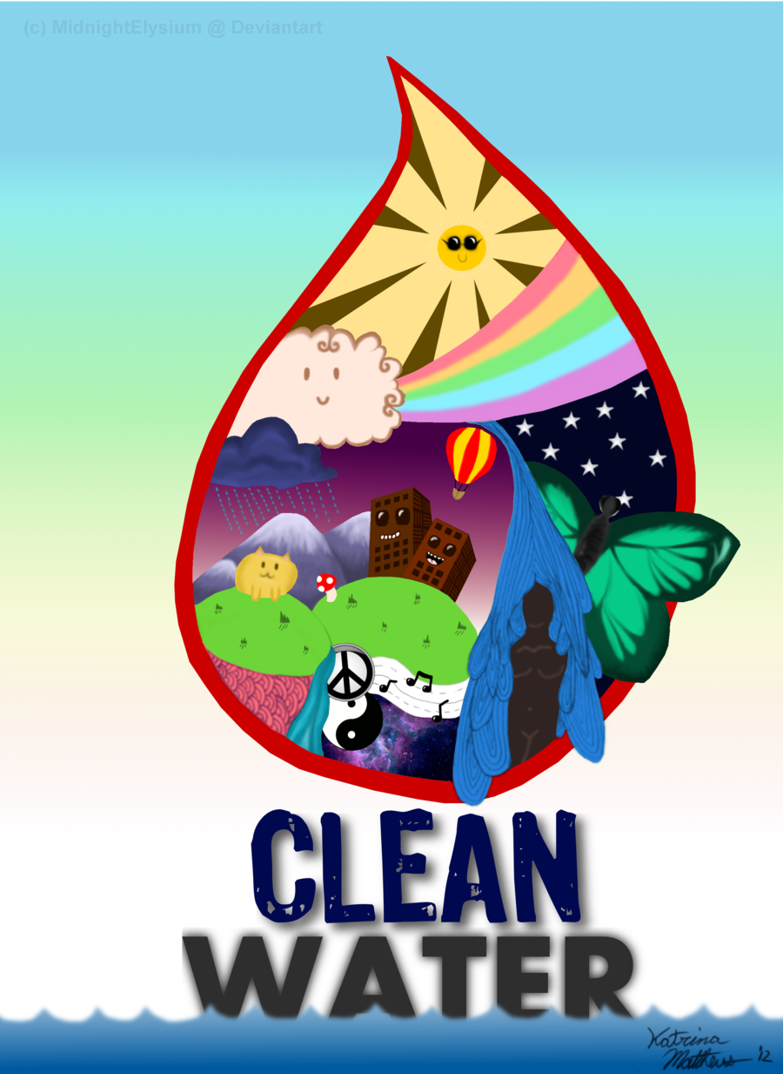
Sustainable Development
Most ecosystems provide us with “goods and services” like water and air
If it can’t, then we must spend money in order to produce them
If the water isn’t being cleaned by the natural rivers and wetlands, we have to pay for chemicals and mechanics to make it safe to drink

Slide 12
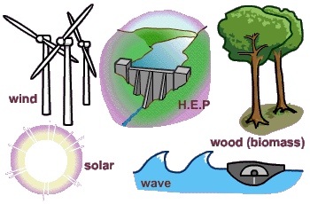
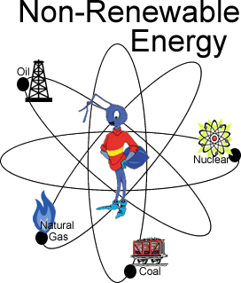
Sustainable Development
Renewable resource: can be produced or replaced by a healthy ecosystem
Ex: Water, wind, organisms
Nonrenewable resource: can’t replenish them within a reasonable amount of time
Ex: Fossil fuels like coal, oil and natural gas

Slide 13
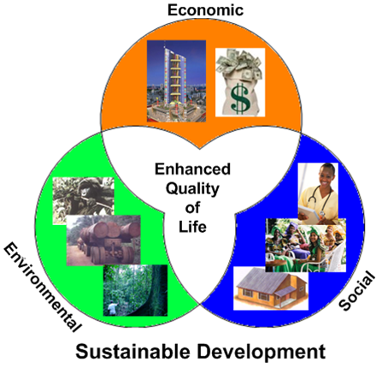
Sustainable Development
Sustainable development: using resources in an environmentally conscious and friendly way.
Provides for human needs while preserving the ecosystem that produces those natural resources

Slide 14
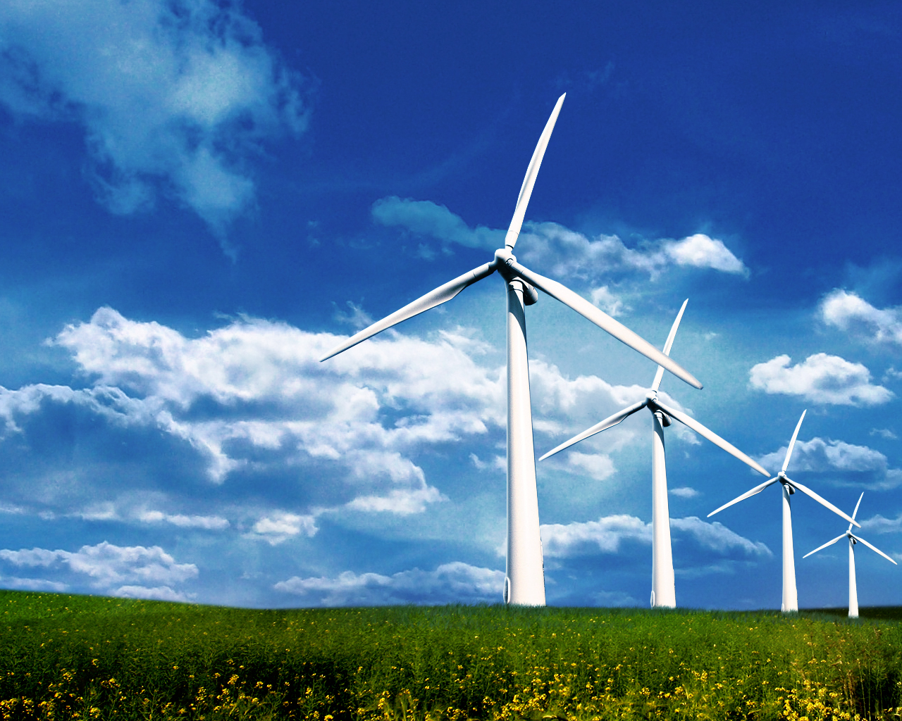
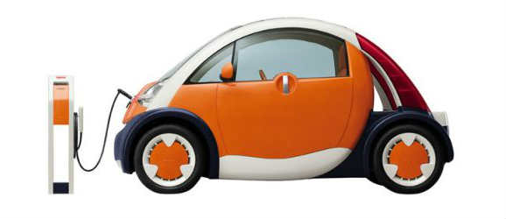
Sustainable Development
It should:
Cause no long-term harm to the ecosystem
Consume as little energy and material as possible
Should be able to withstand environmental stresses (droughts, floods, heat waves, cold snaps)
Help people improve their situation

Slide 15
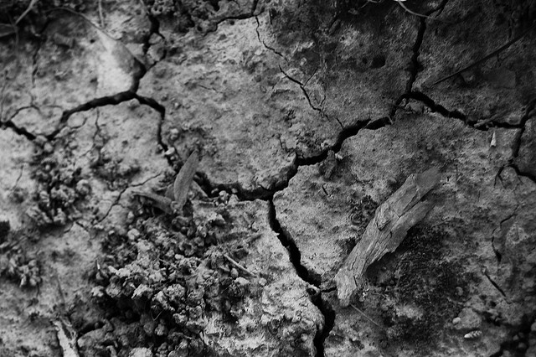
Using Resources Wisely – 6.2
How do we obtain what we need from our local and global environments without destroying those environments?
Not farming is not an option, we all need to eat and depend on things like wheat in many ways!

Slide 16
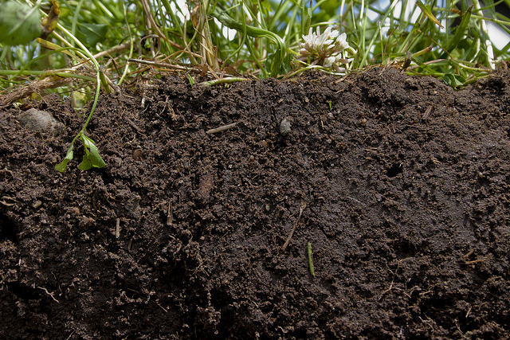
Soil Resources
Healthy soil supports both agriculture and forestry
Your cereal this morning and the paper of your textbook both depend on soil

Slide 17
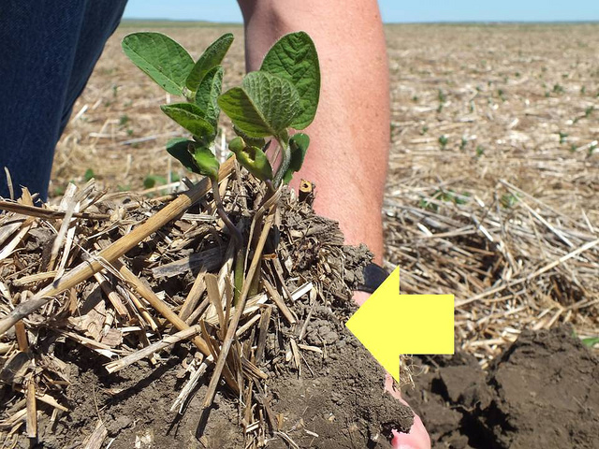
Soil Resources
Topsoil: the mineral and nutrient rich portion of soil
Rich in organic matter and nutrients
Allows water to drain
Produced by long-term interactions between plants
Can be renewable if managed correctly

Slide 18
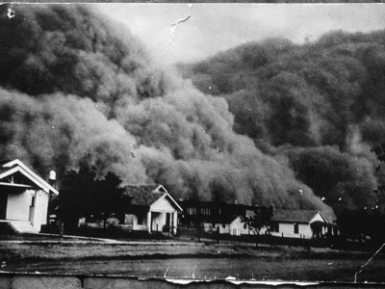
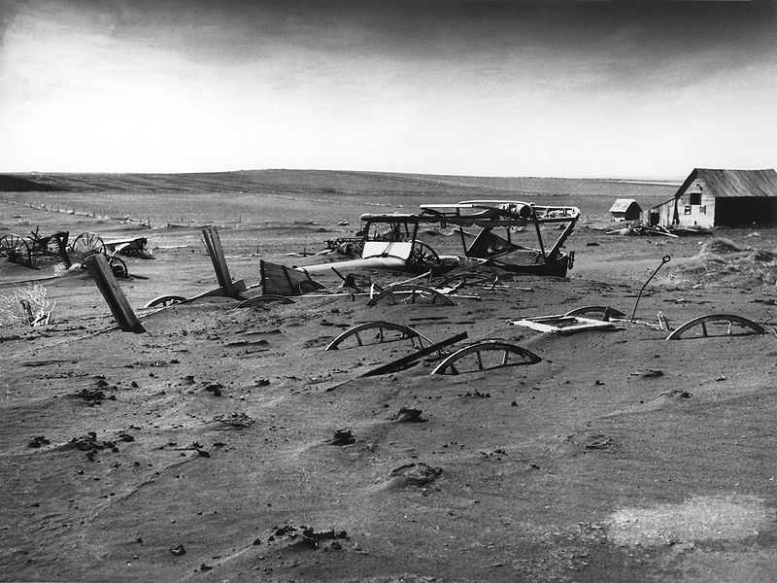
Soil Resources
If not managed correctly, topsoil can be depleted and we lose our farming grounds
The great “Dust Bowl” in the 1930’s – long drought and bad farming led to a loss of many jobs and fertile land

Slide 19
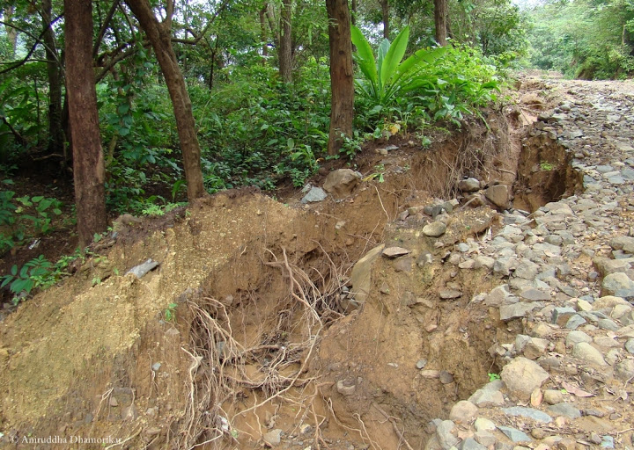
Soil Erosion
Soil erosion: the removal of soil by water or wind
Soil erosion is common when land is plowed and left barren – all organic materials are carried away
Desertification: when dry climates, farming, and overgrazing cause a farmland to turn into a desert.
Happened to the Great Plains in the “Dust Bowl”

Slide 20
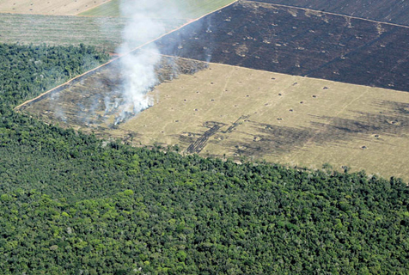
Soil Erosion
Deforestation: the loss of forests
Also has an effect on soil quality because forests hold the soil in place, protect the quality of the water, absorb carbon dioxide and help the climate.
Some areas can re-grow their forests… but remember succession takes years!!
Other areas, like the rainforest, can’t re-grow. Nonrenewable!

Slide 21
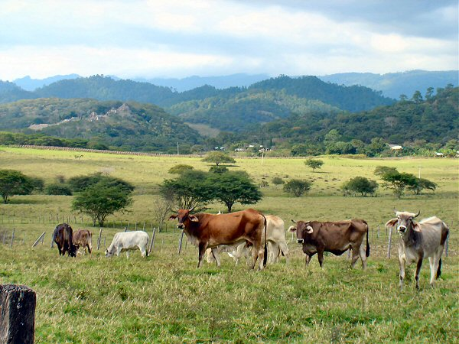
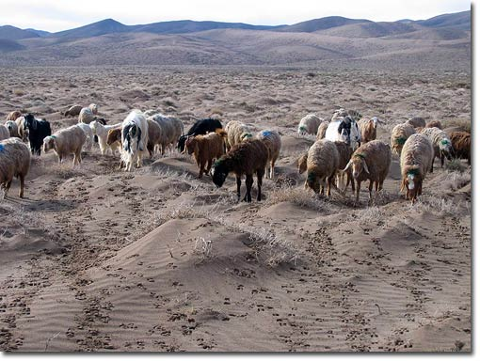
Soil Erosion
Deforestation can make matters worse if you allow over-grazing and farming in rainforests
The topsoil layer in rainforests is very thin, so the organic matter is used up quickly (within a few years)

Slide 22
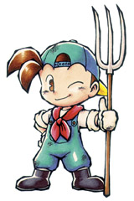
Soil Use and Sustainability
It is possible to minimize soil erosion through careful management of both agriculture and forestry
Leave the stems! Don’t take everything off
Crop rotation! Change the type of crop and how often
“Terrace” the land… create steeps to help hold the soil
Selectively harvest trees! Out with the old, in with the new!

Slide 23
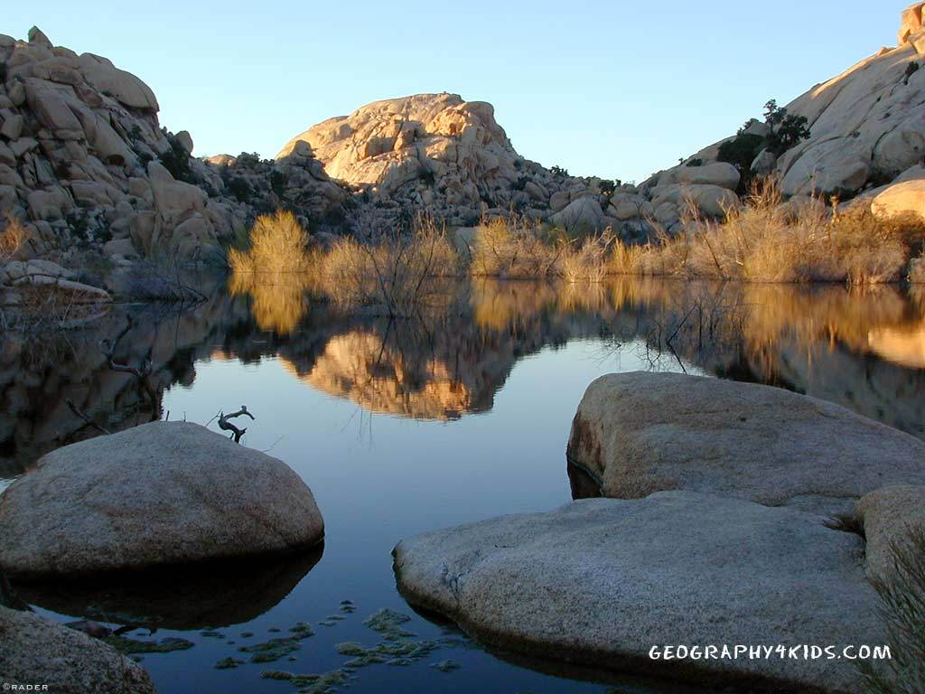
Freshwater Resources
Remember. Only 3% of Earth’s water is freshwater… and most of it is frozen in the ice caps!
We must protect the ecosystems that collect and purify freshwater

Slide 24
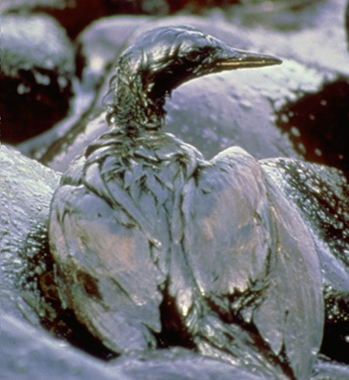
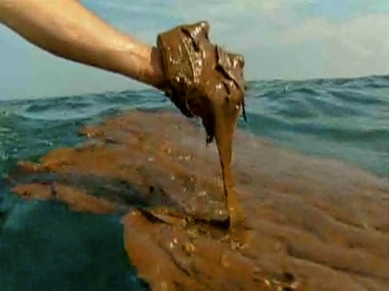
Freshwater Resources
Pollutant: any harmful material that can enter the biosphere
Point source pollution: when pollution enters water from one source
Ex: From a factory or an oil spill

Slide 25
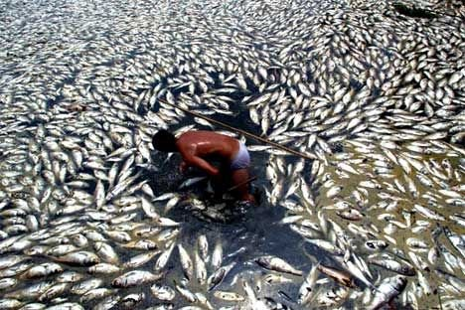
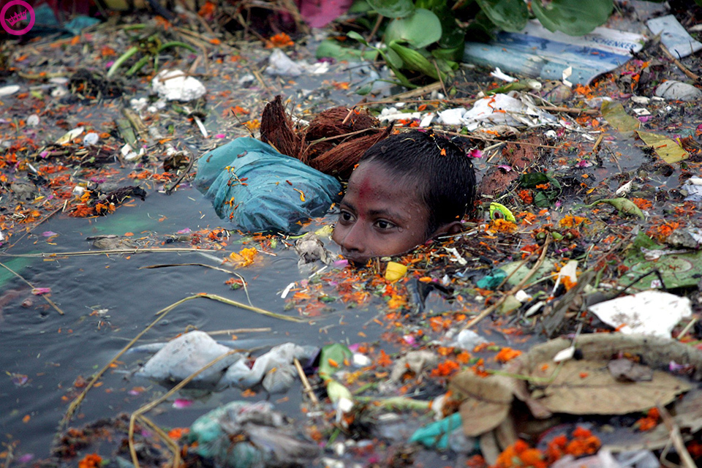
Freshwater Resources
Nonpoint sources: when pollutants enter water supplies from many smaller sources
Ex: the grease and oil washed off streets by rain

Slide 26
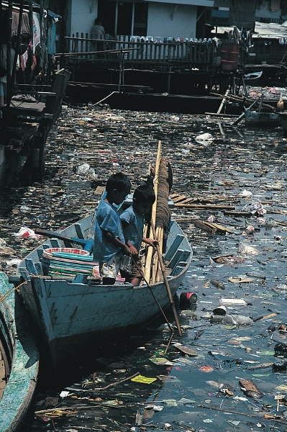
Freshwater Resources
The primary sources of water pollution are:
Industrial and agricultural chemicals
Residential sewage
Nonpoint sources

Slide 27
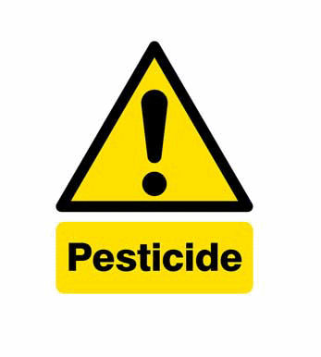
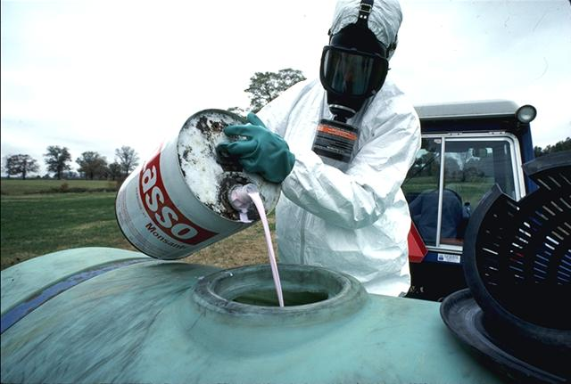
Industrial and Agricultural Chemicals
Industrial pollutants are difficult to eliminate because they stay underneath the ground, in the sand and mud
Ex: PCB’s – these were banned in the 1970’s
Ex: DDT, a pesticide and insecticide that ran off into water supply

Slide 28
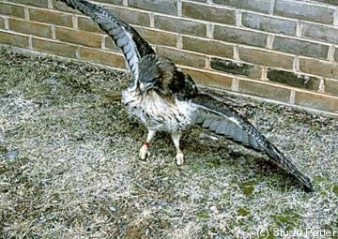
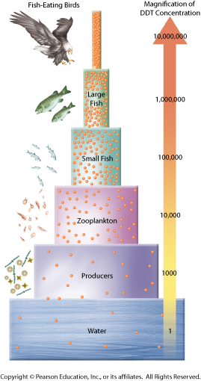
Industrial and Agricultural Chemicals
Biological magnification: when a pollutant (like DDT or mercury) is picked up by an organism and is not broken down or eliminated from its body
Concentration increases as it goes up the food chain

Slide 29
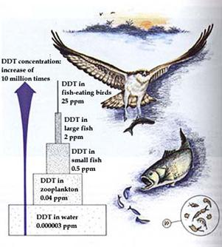
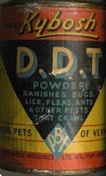
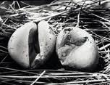
Industrial and Agricultural Chemicals
The concentration of DDT was so high at one point that it threatened the existence of our national bird – the Bald Eagle

Slide 30
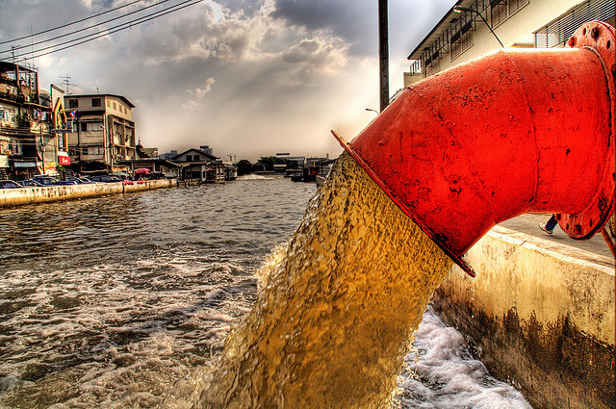
Residential Sewage
Where does the waste in your toilet go when it flushes?
Contaminates water (both fresh and salt) with microorganisms, and depletes it of oxygen

Slide 31
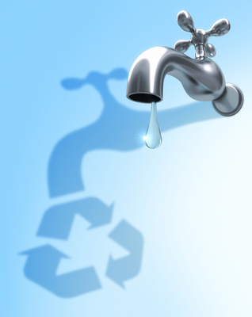
Water Quality and Sustainability
Watershed conservation: clean all areas, including the areas that drop water off, to prevent pollution
Sewage treatments to eliminate bacteria and disease
Use integrated pest management (IPM) – natural predators to the pests instead of pesticides
Drip irrigation: delivers water drop by drop directly to the roots of the plants that need it

Slide 32
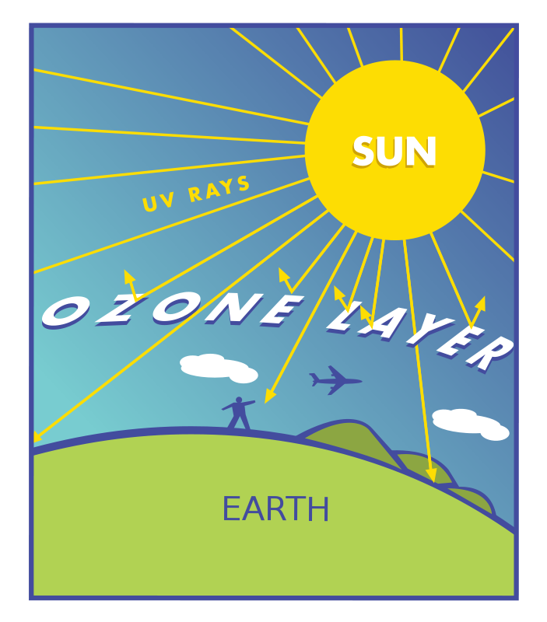
Atmospheric Resources
We need oxygen to breathe! But our pollution is breaking down the ozone layer, which provides us with protection from UV radiation

Slide 33
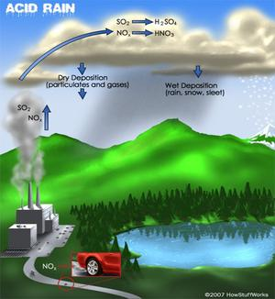
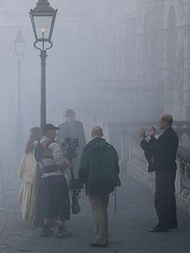
Atmospheric Resources
Common forms of air pollution include
Smog
Acid rain
Greenhouse gases
Particulates
Cause respiratory illness (asthma), change climate patterns and increase skin disease

Slide 34
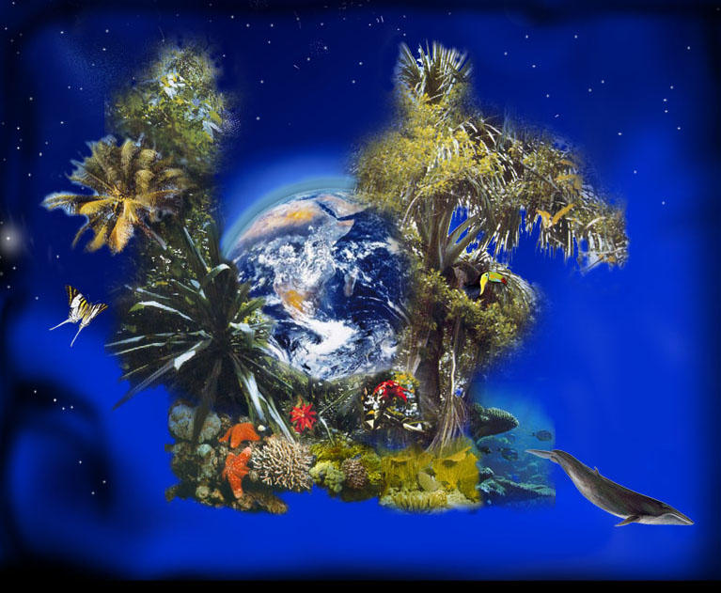
Biodiversity 6-3
Total of all the genetically based variation in all organisms in the biosphere
Variety of organisms

Slide 35
Types of Biodiversity
Ecosystem Diversity-Variety of habitats, communities and ecological processes in the biosphere.
Species Diversity- The number of different species in the biosphere or in a particular area.
1.8 species identified and named
30 million more to be discovered
Genetic Diversity-Sum total of all different forms of genetic information carried by a particular species, or all organisms on Earth.

Slide 36
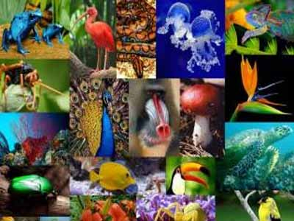
Valuing Biodiversity
Greatest natural resources
Contributions to medicine and agriculture
Provision of ecosystem goods and services
Make our world a beautiful, interesting place

Slide 37
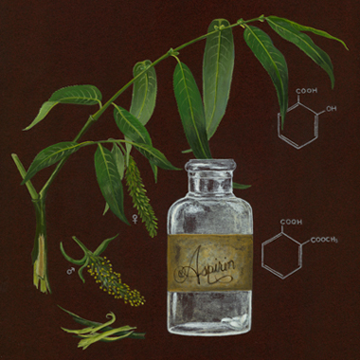
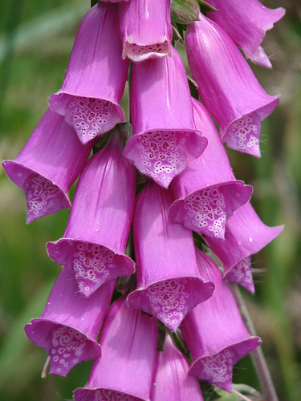
Biodiversity and Medicine
Willow bark
Wild species are original sources of many medicines
Painkillers-aspirin
Antibiotics-penicillin
Blue green mold
Chemicals in wild treat diseases like depression and cancer
Foxglove-Digoxin for heart disease

Slide 38
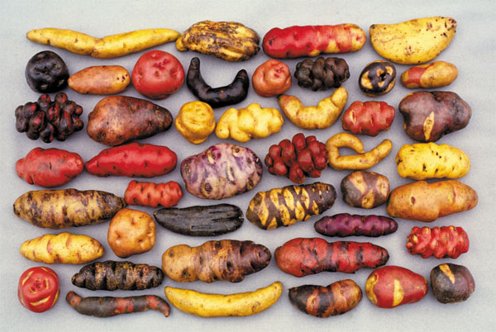
Biodiversity and Agriculture
Wild plants may carry genes we can use for:
Plant breeding
Genetic engineering- transfer disease or pest resistance or other useful traits to plant crops.

Slide 39
Biodiversity and Ecosystem Stability
Number and variety in ecosystem can influence stability, productivity and value to humans.
Keystone species can completely change an ecosystem
Healthy and diverse ecosystems play a role in maintaining soil, water and air quality

Slide 40
Species Loss
Scientist estimate 99% of species that have lived are extinct
Species loss is now approaching 1000 x’s the “typical” rate.
Human knowledge held in genes is lost

Slide 41
Species diversity/Genetic Diversity
More genetically diverse, greater chances of survival
Human activity reduces genetic diversity; species greater risk of extinction
Ecosystems damages-organisms more at risk

Slide 42
Humans reduce biodiversity
Altering habitats
Hunting
Introducing invasive species
Releasing pollution into food webs
Contribute to climate change

Slide 44
Altered Habitats
Agriculture and urban development-loss of habitats; some species become extinct
Habitat fragmentation-development splits ecosystems into pieces leaving “islands”
Smaller island, fewer species
More vulnerable- Open to attack or damage

Slide 45
Hunting and Demand for Wildlife Products
Hunting can lead to extinction
Carolina parakeet
Passenger pigeon
Today endangered species protected; but not in Africa, South American and Southeast Asia
Hunting purposes
Birds hunted for meat
Hides and skins for commercial value
Body parts of medicinal properties
Pets
Habitat fragmentation leaves less hiding spaces for prey

Slide 46
CITES
Convention on international Trade in Endangered Species
Bans international trade in products from a list of endangered species.

Slide 47
Introduced/Invasive Species
Threaten biodiversity
Change ecosystems
Drive native species close to extinction
Economical loss
E.g. Leafy spurge; infest millions of hectares across Northern Great Plans; displaces grasses and other plants; milky latex can sicken/kill cattle and horses; ranchers and farmers losses exceeded $120 million.

Slide 48
Meeting Ecological Challenges 6.4
Ecological Footprint: describes the total area of functioning land and water ecosystems needed to provide resources for an individual/population and to absorb harmless wastes from that individual/population

Slide 49
Meeting Ecological Challenges
Ecological footprints help us determine what the carrying capacity is for humans and our own impact on the world
No exact way to calculate it
It is estimated that Americans footprints are four times larger than the global average – we use too much!!

Slide 50
Meeting Ecological Challenges
Steps to take action:
1. Recognize the problem in the environment
2. Research the problem to determine its cause
3. Use scientific understanding to change our behavior to have a positive impact on the global environment

Slide 51
Let’s Meet A Challenge!
In your table groups, design an ecologically sustainable house and draw it out on a piece of paper. You will have to explain the different things you’ve added to the house that make it sustainable.

