Slide 1
The Human Body
Chapters 35-40

Slide 2
Main Ideas
Specialized cells make up tissues
A collection of specialized tissues make up organs that perform a function
Organs are part of larger systems that perform all functions necessary for multicellular organisms to live, grow, reproduce, use energy, respond to stimuli and maintain homeostasis

Slide 3
Main Ideas
Anatomy is the study of the structure of the organs and organ systems
Physiology is the study of the function of the organs and organ systems

Slide 4
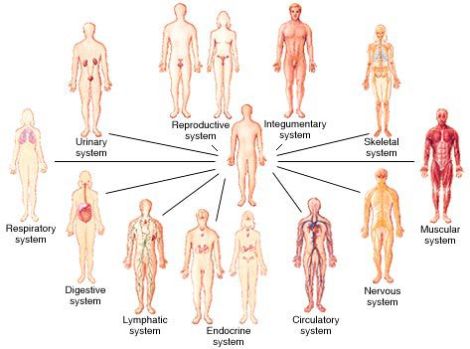
Human Organ Systems

Slide 5
Human Body Project
https://www.youtube.com/watch?v=0yjLJfz6saU

Slide 6
Human Body Project-Process
Research and present information on assigned organ system-how does it work? What does it do? What types of cells and tissues? How is it organized? How does it function? How does it work with other organ systems? What goes wrong in diseases that affect the organ system?
Using Biological, physical and engineering principles, design, plan and build a model that performs the function of the assigned organ system

Slide 7
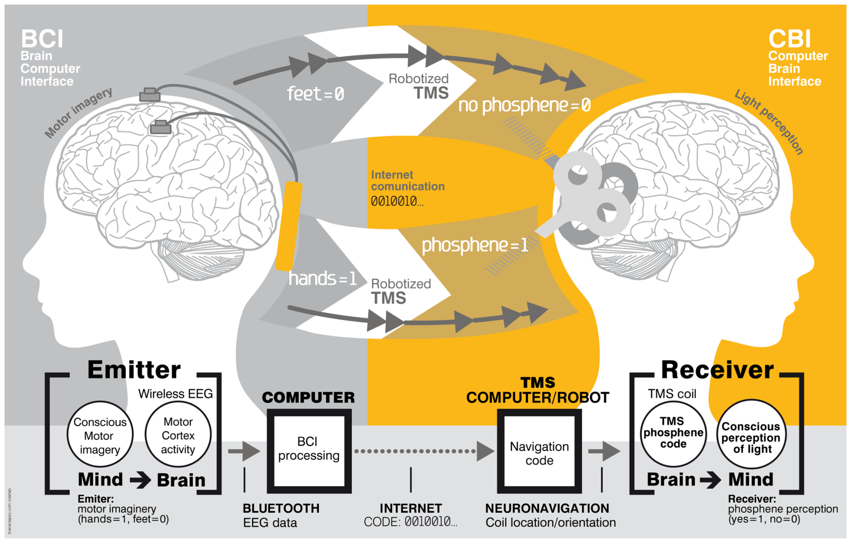

Slide 8
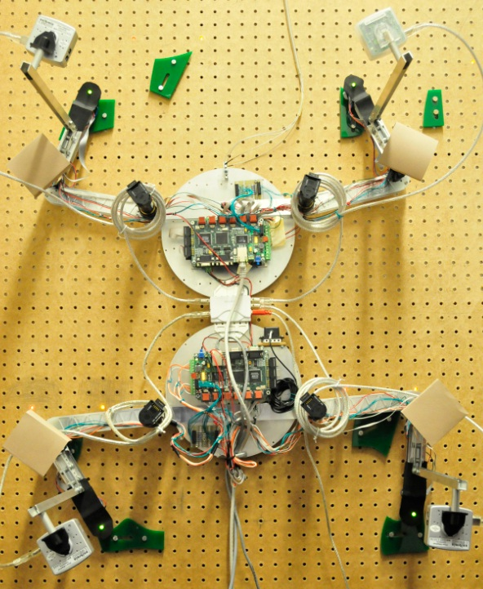

Slide 9
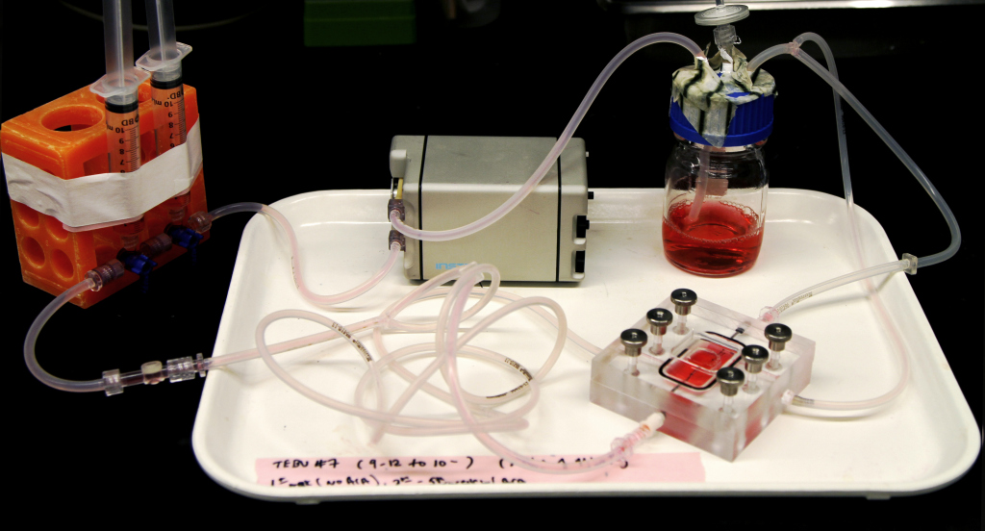

Slide 10
3D printing of organs
http://www.bloomberg.com/video/70495962-atala-discusses-human-organ-engineering-innovators.html

Slide 11
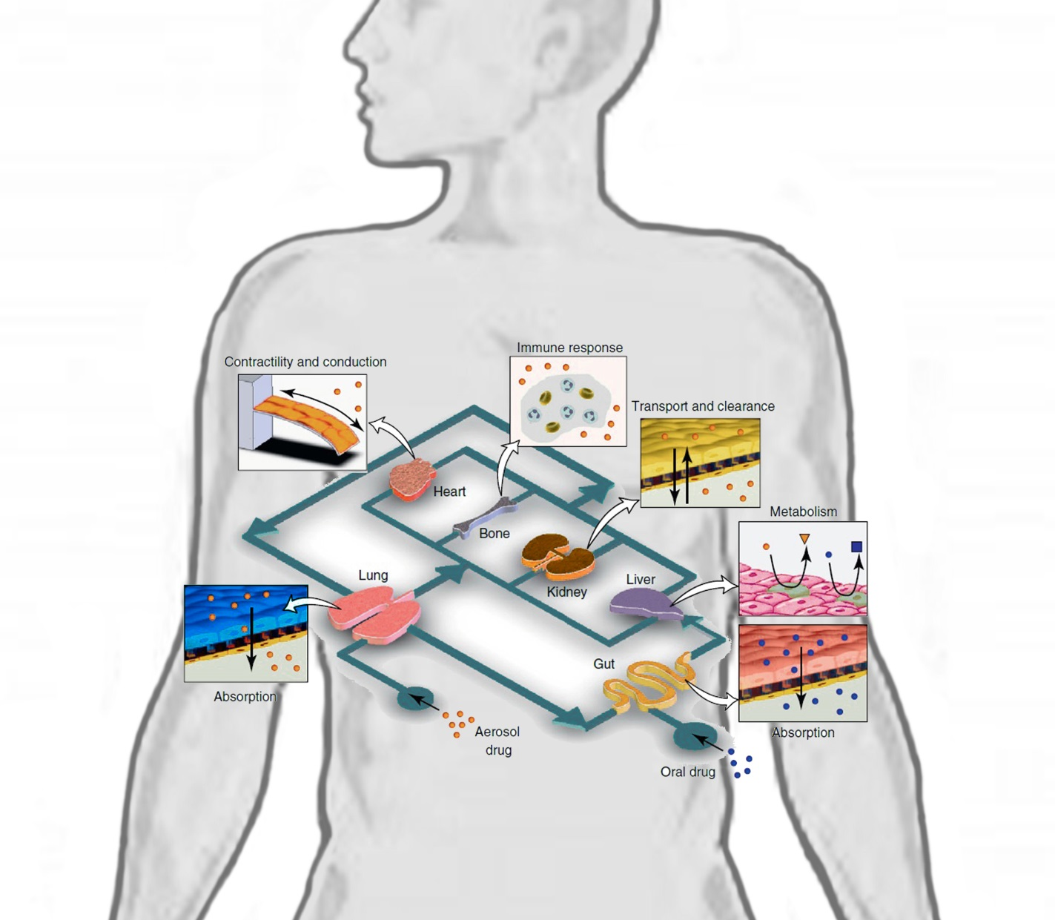

Slide 12
Organ systems on a chip
http://nanoscience.ucf.edu/hickman/
http://phys.org/news/2013-03-3d-printer-bio-ink-human-video.html

Slide 13
Human Body Project-Timeline
Presentations will be made during the second day that you have class during Finals
Design, materials list and building plan due January 16
Final tested model due February 6
Exhibition February 13

Slide 14
Human Body Project-Products
Presentation on organ system and diseases that affect it
Design, materials list and plan
Model
Presentation of model on exhibition night
Collaboration report
Reflection on process and project

